Slide 1
IT Support that Puts the Ops into DevOps

Slide 2
Introducing ALM & DevOps

Slide 3
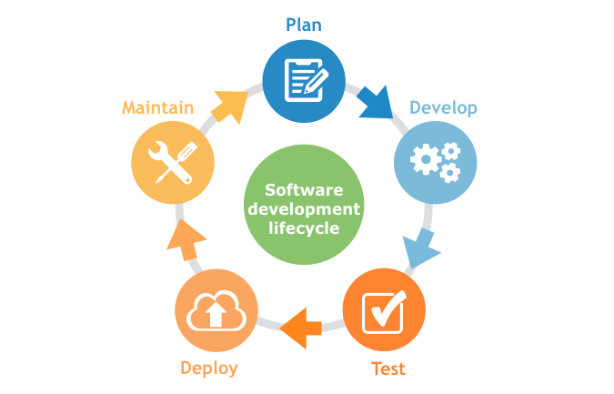
Application Lifecycle Management (ALM)
ALM is basically the fusing together of the disciplines concerned with all aspects of the software delivery process.
It encompasses project management, requirements management, development, testing and quality assurance, as well as customer support and IT service delivery

Slide 4
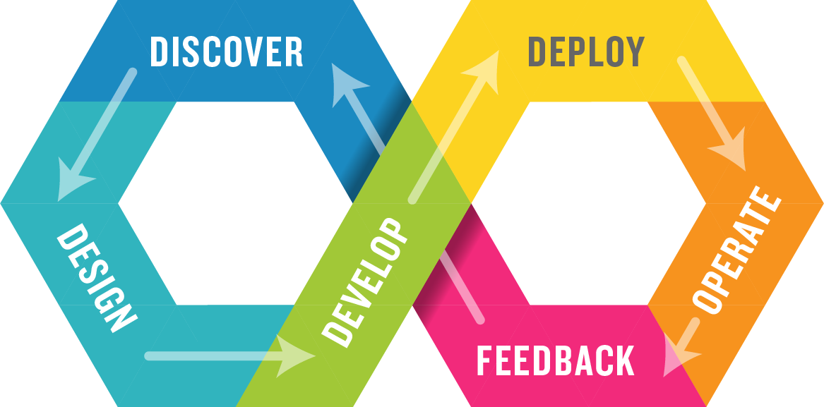
Development & Operations (DevOps)
DevOps integrates Dev, Test & Ops in a single process.

Slide 5
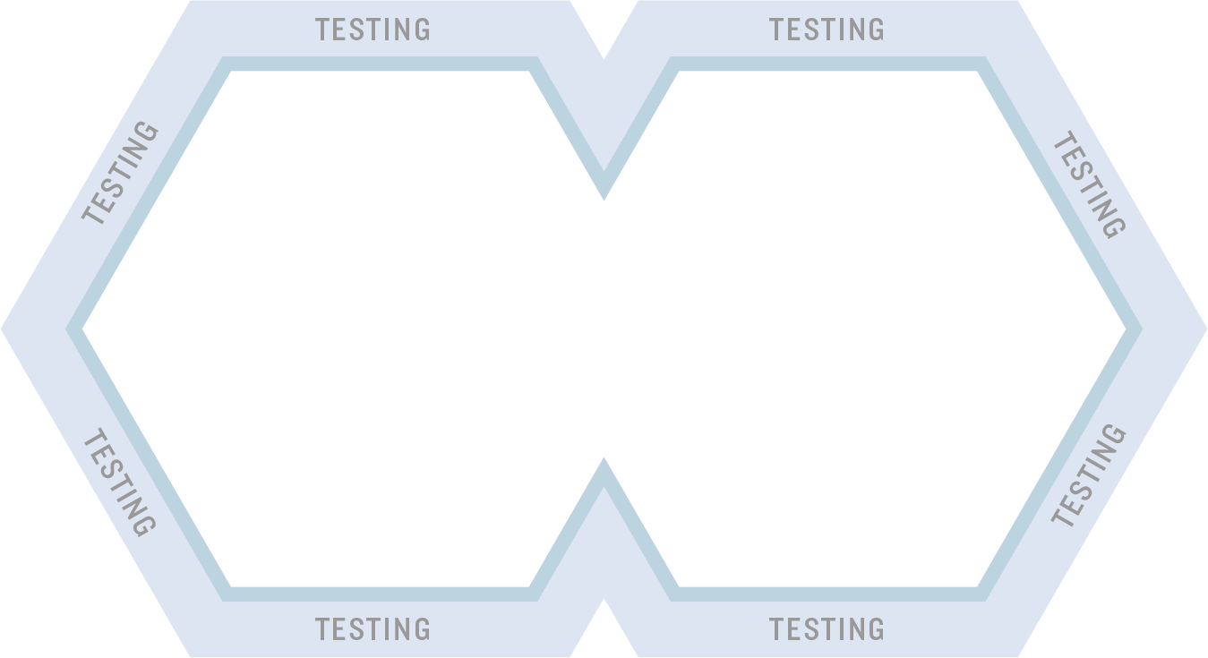
Testing is throughout the process
However how do you get feedback from users after you release?

Slide 6
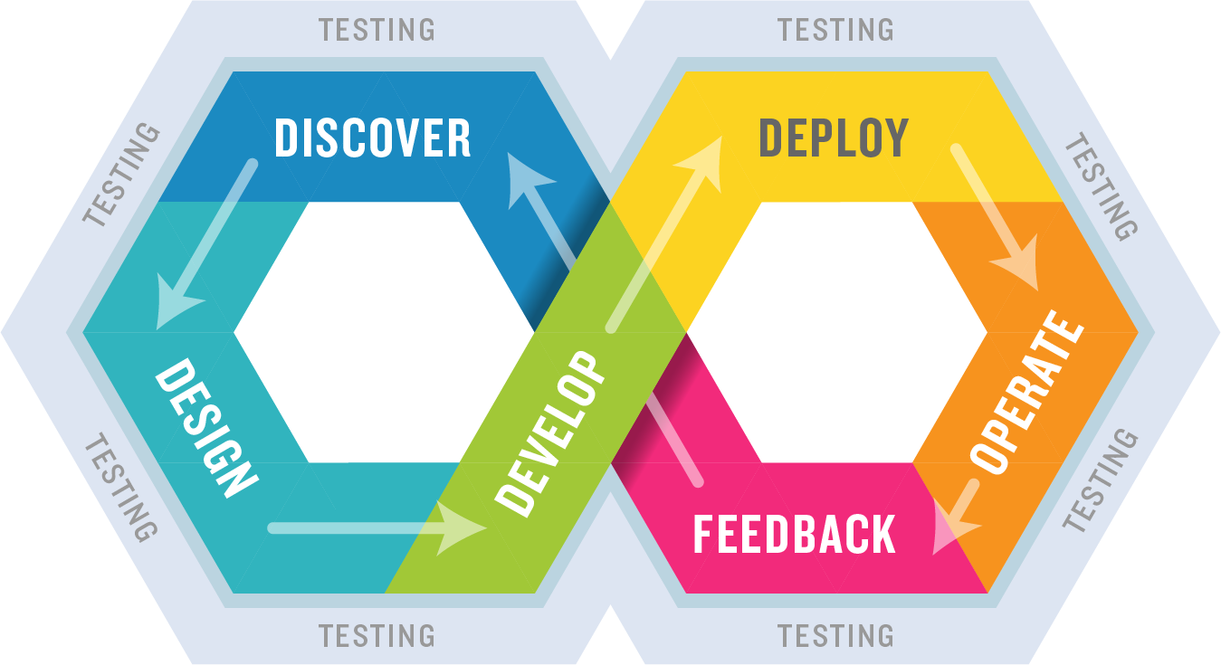
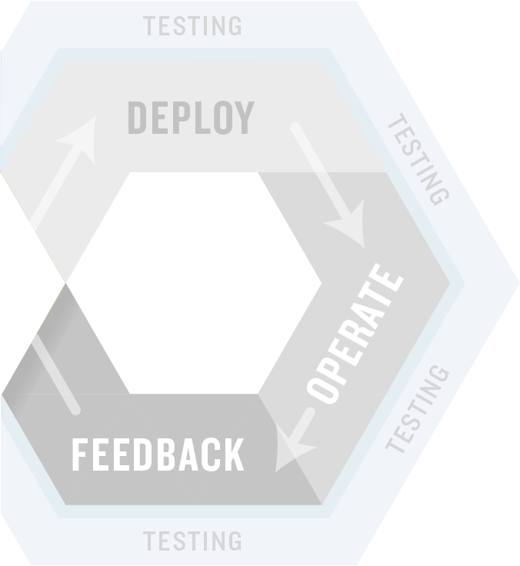
Shifting Left – Testing Earlier in the Process
Integrate automated unit, functional, API, performance, and security testing into your CI process.
Exploratory testing before the code is finished.

Slide 7
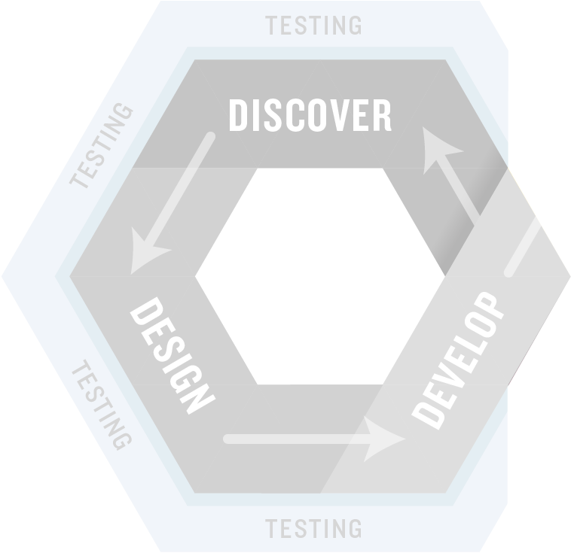
Shifting Right – Monitoring & Feedback
Once features are released into production, you need mechanisms to incorporate customer feedback into your development process…

Slide 8
Introducing KronoDesk
Manage customer support and incorporate feedback into development

Slide 9
The KronoDesk Difference
How are we different and what our customers say

Slide 10
Introducing the Inflectra® Suite
KronoDesk®
IT Support & Help Desk
SpiraCapture™
Exploratory Testing
SpiraPlan®
Agile Program & Portfolio Management
SpiraTeam®
Application Lifecycle Management (ALM)
SpiraTest®
Requirements, Test Management
& Bug Tracking
TaraVault® - Source Code Management
Rapise®
Test Automation (Web, GUI, Services)

Slide 11
KronoDesk, the integrated IT Support Solution
KronoDesk®
IT Support & Help Desk Ticketing
SpiraTeam®
SpiraTest®
Requirements, Test & Defect Management
Agile Project Management
+
TaraVault® - Source Code Management & DevOps
Rapise®
Test Automation Platform (Web, GUI, Services)

Slide 12
Why Choose KronoDesk?
KronoDesk provides help desk, forums and knowledge base in one solution that is fully integrated with our Spira platform.
Web-based User Interface
Robust APIs
IT Support Management
Help Desk
Knowledge Base
Support Forums
Organization and User Management Core Functionality

Slide 13
harmony
Notes:
Make great products
Help you work together
Help you deliver your products faster, more easily, with less pain, and less stress
At a grand scale – we’re passionate about making products that you will find transformative to how you work.
We both want to use our tools every day to help you do a whole number of complex things, and at the same time get out of your way so you don’t need to worry about SpiraTeam and can instead focus on helping your own customers

Slide 14
How Do We Foster Harmony?
Across Disciplines
Through Simplicity
Across Ecosystems

Slide 15
Harmony Across the Disciplines
Testers
Developers
Managers
We consider each of these three stakeholders groups when designing features for our platform, so that everyone in teams can get the most out of our systems working together.

Slide 16
Simplicity = Productivity from Day One
Less Time Doing:
More Time Doing:
No plugins, customization or configuration needed day one

Slide 17
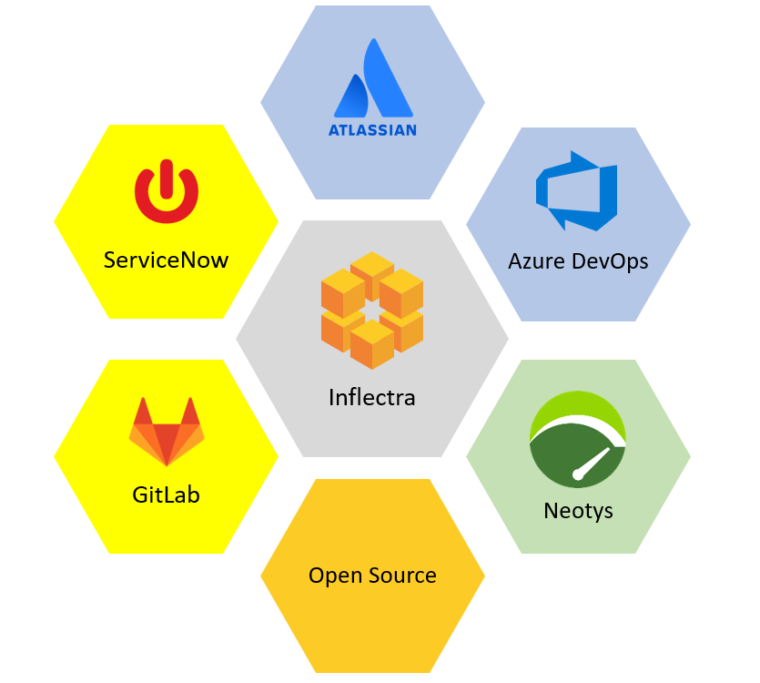
Harmony Across Ecosystems
We recognize that you need to integrate our products with other tools and systems
We make this easy and straightforward so you can get working faster & easier

Slide 18
Representative Customers by Industry
We have ~ 80,000 users in 5,000+ companies worldwide:
Energy & Industrial
Financial & Business Services
Government & Defense
Information Technology
Healthcare & Bio-Technology
Telecommunications
Retail & Consumer Goods
Transportation & Hospitality

Slide 19
Regulated Industries - Automating Compliance
End-to-end traceability out of the box
Data Privacy, Security baked in
Generate Documentation from data
Workflows & Electronic Signatures
Integration across the software value chain

Slide 20
Global Partner Network
North America
South America & Mexico
Asia
Europe
Australia
Middle East & Africa

Slide 21
Customer Testimonials
“
It provides all the functionality that is needed to run a helpdesk off of and for the tracking, assigning, and communication of problems for customers. It also provides forums and a knowledge base so customers may browse similar or the same problem and find a solution before the helpdesk is required.
- Eric Bailey, Strategic Manufacturing Solutions.
“
The best part about KronoDesk is its helpdesk ticketing which agents can check and serve the customers well. Moreover, I find that their customer support forums helps users to check and learn the other features of KronoDesk that will increase their knowledge and understanding about the software platform.
- Eunice Joy T, Support Technician
“

Slide 22
Feature Overview
Lets Look at the Key Features in KronoDesk

Slide 23
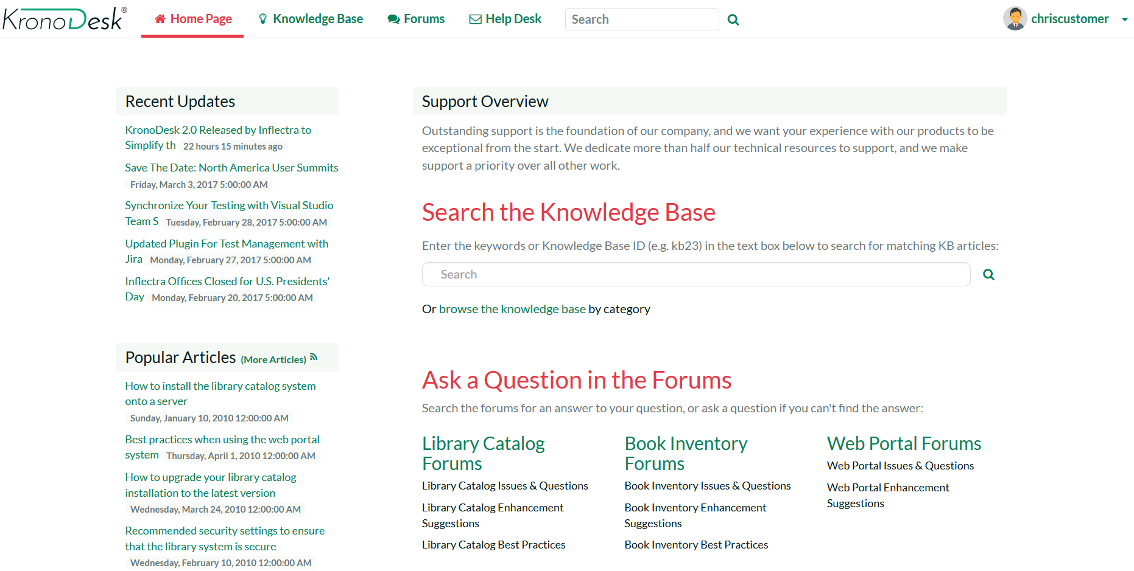
Customer Home Page
The customer dashboard provides a single view for your customers to see new knowledge base articles, recent forum posts and all their open tickets.

Slide 24
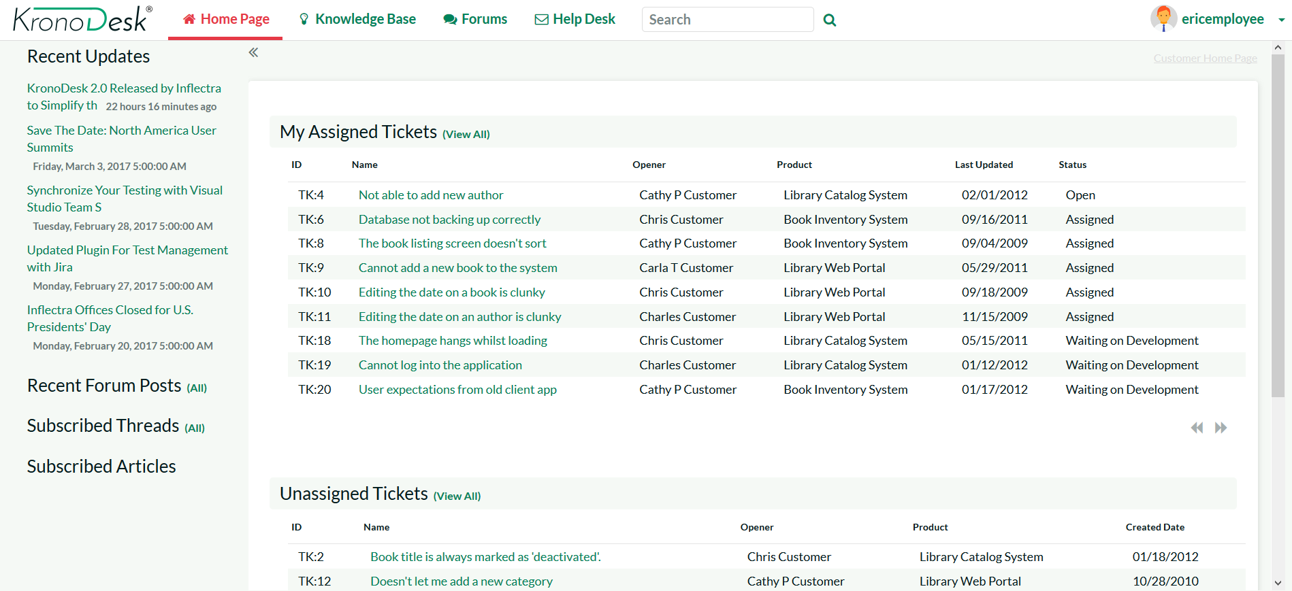
Support Agent Home Page
The customizable agent dashboard, allows your support agents to view all their assigned tickets, monitor incoming forum posts and check for new tickets all from the same screen.

Slide 25
Help Desk
Notes:
Managers, our third pillar, could always take advantage of our reporting, dashboards, and traceability features. But we knew we could do a lot more to help managers – both senior leaders and those in other roles like BI

Slide 26
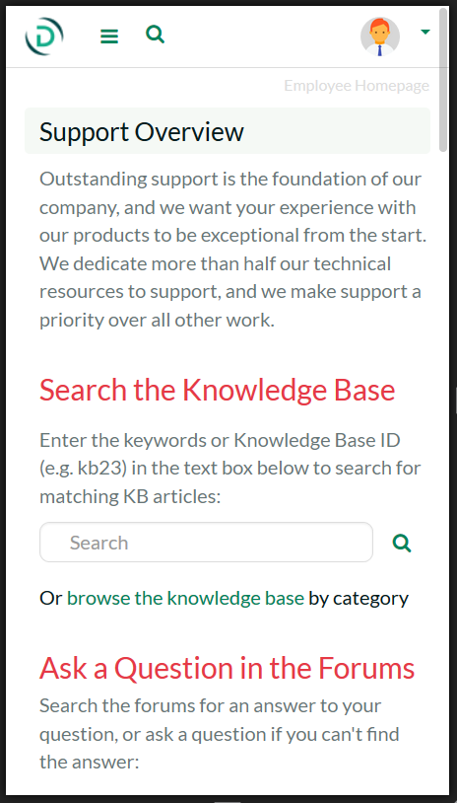
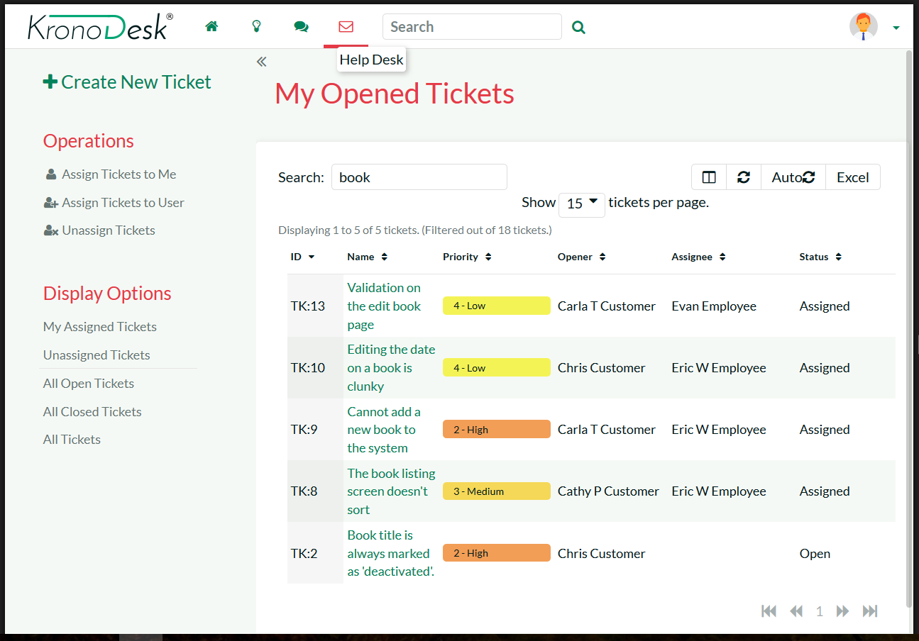
Fully Mobile Responsive
KronoDesk has been designed to optimize its features on any device, whether that be a large desktop monitor, a tablet or mobile phone.
Customers can browse the knowledge base, reply to forum posts and submit help desk tickets from the convenience of their phones.

Slide 27
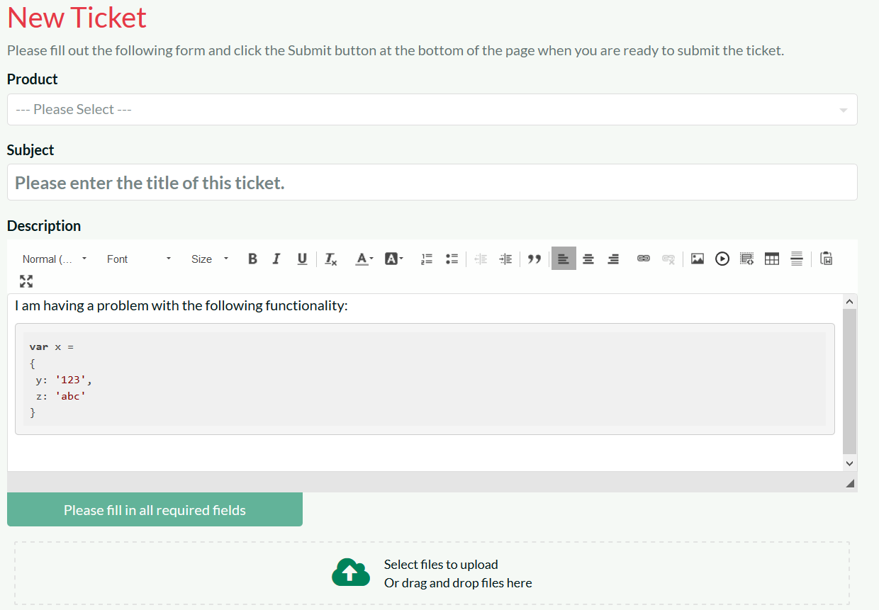
Help Desk Ticketing - Submitting
KronoDesk makes it easy for your customers to submit help desk tickets, attaching files and screenshots
KronoDesk makes it easy for your support agents to reproduce issues and provide help.

Slide 28
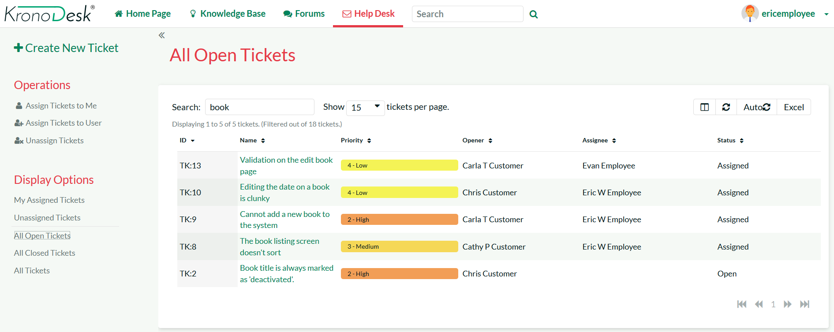
Help Desk Ticketing – Searching & Filtering
Your support agents can use the powerful sorting, searching and filtering features to track and manage their assigned tickets.

Slide 29
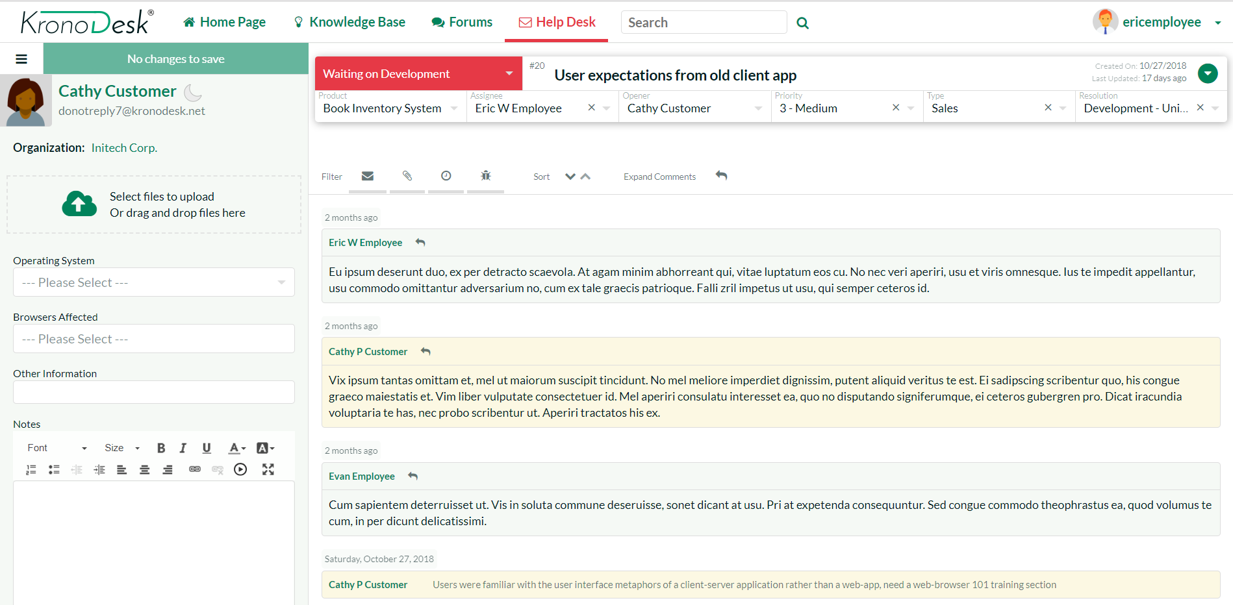
Help Desk Ticketing - Responding
The ticket editing screen lets your customer agents quickly and easily respond to custom help desk tickets.
The system allows them to add notes, view the change history, attach documents and update the fields based on the workflow.

Slide 30
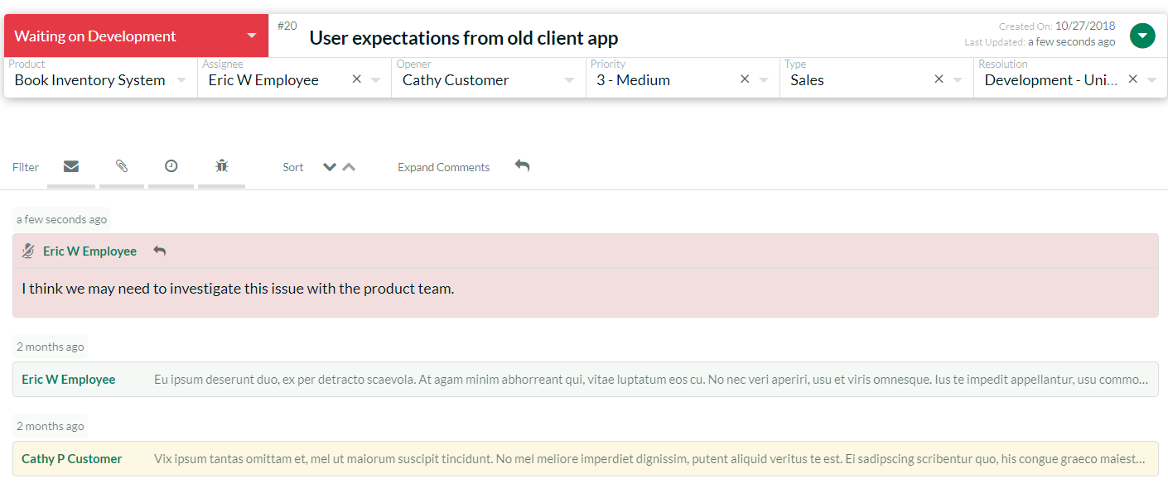
Help Desk Ticketing – Contact History
The ticket details page lets you see all of the interactions between your support personnel and the customer. You can have both public and private notes added to the ticket.
The change history lets you see the actions and escalations that have been performed on the help desk ticket

Slide 31
Knowledge Base
Notes:
That’s the very high level, but what does this mean in detail for you? What have we or are we about to release that can help you? Let’s talk testers first

Slide 32
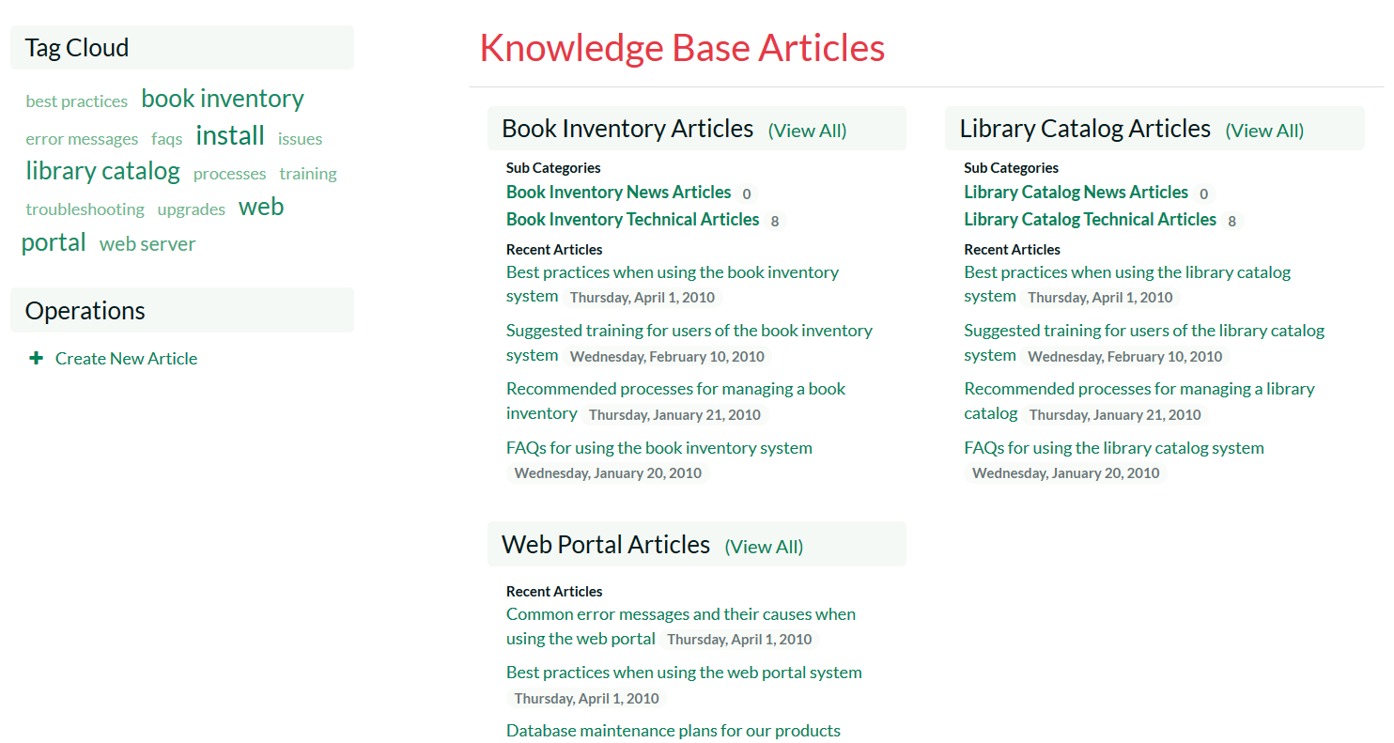
Knowledge Base – Categories & Tags
The knowledge base allows you to categorize support articles into categories based on the different products and types of article.
The tag cloud lets your customers quickly find articles related to specific topics.

Slide 33
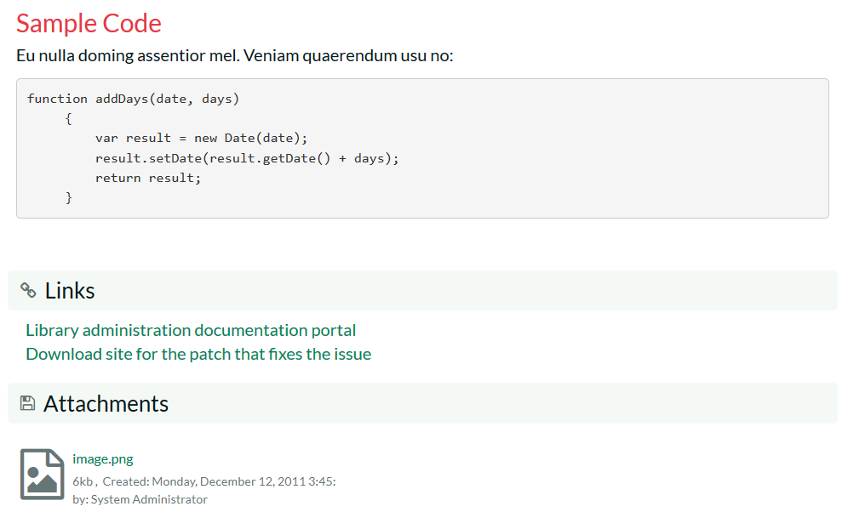
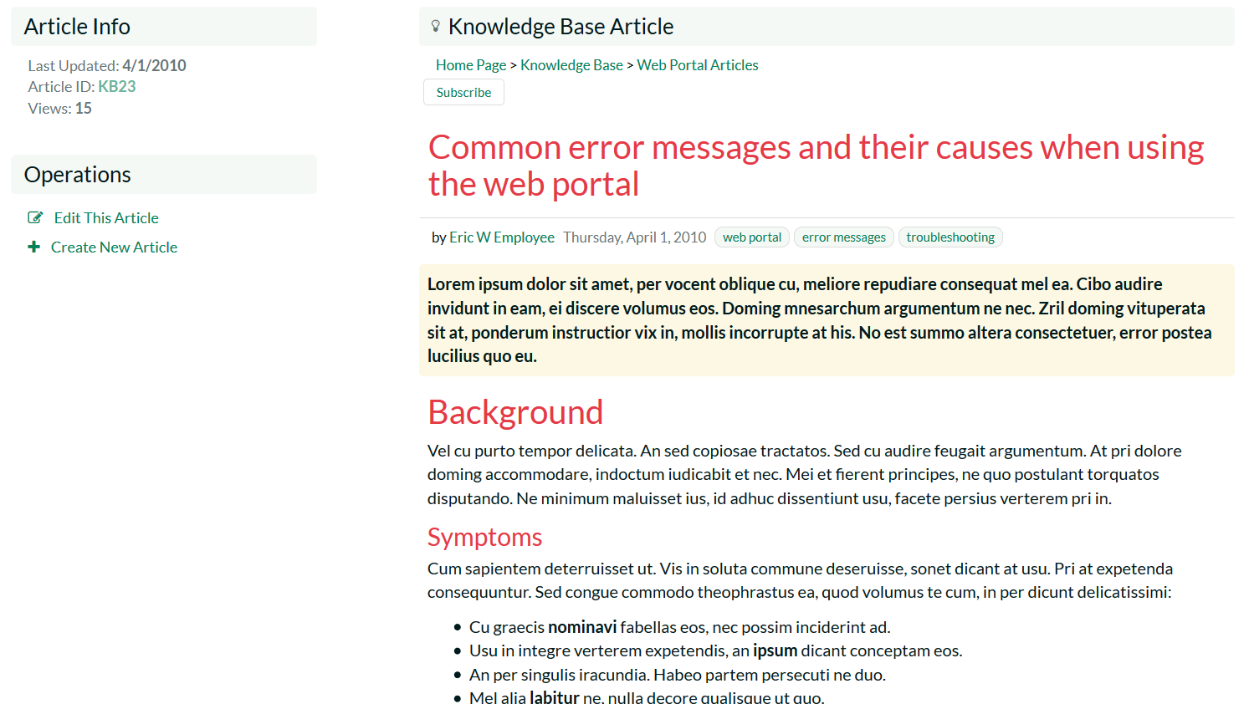
Knowledge Base – Creating & Editing
The knowledge base lets you write articles, embed screenshots, attach documents, add links and specify meta-tags.
When customers click on the tags, KronoDesk will display any other articles that share the same meta-tag, allowing customers to quickly find related information.

Slide 34
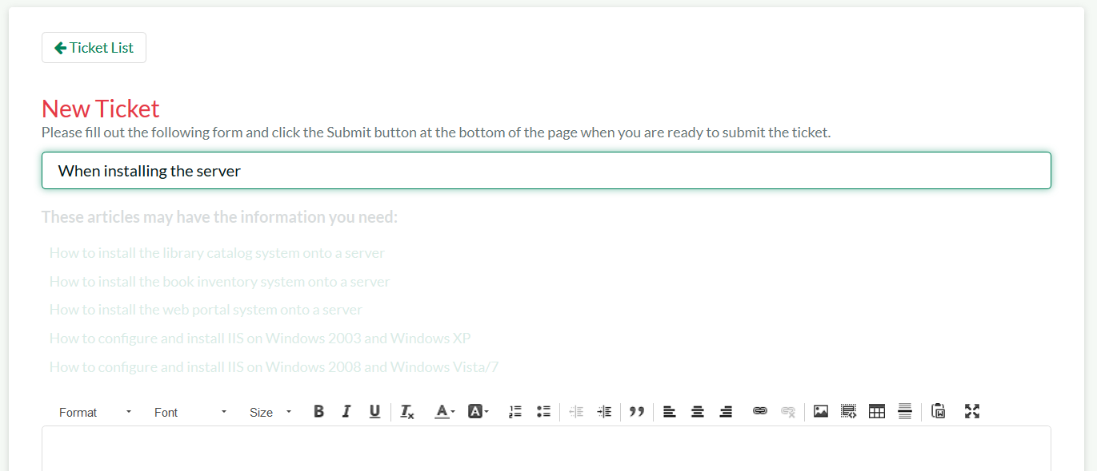
Knowledge Base – Auto Suggestions
When submitting a new help desk ticket, the system scans the existing knowledge base and makes intelligent suggestions to help the customer. This reduces the number of repetitive help desk enquires that have previously been answered.

Slide 35
Support Forums
Notes:
Let’s talk next about developers

Slide 36
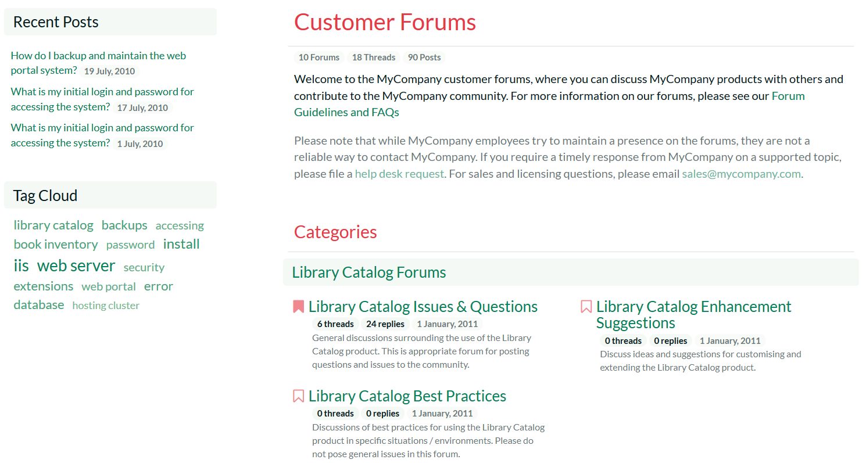
Support Forums - Categories
The customer support forums allow you to create different support forum categories for different products and customer needs.
The system remembers which forums you have read and highlights any that have new threads or messages.

Slide 37
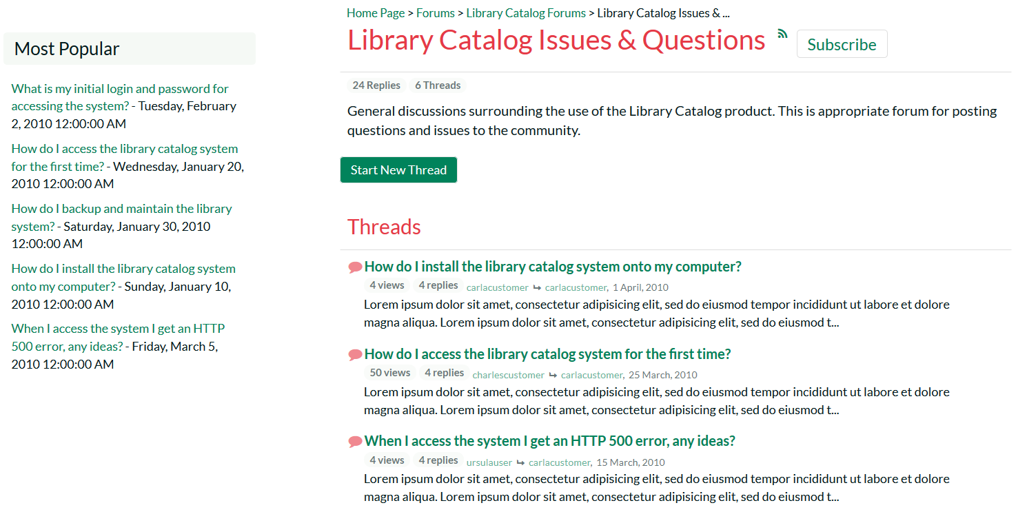
Support Forums - Forums
The system displays the list of threads in each forum together with the number of replies and views.
The system remembers which threads you have read and highlights any that have new messages.

Slide 38
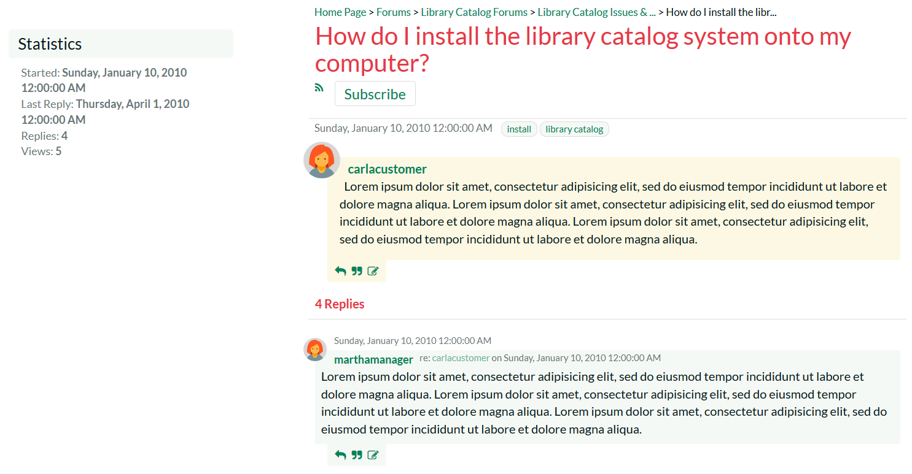
Support Forums - Threads
The thread details page displays the original message together with a threaded list of customer and support agent replies.
Users can subscribe to the thread/forum as an RSS feed

Slide 39
Other Features
Notes:
Let’s talk next about developers

Slide 40
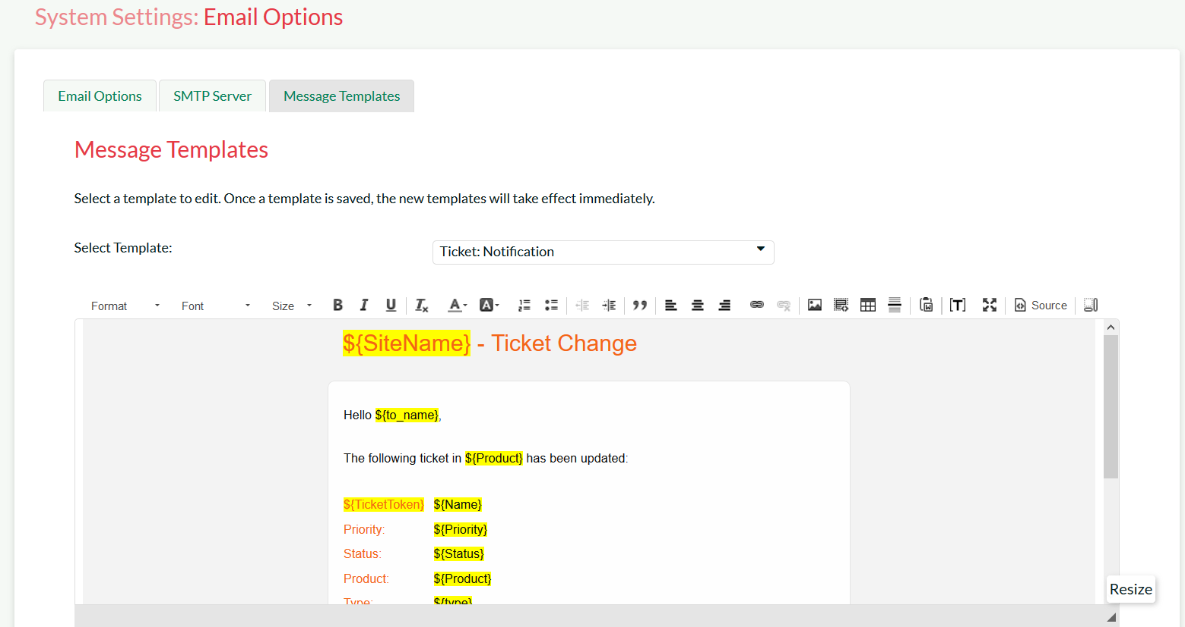
Email Notifications
KronoDesk contains a powerful email templating system so that outbound email messages can be formatted to fit your organization.
When users subscribe to threads, forums or articles, the system sends out automatic notifications. It supports CC lists for tickets

Slide 41
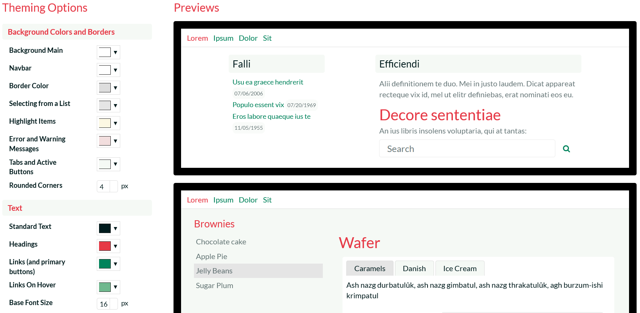
Theming & Rebranding
KronoDesk provides an intuitive theme creation tool that lets you quickly and easily rebrand it to integrate with your website and other systems.

Slide 42
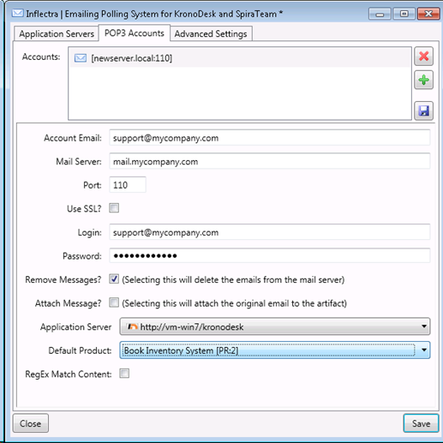
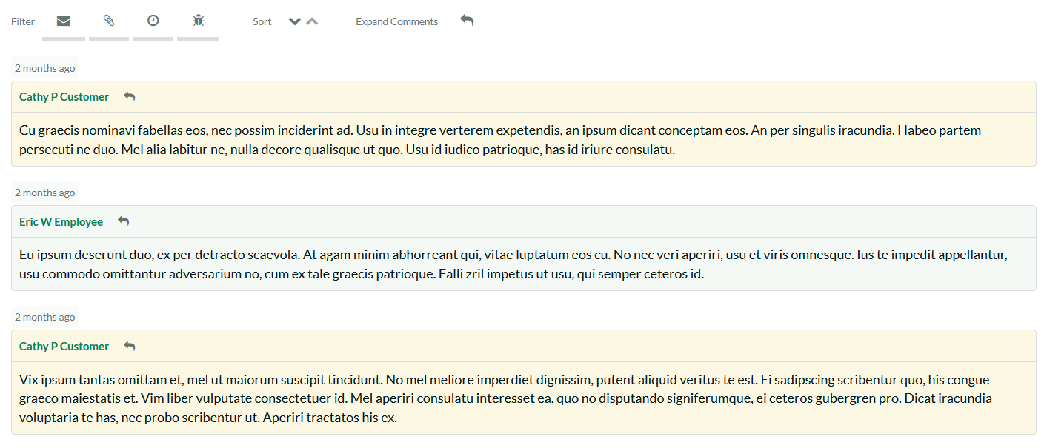
Email Integration
KronoDesk can connect to your email system and automatically convert emails from customers into new help desk tickets.
The system is intelligent enough to determine which emails are replies to existing tickets and will automatically add the emails as new comments onto the existing help desk ticket.

Slide 43
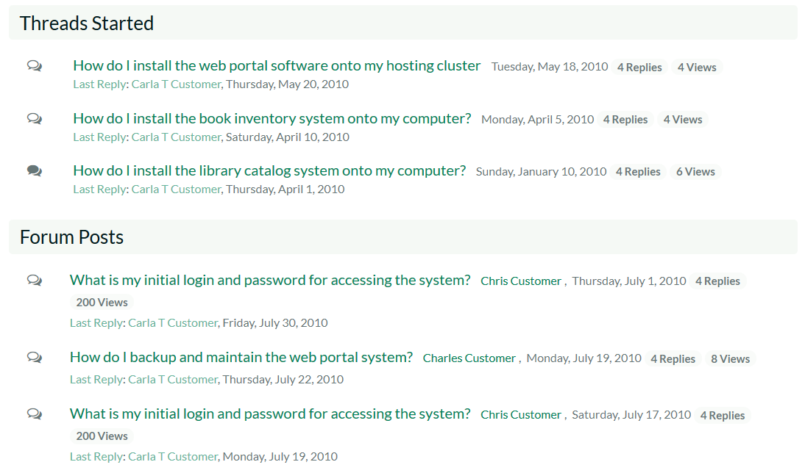
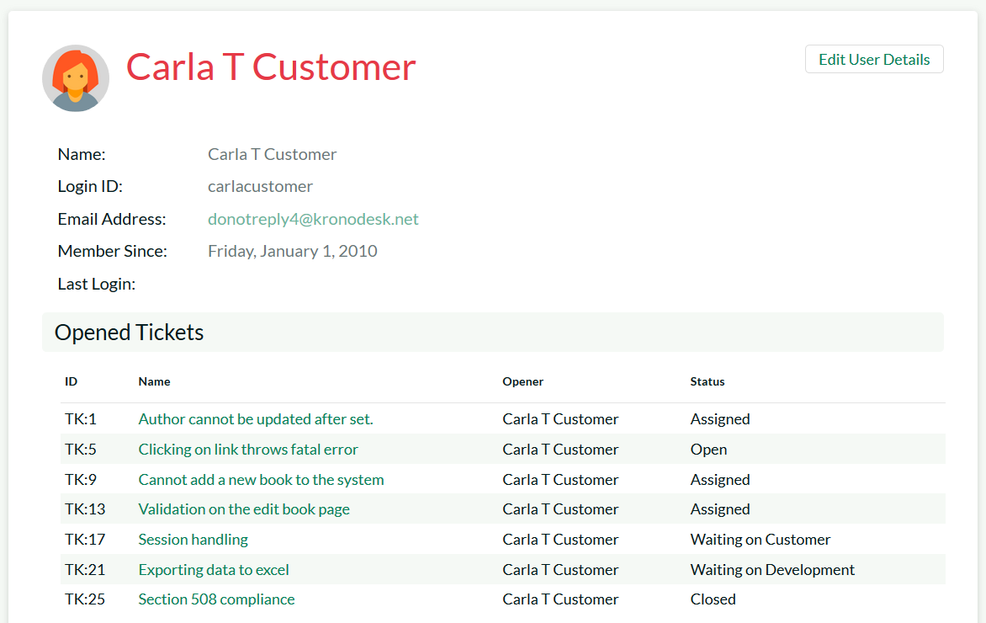
Subscribe to Threads/Articles
Users can subscribe to specific articles, threads and forums
When changes are made to an article, new threads are posted in a forum or new replies are added to a thread, the user will be notified

Slide 44
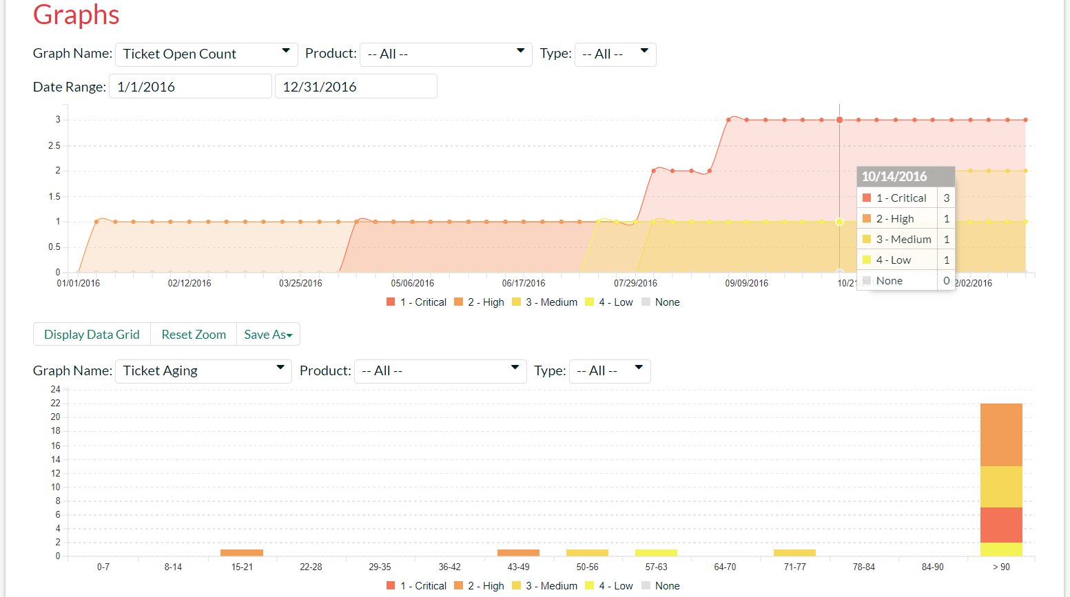
Customizable Reporting Dashboard
KronoDesk allows you to build a customized reporting dashboard featuring your frequently-used graphs, charts and reports. The data behind the graphs can be exported to Word, Excel, PDF and CSV.

Slide 45
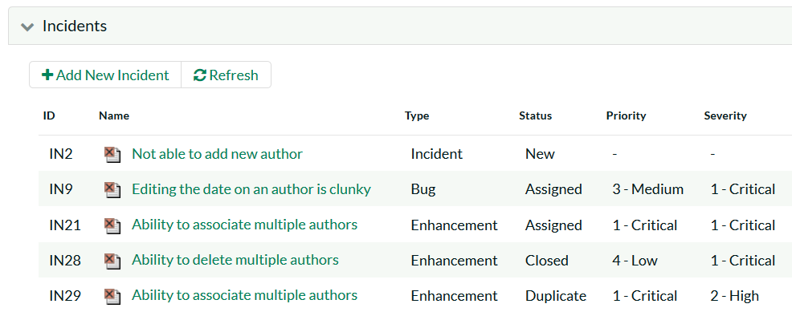
SpiraTeam® Integration
When used with SpiraTeam® you can integrate your customer support into your software development lifecycle.
Each KronoDesk® ticket can generate new incidents in SpiraTeam so that customer requests can be seamlessly added to the project.

Slide 46
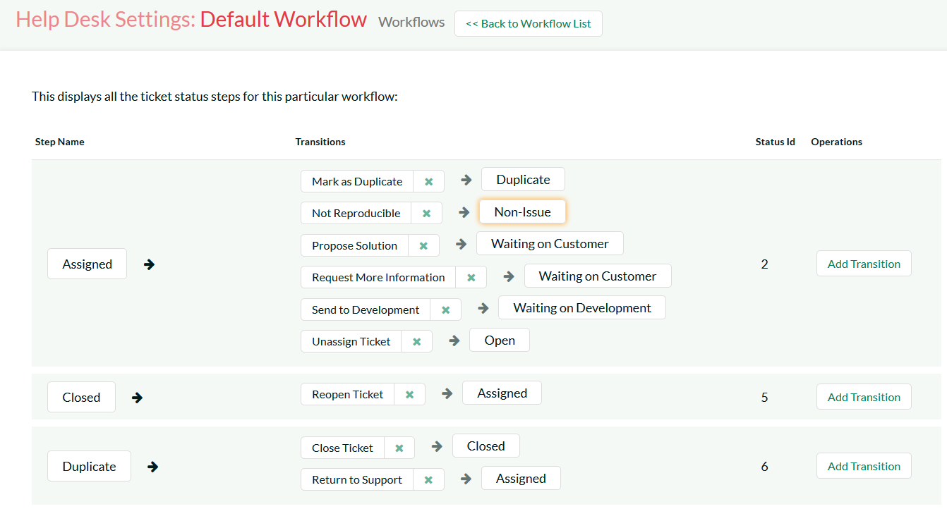
Configuration & Customization
KronoDesk is completely configurable, so that you can tailor the system to match your customer support process.
The system lets you setup custom fields, priorities, statuses, types, resolutions and workflows so that you can tailor the product to fit your process and business.

Slide 47
Questions?

