Slide 1

Automation of Test Maintenance or Say Hello to AI
@Inflectra | #InflectraCon

Slide 2


Alexey Grinevich
Rapise Engineer, Inflectra
@AlexeyGrinevich
alexey.grinevich@inflectra.com
@AlexeyGrinecivh

Slide 3
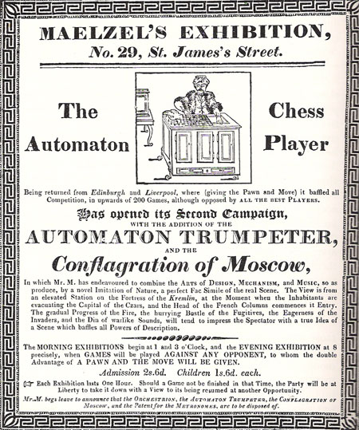
This Story Started Back in 1819

Slide 4
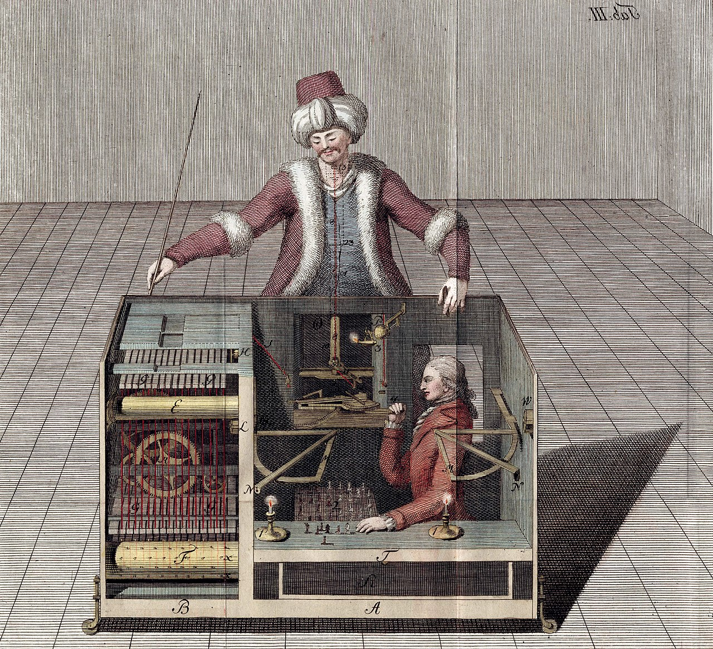

Slide 5


Slide 6
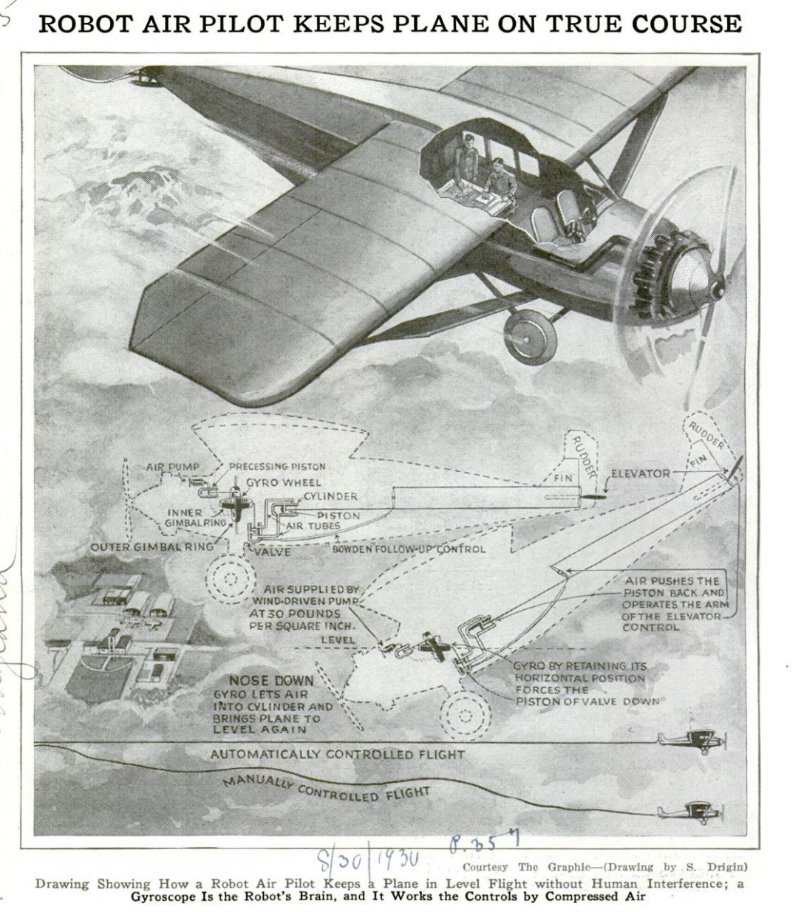

Slide 7
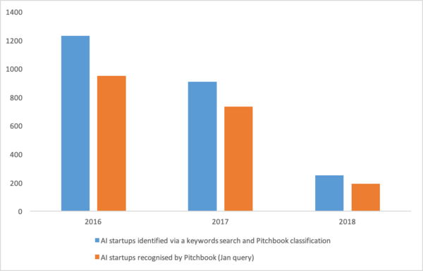
AI Winters
1974-1980
1987-1993
https://www.getrevue.co/profile/peterzhegin/issues/ai-investment-activity-trends-of-2018-issue-8-150825

Slide 8

Is Winter Coming?

Slide 9
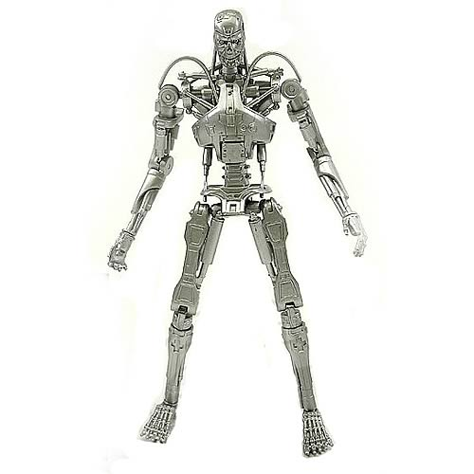
New Vision of AI in Testing
Define Goals
Interact
Report

Slide 10
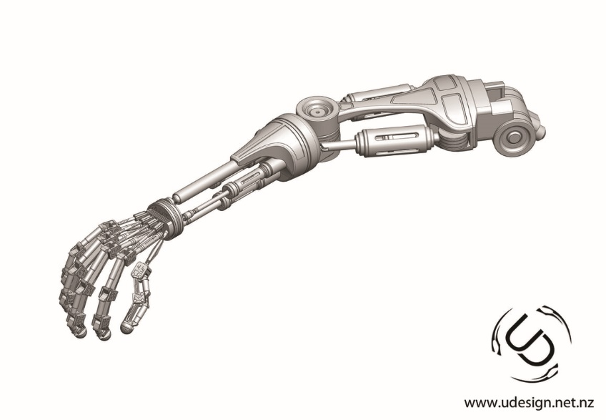
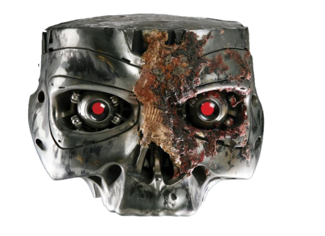

Slide 11
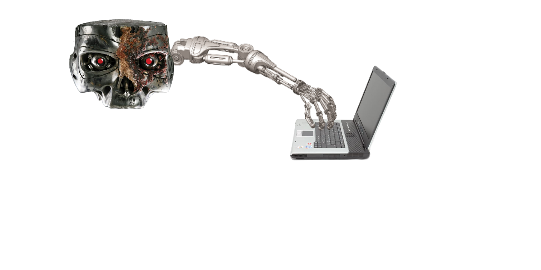

Slide 12
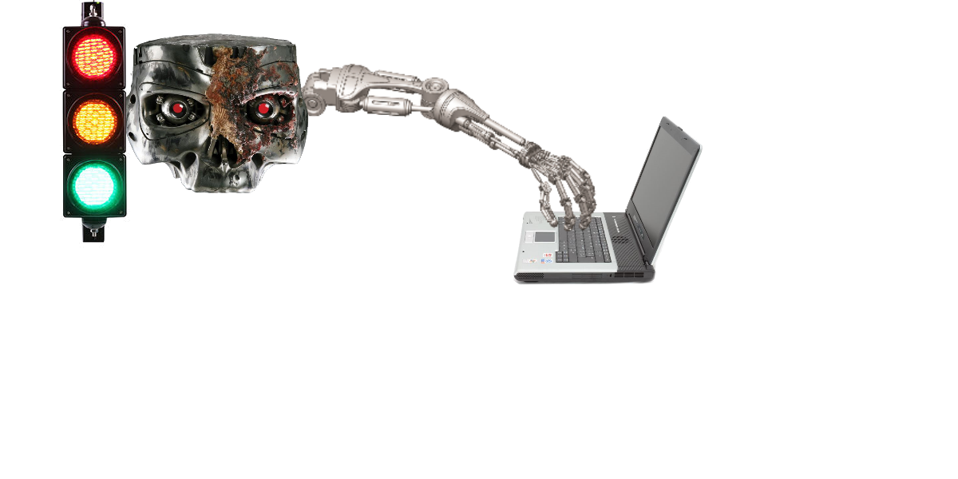

Slide 13
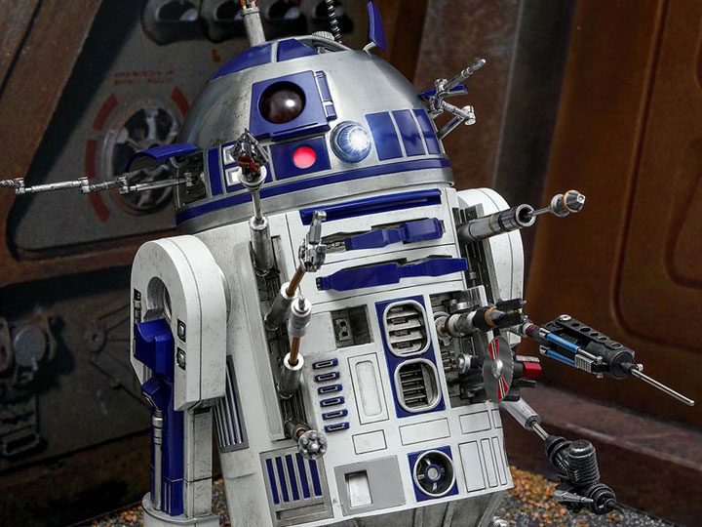
R2D2 – Another Form Factor

Slide 14
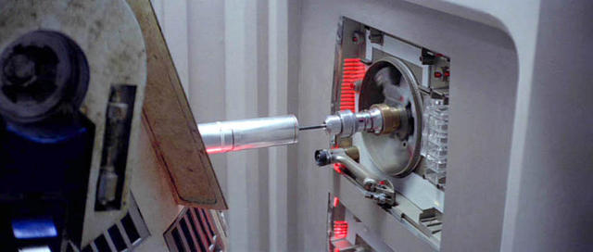
API Testing

Slide 15
T800 Also has Benefits

Slide 16
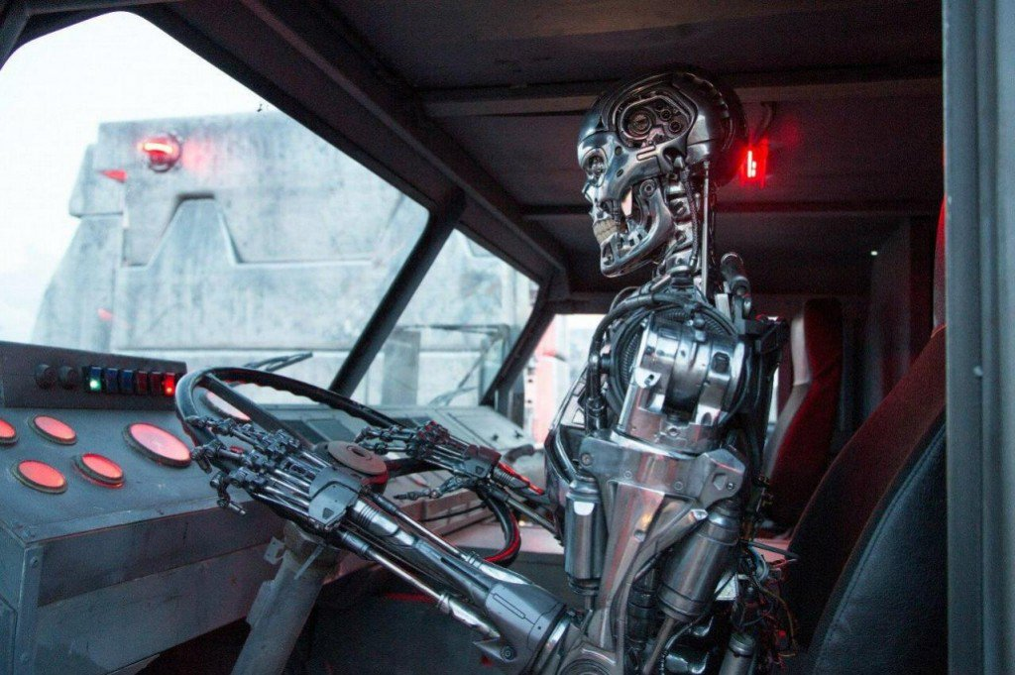

Slide 17
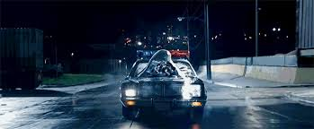

Slide 18


Slide 19
Let’s Talk About AI
Big Data – server side or Cloud-based
Smarter Algorithms – like BD
Useful – NOT like auto-suggestion in phone

Slide 20
Self Healing in Rapise

Slide 21
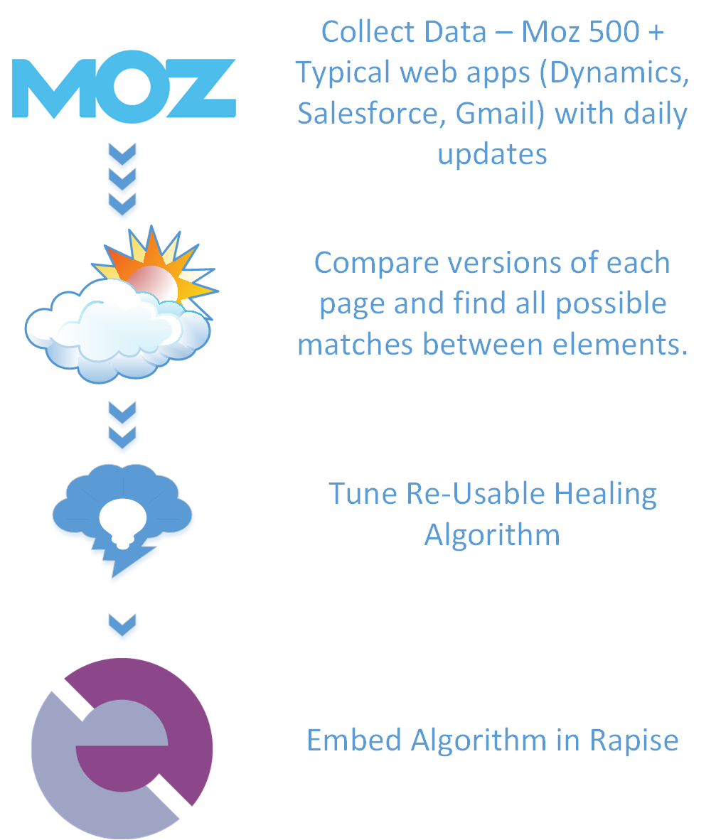

Slide 22
How It Works
Record test on Old version with AI enabled
Switch to new version
Use Self-Healing to recover
Apply changes to objects

Slide 23
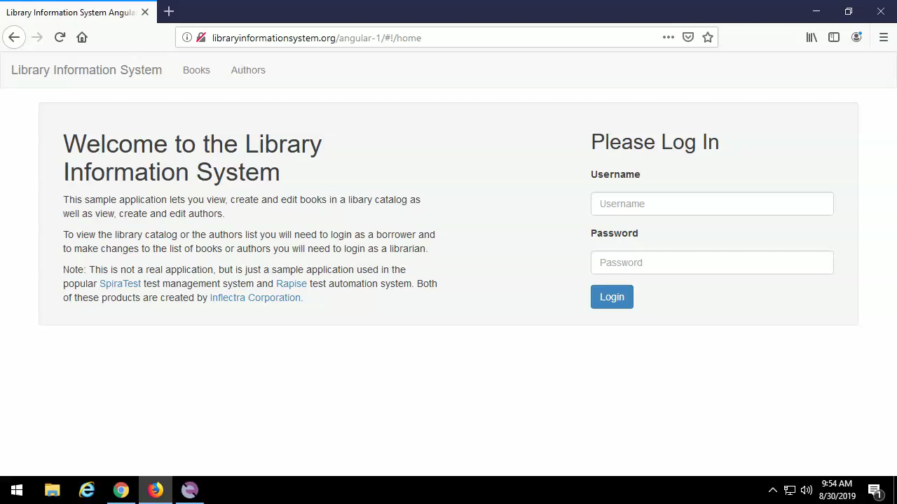

Slide 24
Our Vision
Maintainability = Success of Automation
Other smart libraries may be used:
OCR (Tesseract)
ComputerVision (OpenCV)

Slide 25
Q&A
Contact me:
@AlexeyGrinevich
alexey@inflectra.com

Slide 26
