Slide 1
Spira:
Extending Spira with Add-Ons
@Inflectra | #InflectraCon

Slide 2
Adam Sandman
Director, Inflectra
Programmer from the age of 10
Working in the IT industry for over 20 years
Adam lives in Washington, DC, USA
@adammarksandman

Slide 3
About Me
Adam Sandman was a programmer from the age of 10 and has been working in the IT industry for the past 20 years.
Currently Adam is Director at Inflectra Corporation, where he is interested in technology, business and innovation.
Adam lives in Washington, DC, USA

Slide 4
Session Objectives
We will explore some of the add-ons available for Spira, including RemoteLaunch, KronoDesk, data-synchronization, and TaraVault.
We will outline the benefits of each add-on and illustrate some of the use cases with examples from customer deployments.

Slide 5
harmony
Notes:
Make great products
Help you work together
Help you deliver your products faster, more easily, with less pain, and less stress
At a grand scale – we’re passionate about making products that you will find transformative to how you work.
We both want to use our tools every day to help you do a whole number of complex things, and at the same time get out of your way so you don’t need to worry about SpiraPlan and can instead focus on helping your own customers

Slide 6
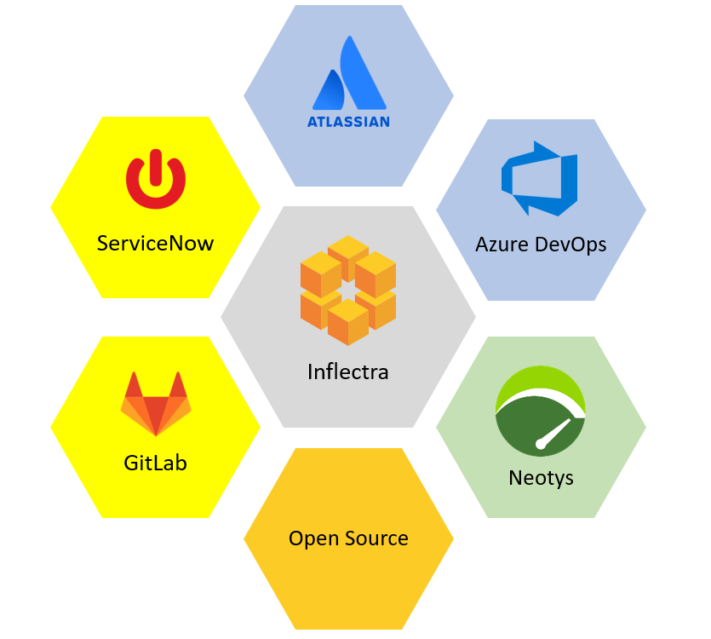
Harmony Across Ecosystems

Slide 7
Data Synchronization

Slide 8
Seamless Integration

Slide 9
Sample Use Cases
Spira
Team #1
Jira
incidents
user stories
Team #2
Azure DevOps (TFS)
incidents
user stories
tasks

Slide 10
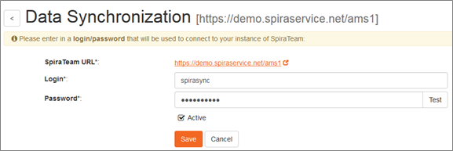
Spira and Tool Cloud Hosted
The Inflectra cloud data-sync service is an add-on to your subscription that manages the integration entirely cloud-based
Nothing needs to be installed locally
We take care of running the integration

Slide 11
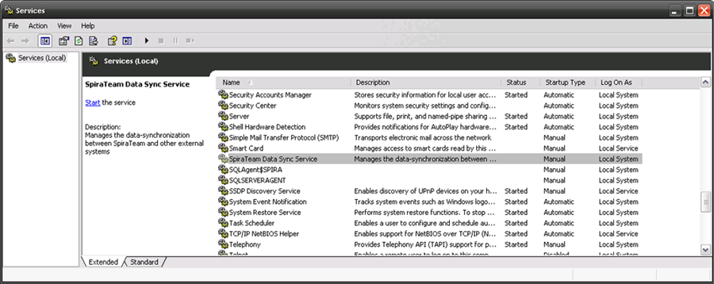
Spira On-Premise
The installed version of SpiraTest comes with a built-in Synchronization Windows Service
It takes care of the synchronization, it just needs to be started
There are plugins for each tool that you need to download from our website, and put into the appropriate folder in your SpiraTest installation

Slide 12
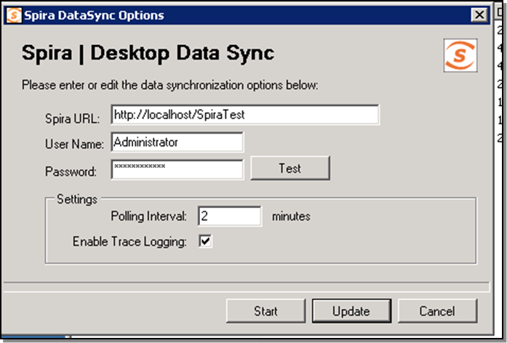
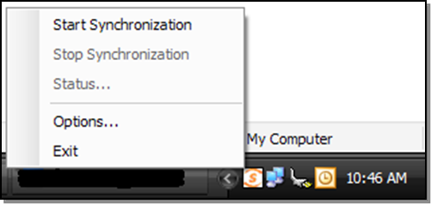
Spira Cloud-Hosted, Only
This is a less typical case, where you have a locally installed version of JIRA, TFS, etc. but SpiraTest is cloud-hosted by Inflectra
We have a special DesktopDataSync tool that sits inside your firewall, and connects to SpiraTest and the other tools

Slide 13
IDE Integration

Slide 14
IDE Integration Options
Visual Studio Code
Android Studio
Visual Studio

Slide 15
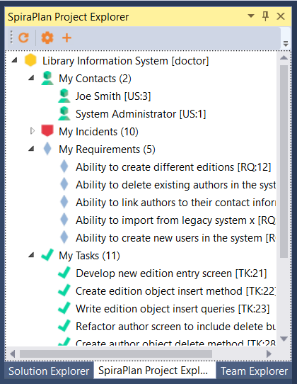
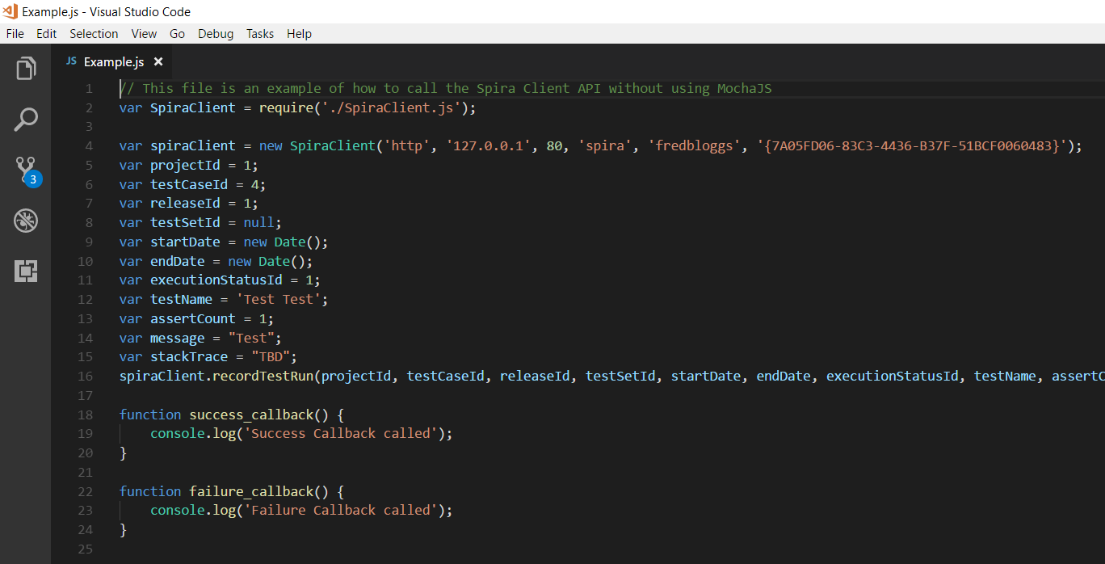
Write Code to Plan

Slide 16
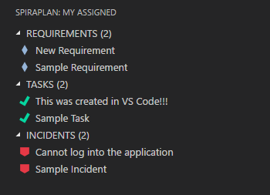
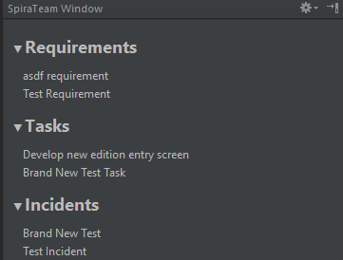
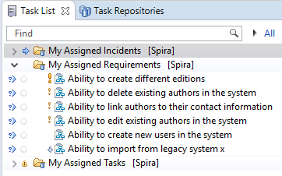
Write Code in IDE

Slide 17
Source Code Management

Slide 18
Source Code Integration Options
Inflectra Hosted
Third-Party
&
VSS

Slide 19
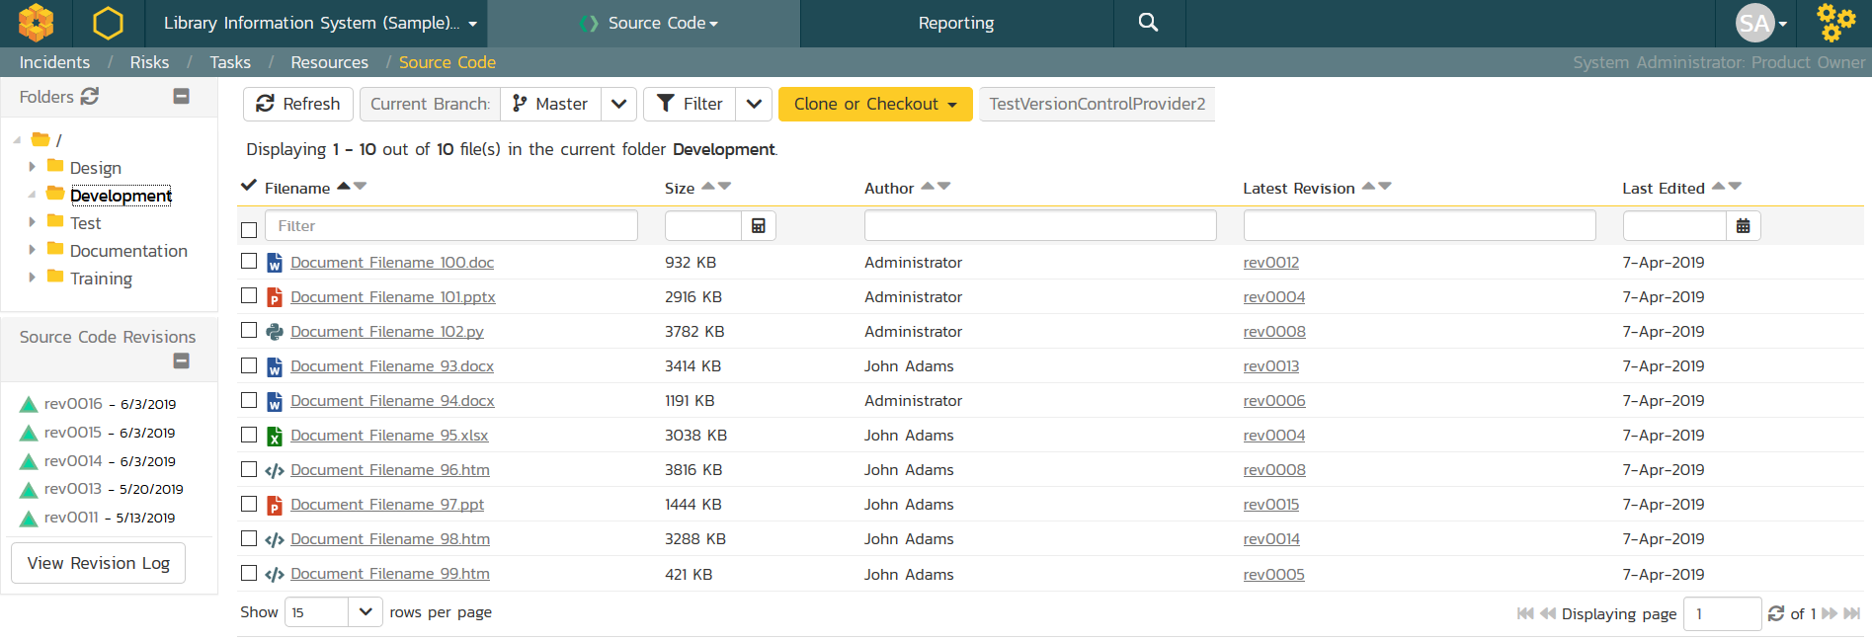
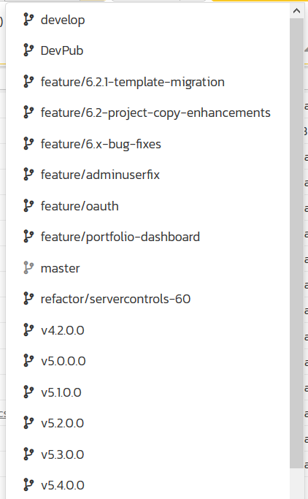
Manage Code

Slide 20
Integrating Test Frameworks

Slide 21
Write Unit Tests (!)
Plugins Available for:

Slide 22
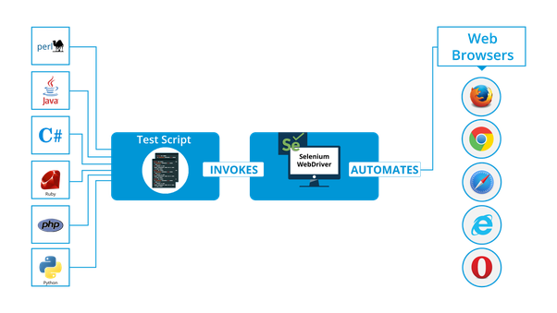
Integrate Selenium / Appium
Mobile Devices

Slide 23
Automated Testing w/RemoteLaunch

Slide 24
Orchestrate Automated Testing
Host #1
Windows 2008
IE 8.0
Manual
Tester #1
RemoteLaunch®
Host #2
Windows Vista
Mozilla Firefox
SpiraTeam®
Repository
Manual
Tester #2
RemoteLaunch®
Host #3
Ubuntu Linux
Google Chrome
Manual
Tester #3
RemoteLaunchX®

Slide 25
Integrate Different Testing Tools
RemoteLaunch

Slide 26
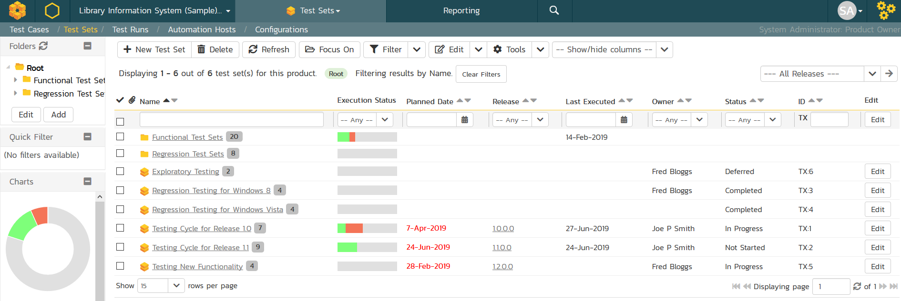
Automation Hosts & Test Sets

Slide 27
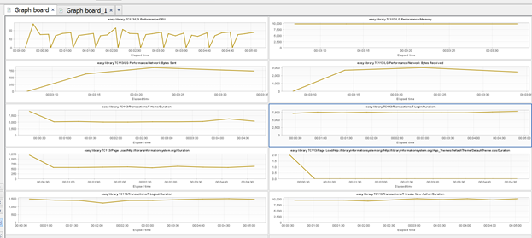
Load Testing

Slide 28
Exploratory Testing with SpiraCapture

Slide 29
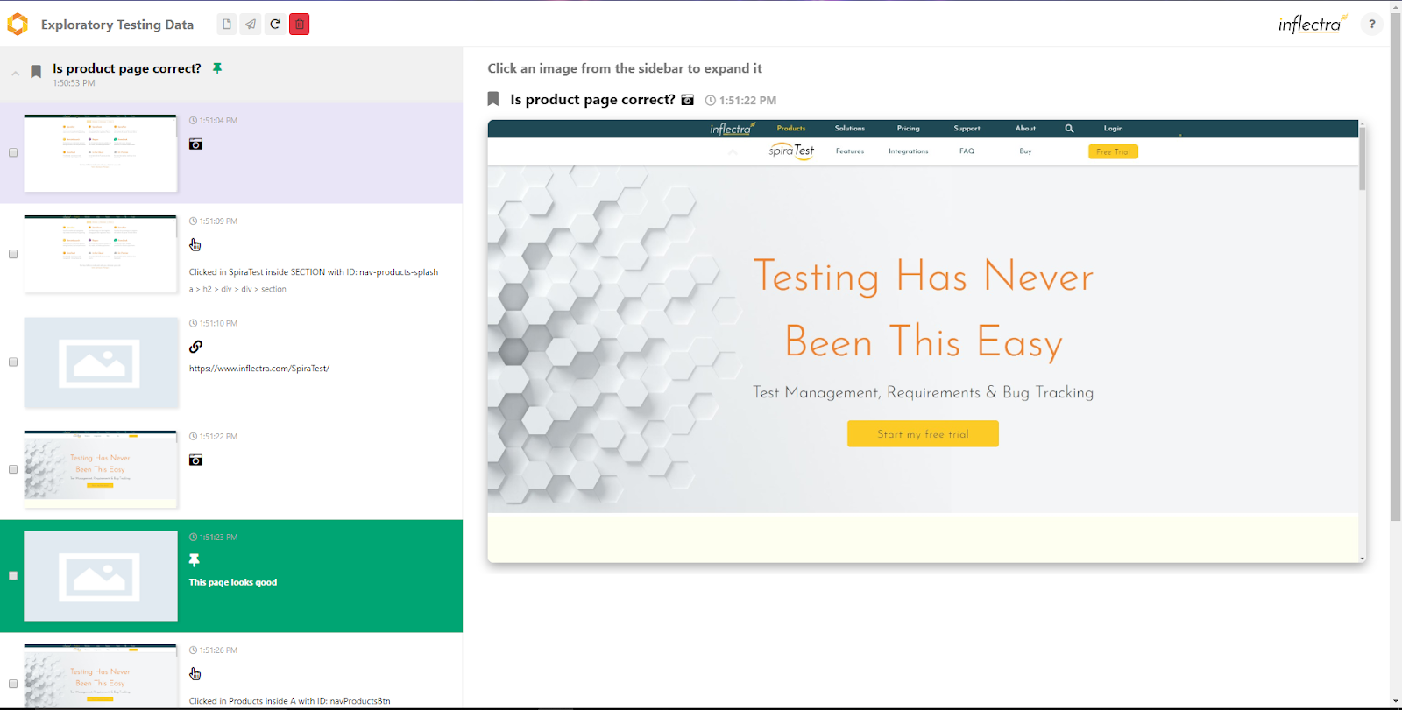
SpiraCapture – Chrome Extension

Slide 30
CI Build Server Integration

Slide 31
CI Plugins
Current Plugins:
Planned Plugins:

Slide 32
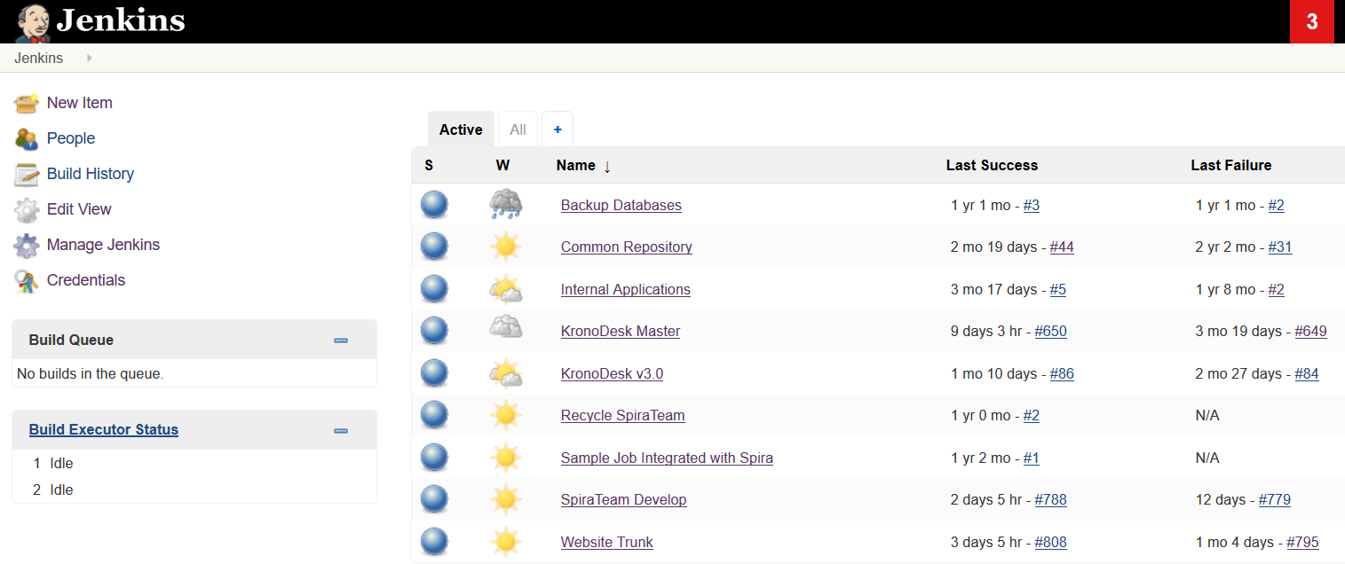
Build Code using CI

Slide 33
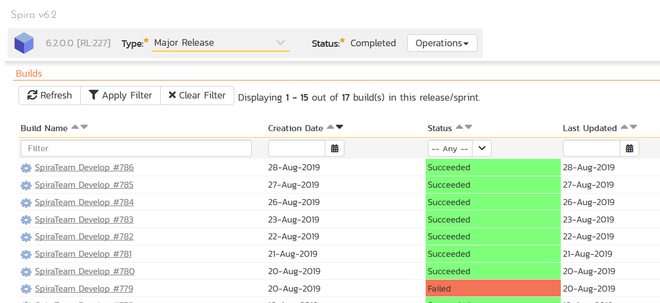
Build Code using CI

Slide 34
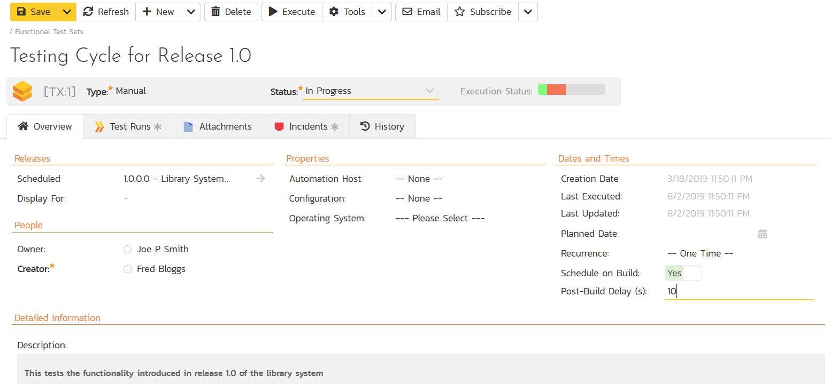
Executed Automated Tests

Slide 35
Integrating Support with KronoDesk

Slide 36
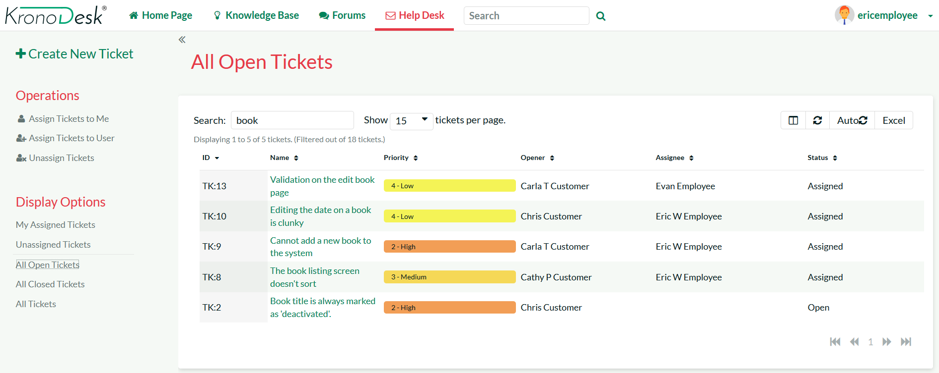
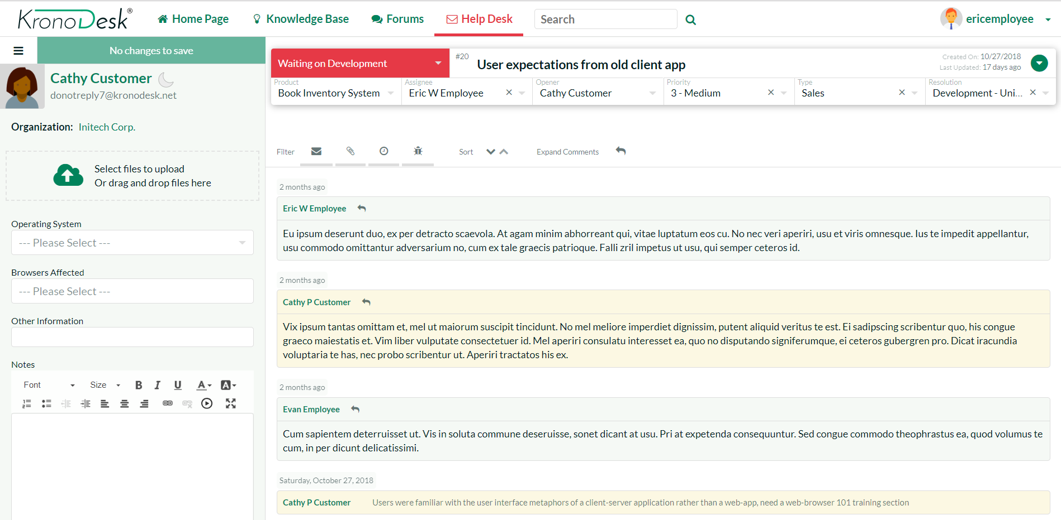
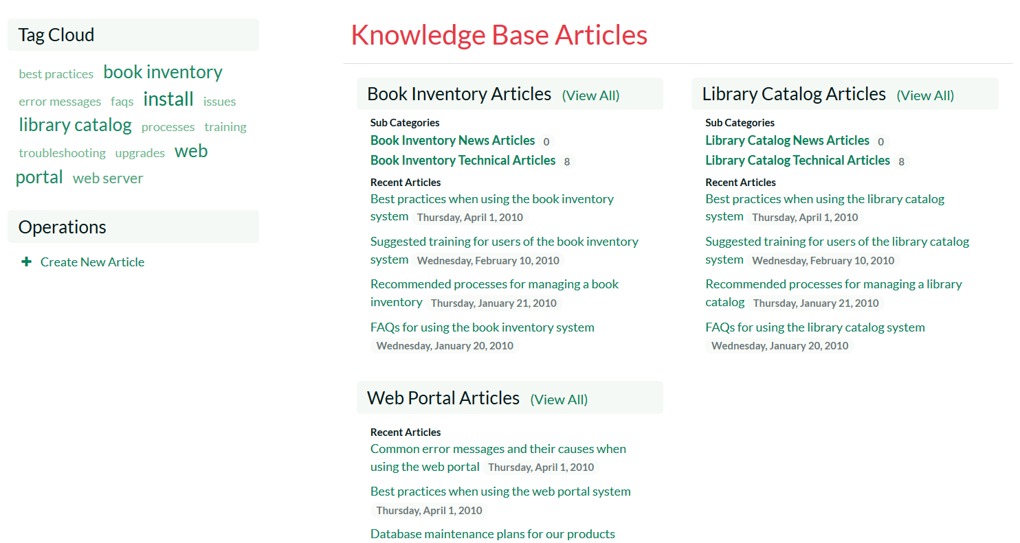
Integrated Service & Support

Slide 37
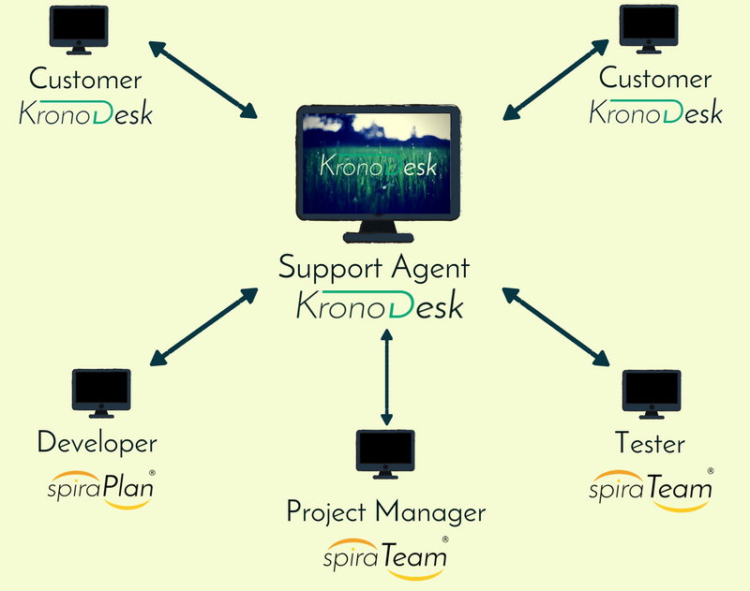
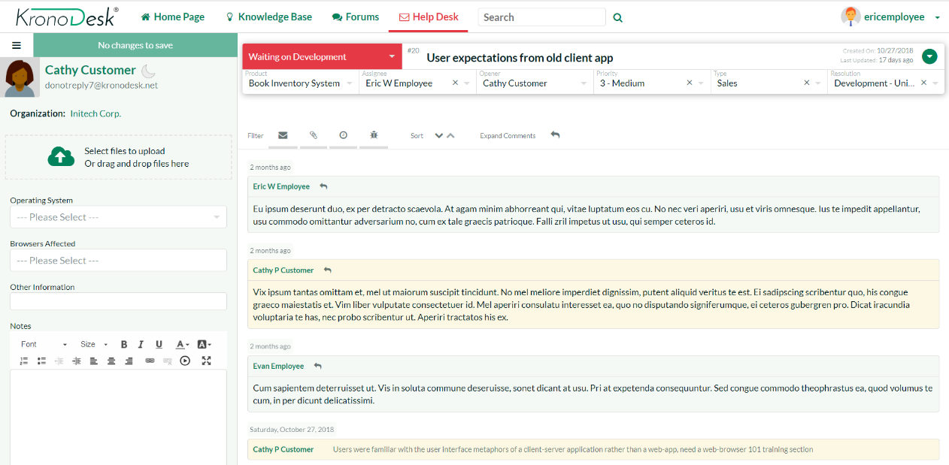
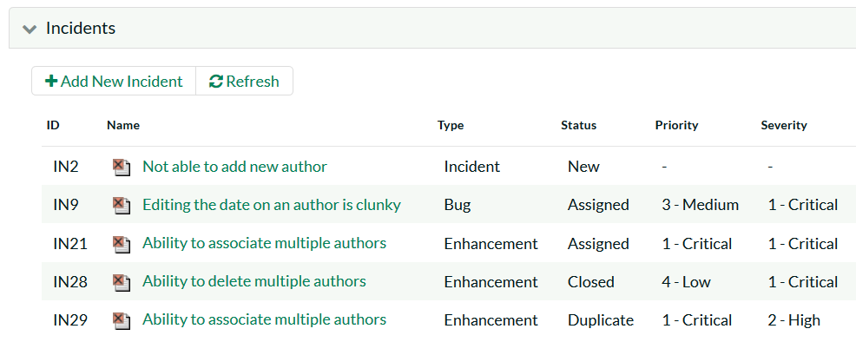
SpiraTeam & KronoDesk

Slide 38
Other Plugins and Add-Ons

Slide 39
Others
ZenDesk – integrate customer support
Migration Tools
TCM tools – ALM, TestRail, TestLink, MTM
Documents – Excel, Word, Sheets, Project
Requirements – DOORS, RequisitePro

Slide 40
Key Takeaways
The Spira platform seamlessly integrates with other parts of your ALM infrastructure
There any many free add-ons available
Your feedback & suggestions drive which add-ons and integrations get developed

Slide 41
Questions?

Slide 42
Further Reading
Add-Ons & Downloads Page: https://www.inflectra.com/SpiraPlan/Downloads.aspx
Integrations Information: https://www.inflectra.com/SpiraPlan/Integrations.aspx

