Slide 1

Developer 2:
Building a
DevOps Toolchain
@Inflectra | #InflectraCon

Slide 2


Adam Sandman
Director, Inflectra
Programmer from the age of 10
Working in the IT industry for over 20 years
Adam lives in Washington, DC, USA
@adammarksandman

Slide 3
Session Objectives
Explore the basics of creating an end-to-end DevOps toolchain using Spira plus associated tools such as Jenkins, Git, AWS, xUnit, RemoteLaunch, and Rapise.
We will discuss techniques for incorporating automated testing, packaging, and deployment into the CI/CD process.

Slide 4
Overview of DevOps

Slide 5
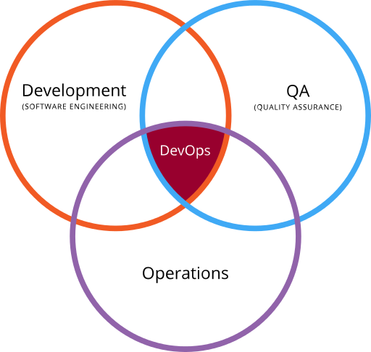
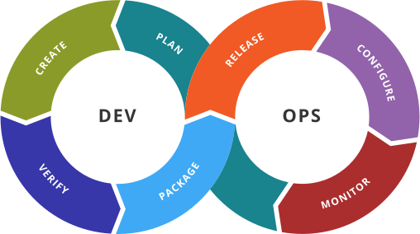
What is DevOps Anyway?
and
(By Devops.png: Rajiv.Pant derivative work: Wylve - derived from Devops.png: , Link, originally by Gary Stevens)

Slide 6
Elements of DevOps
Plan
Create / Build
Test / Verify
Package
Release
Configure
Monitor

Slide 7
1. Plan
Plan

Slide 8
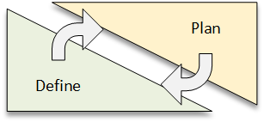
Planning & Definition
Define – refers to the activity needed to come to a common understanding of the application requirements and the inherent business value
Plan – refers to taking those requirements and developing a set of activities with milestones and roles that will carry out their realization.

Slide 9
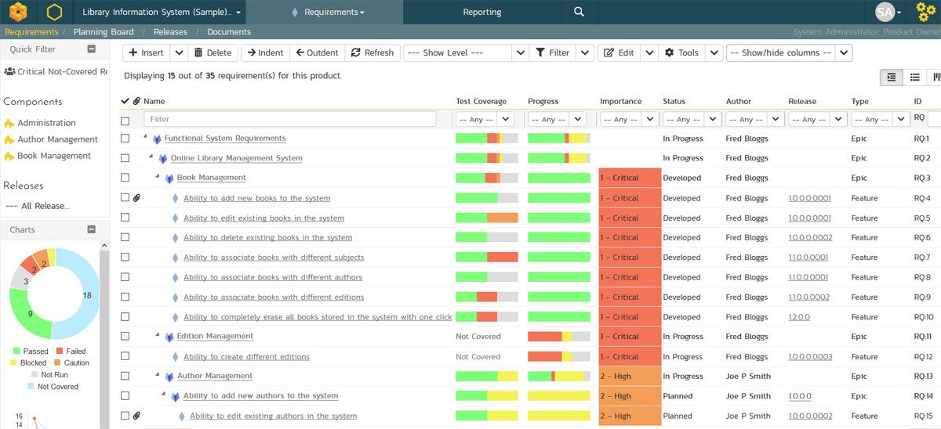
Requirements Definition

Slide 10
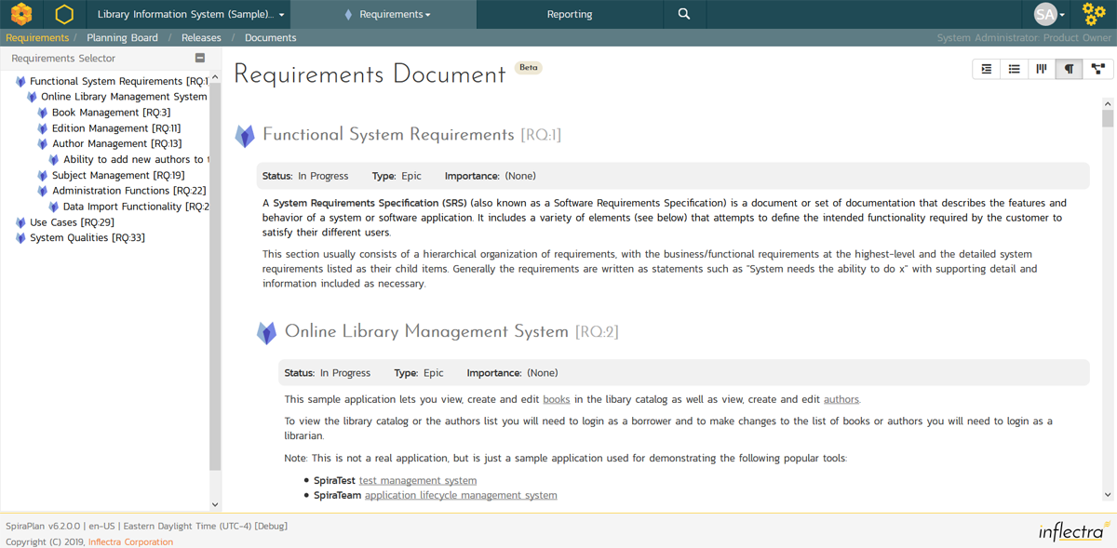
Requirements Definition

Slide 11
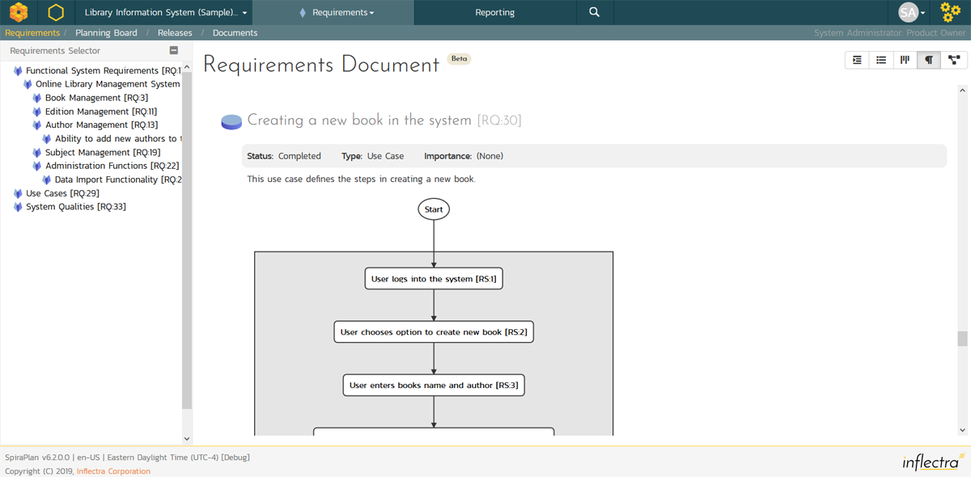
Requirements Definition

Slide 12
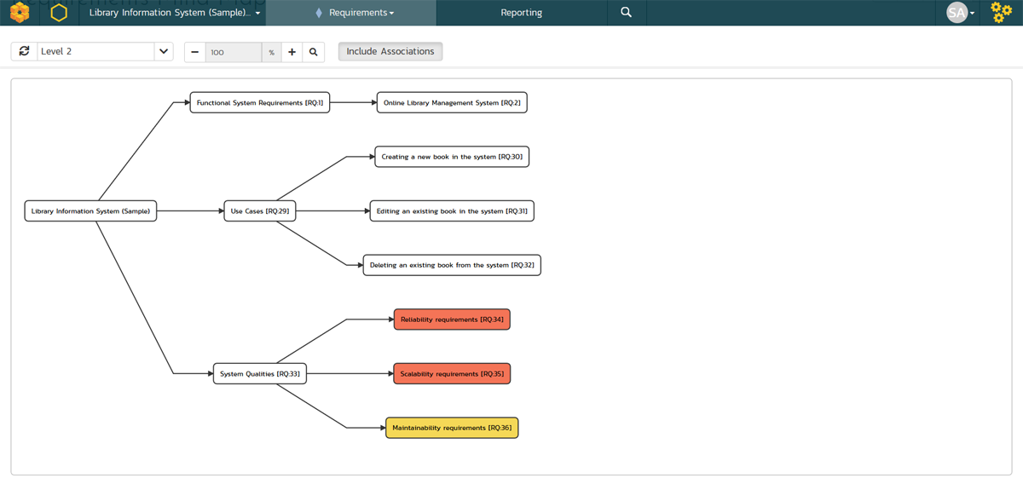
Requirements Definition

Slide 13
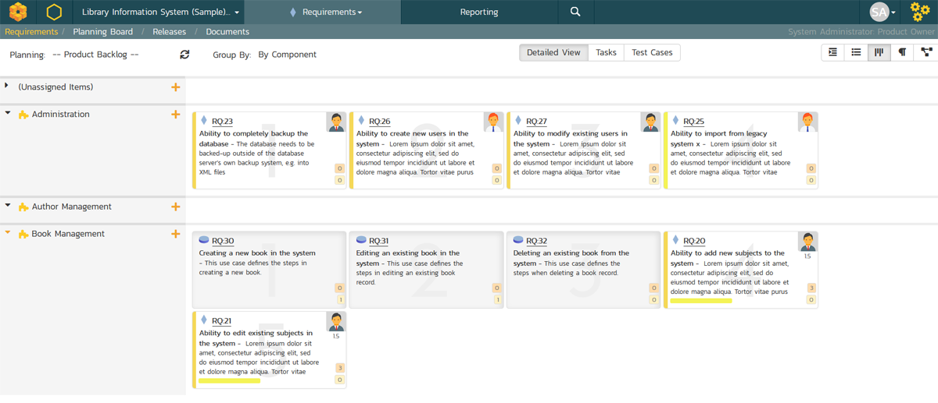
Requirements Definition

Slide 14
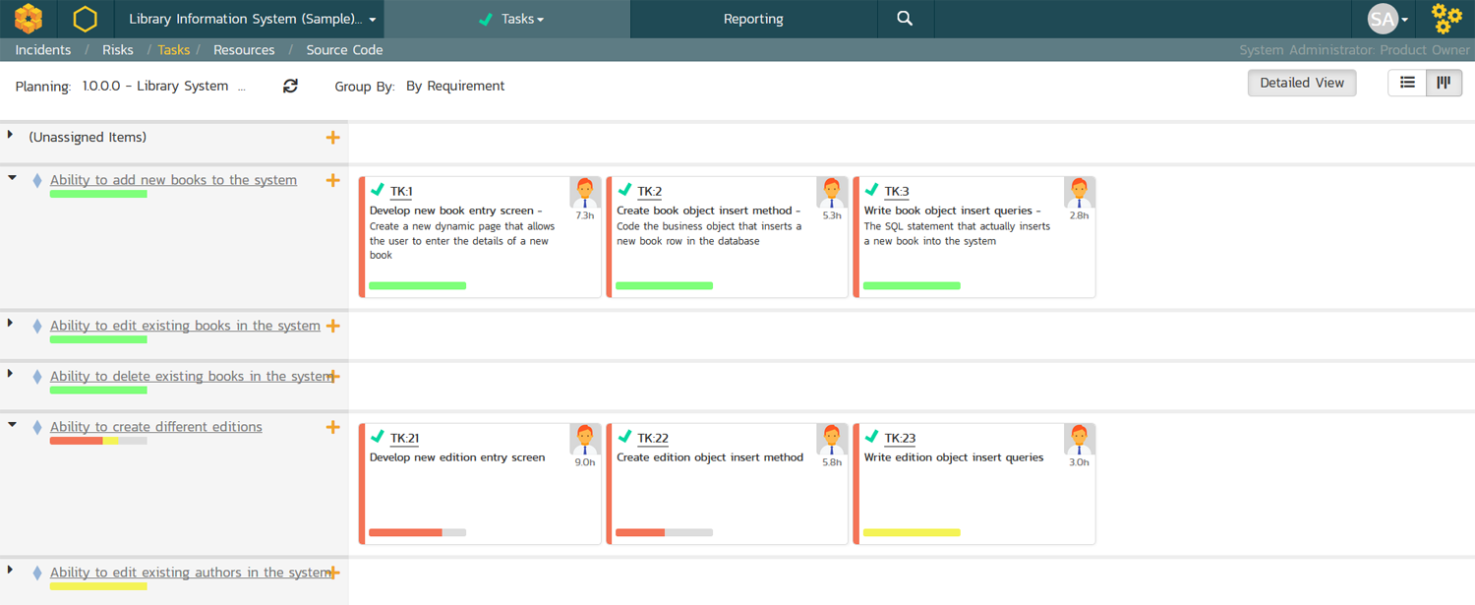
Requirements Planning

Slide 15
2. Create / Build
Create / Build

Slide 16
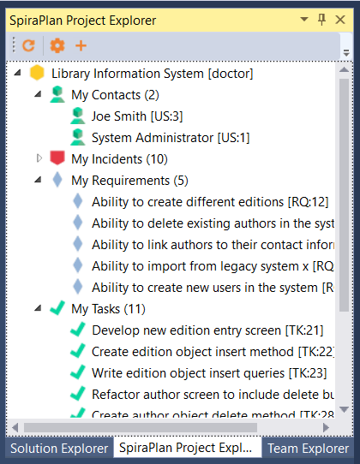
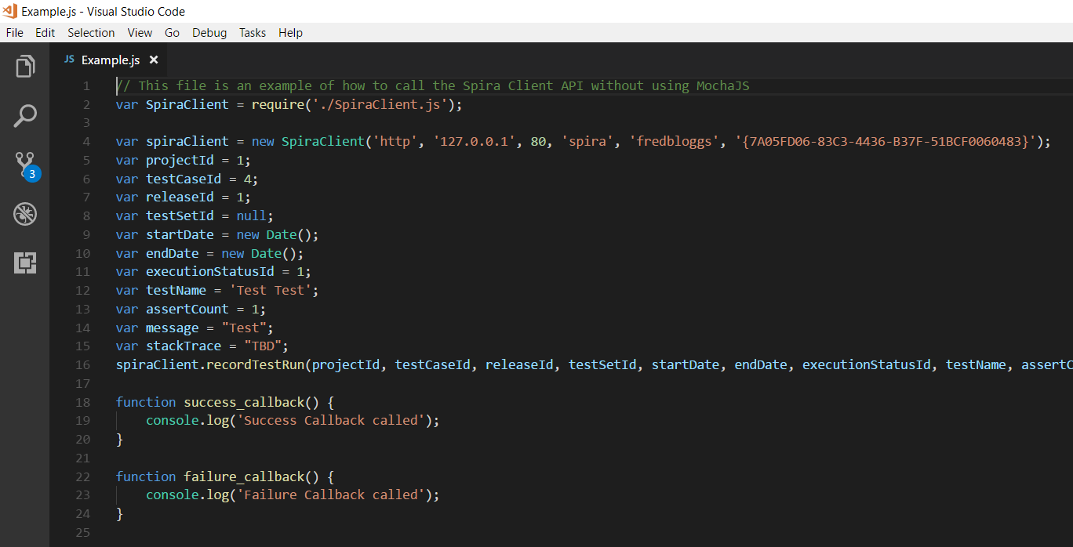
Write Code to Plan

Slide 17
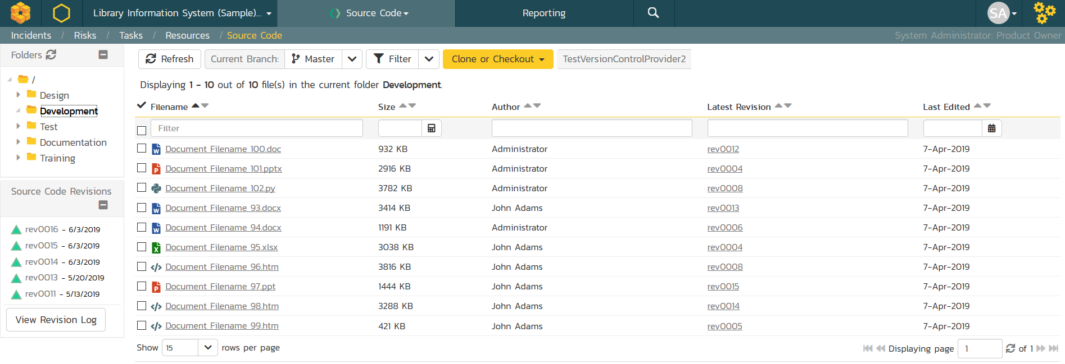
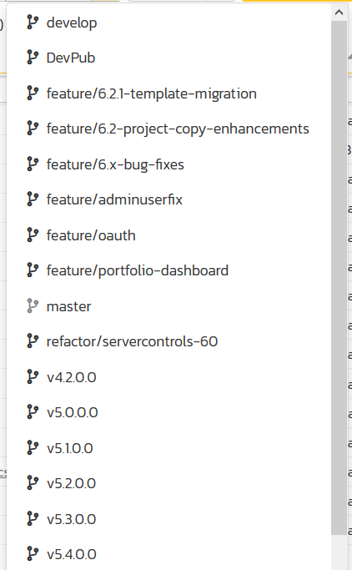
Manage Code

Slide 18
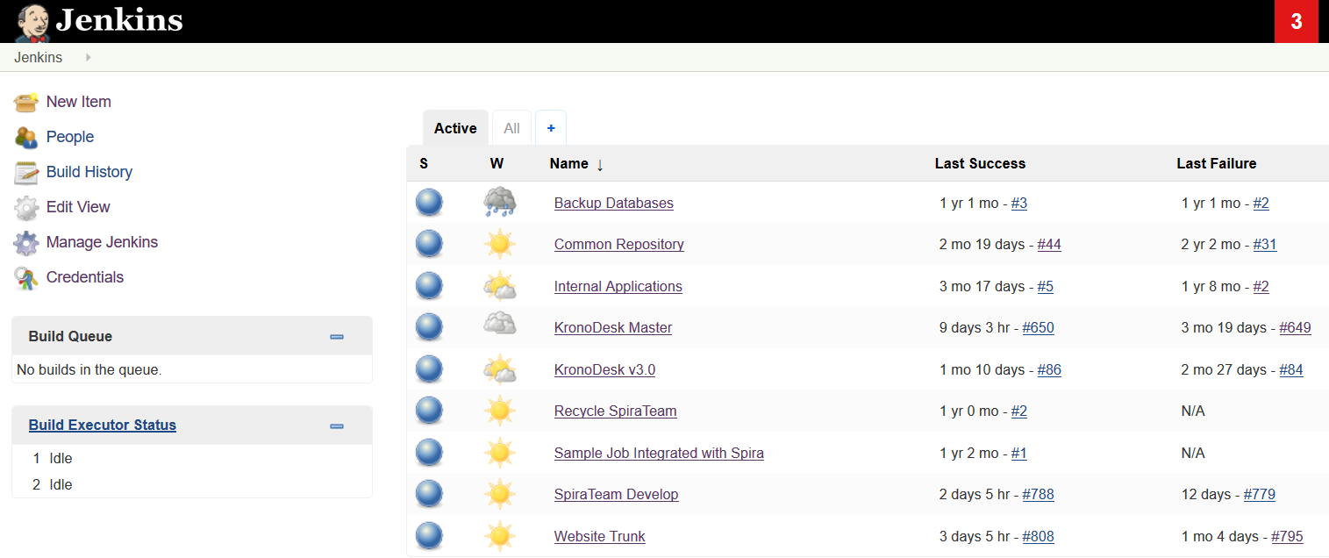
Build Code using CI

Slide 19
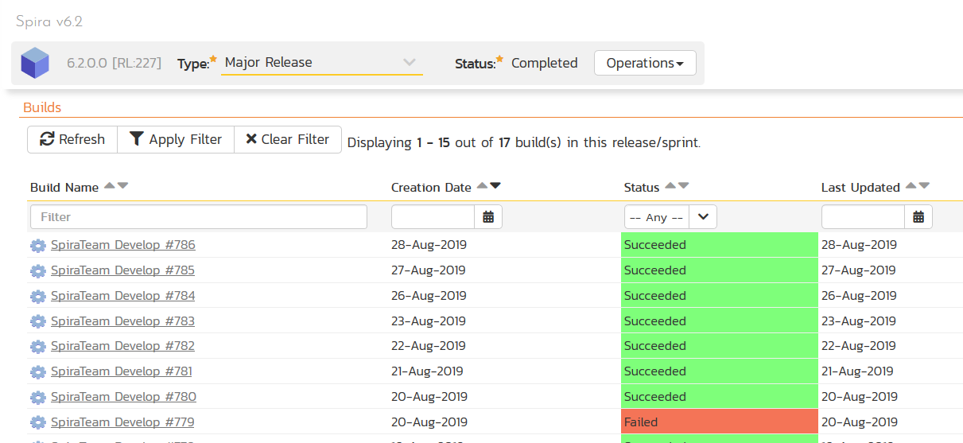
Build Code using CI

Slide 20
3. Test / Verify
Test / Verify

Slide 21
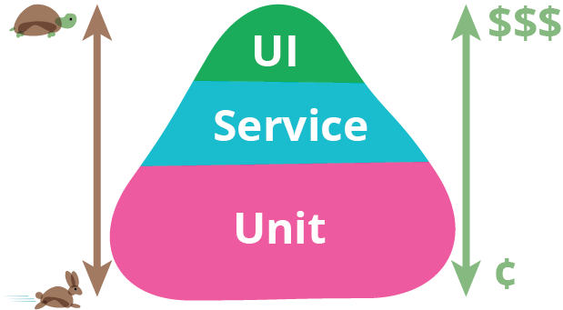
How Should We Test/Verify?

Slide 22
Hierarchy of Testing Risk
If it breaks here, then no point trying further levels in the hierarchy
Happy Path, Safe Environment
Realistic Paths, Safe Environment
Edge Cases, Safe Environment
Edge Cases, All Environments

Slide 23
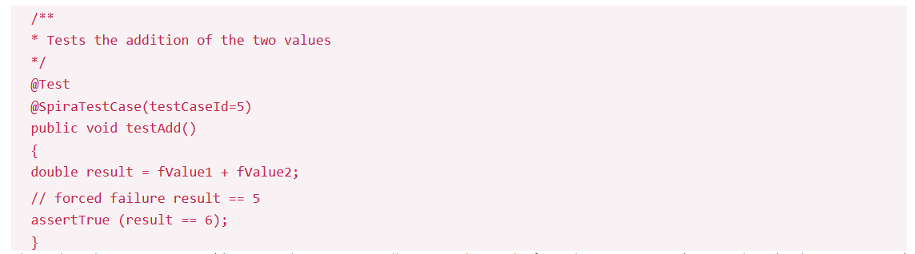
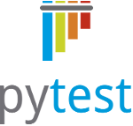

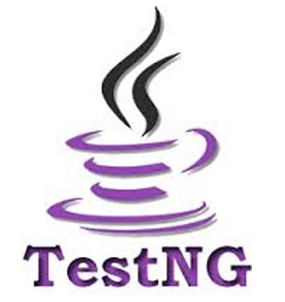





Unit Testing
Plugins Available for:

Slide 24
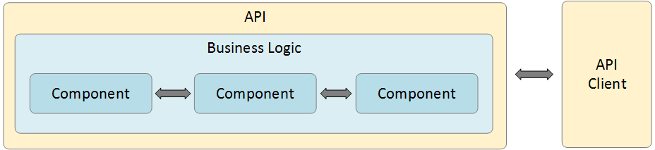
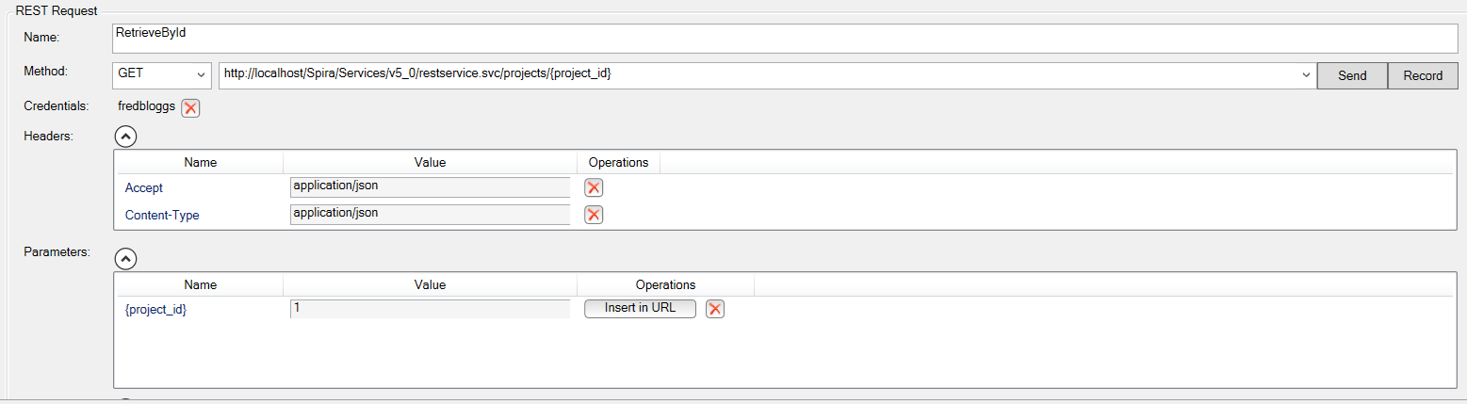
API & Integration Testing

Slide 25
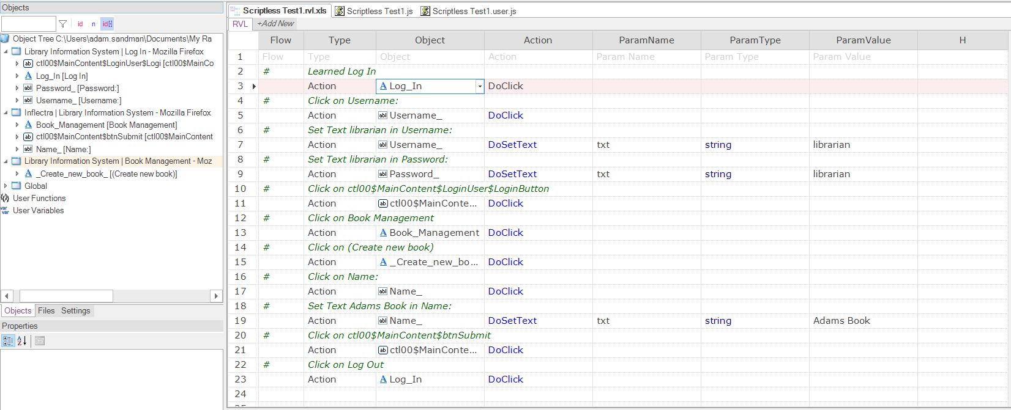
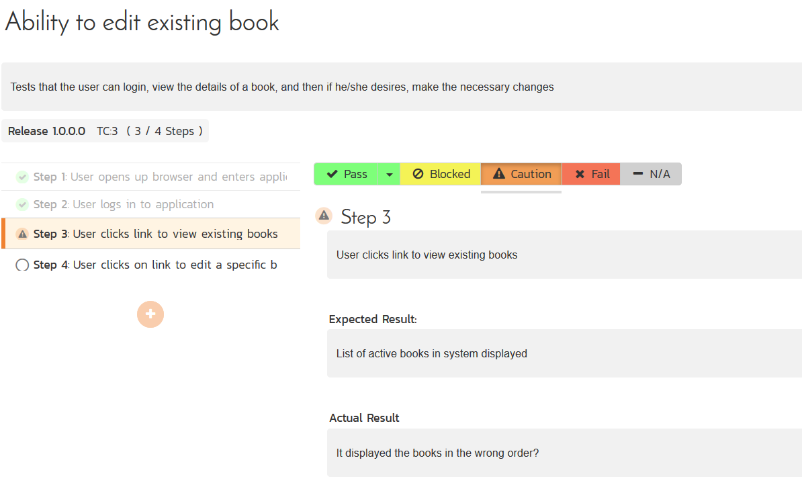
User Interface Testing
Automated Tests
Manual Tests
You need both to really test and verify!

Slide 26
4. Package
Package

Slide 27
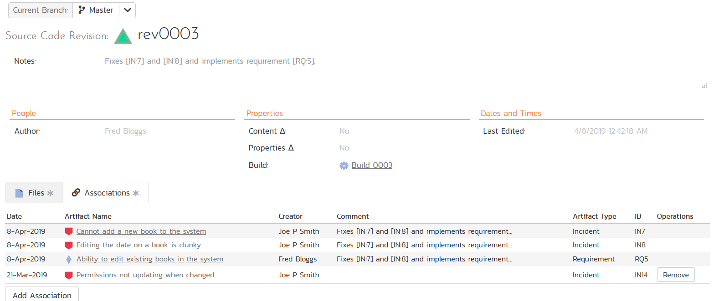
Artifact Repository

Slide 28
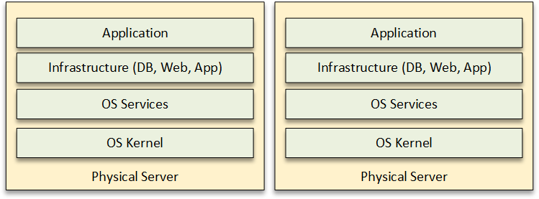
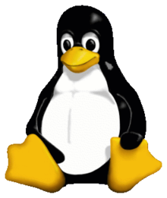
Environments – Physical
Traditional: Physical Servers running Operating System (OS)

Slide 29
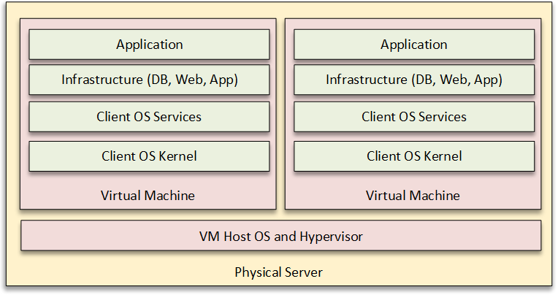
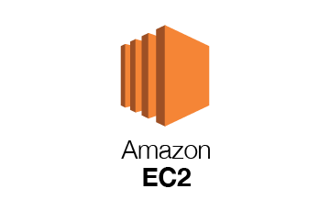

Environments – Virtual
Virtual Machines (VMs) either on-premise (VMware, HyperV) or Cloud (EC2)

Slide 30
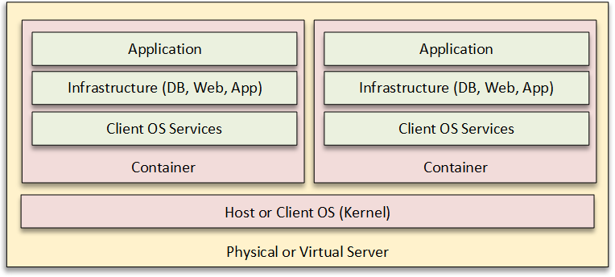
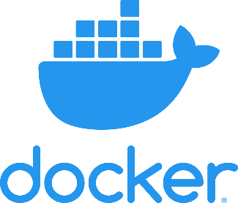
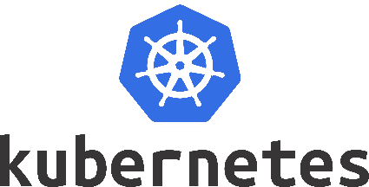
Environments – Containers
Containers running application and services without needing OS per image

Slide 31
Packaging Options
Traditional Installer (MSI, EXE, TAR)
Virtual Machines Image (ESXi, AMI)
Container Image (Docker, Kubernetes)
Plugin/Add-In (Renamed Zip archive!)

Slide 32
5. Release
Release

Slide 33
Release Components
Release Management
Configuration Management
Change Management
Deployment Automation

Slide 34
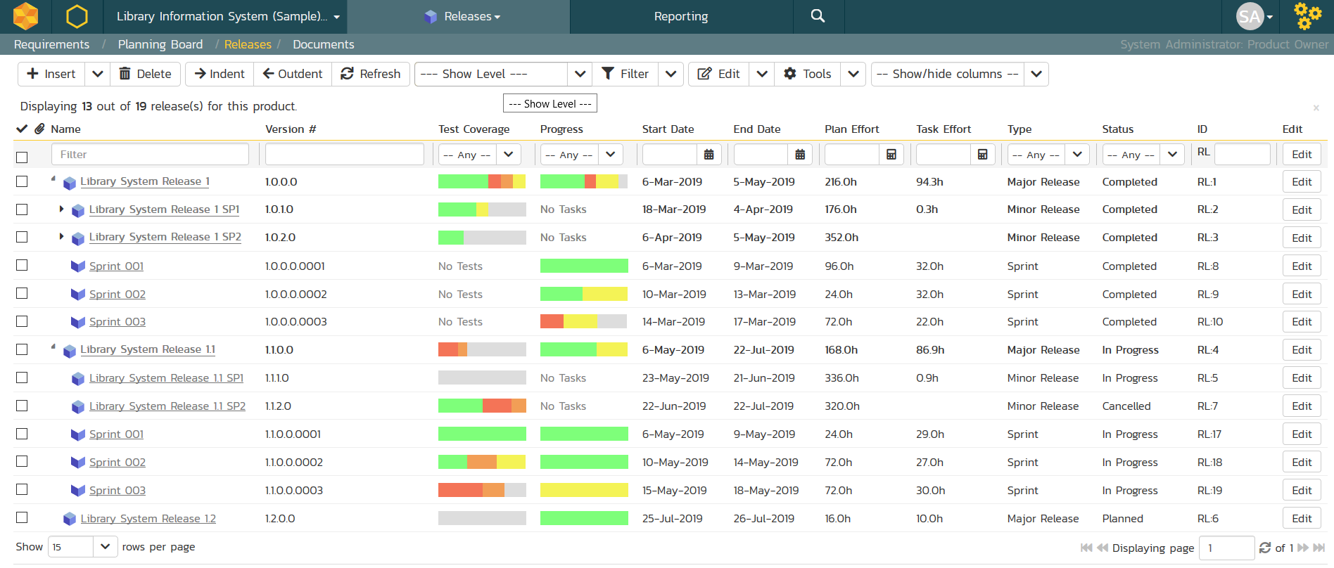
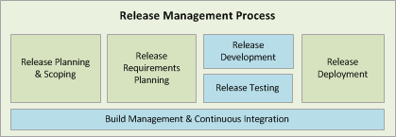
Release Management

Slide 35
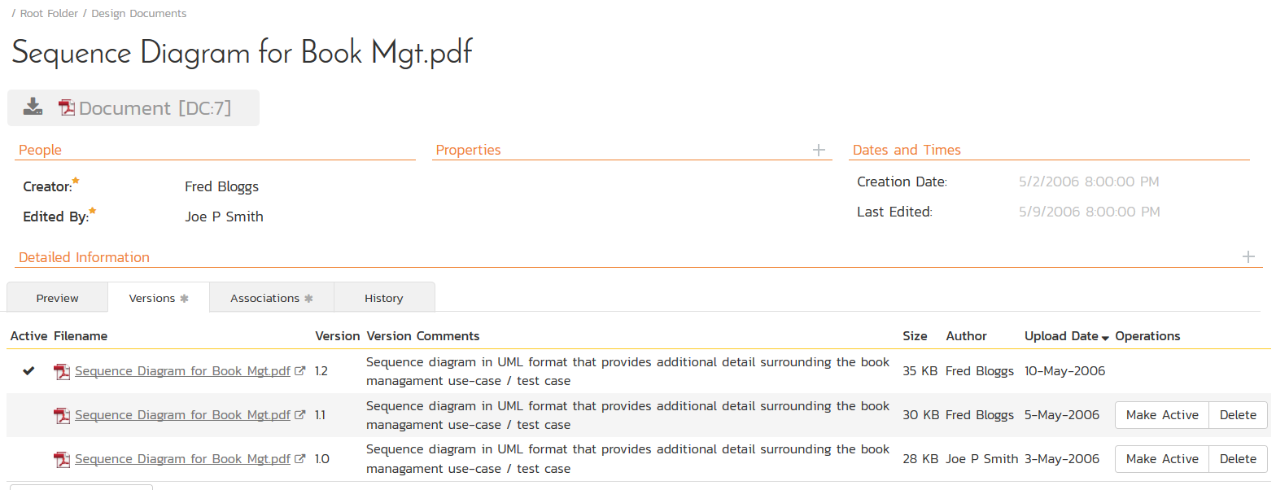
Configuration Management

Slide 36
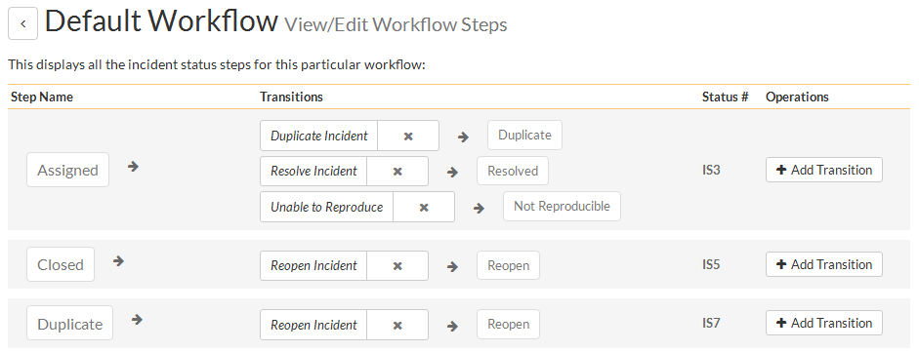
Change Management

Slide 37
6. Configure
Configure

Slide 38
On-Demand Infrastructure
Move from fixed infrastructure to on-demand cloud
Infrastructure as a Service (IaaS) such as AWS, Azure
Infrastructure as Code (IaC) – using REST APIs
Continuous Configuration Automation (CCA)
  Tools like Chef, Puppet, etc.

Slide 39
7. Monitor
Monitor

Slide 40
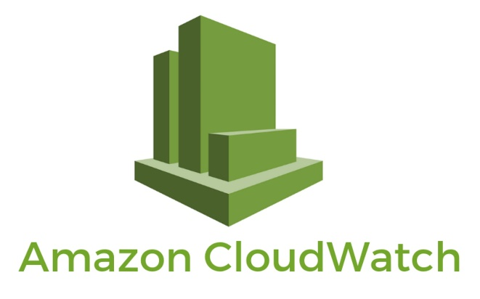
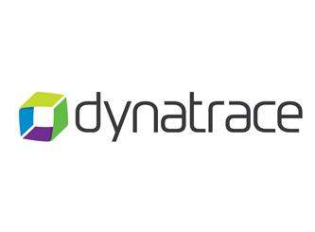
System Monitoring
Functional Monitoring
Performance Monitoring
Security Monitoring

Slide 41
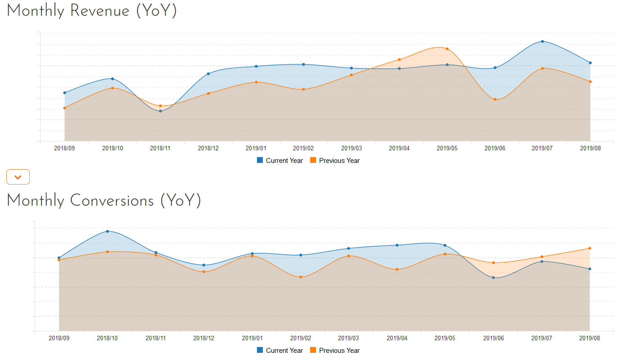
Business Monitoring
Business metrics can be a useful indicator of a problem that system monitoring may have missed!

Slide 42
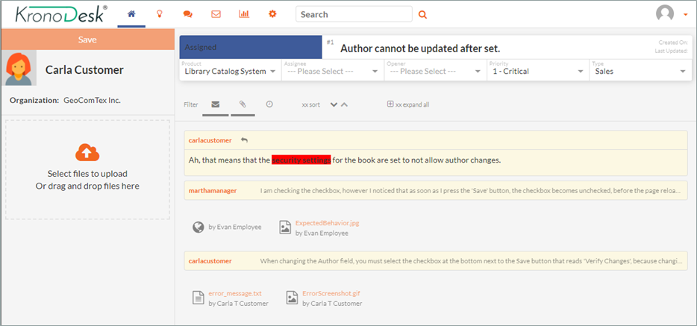
User Monitoring

Slide 43
Wrap Up

Slide 44
Key Takeaways
Agile methods and cloud computing provide faster and easier ways to create, build & deploy
DevOps pipelines let you streamline the path from ideation to realization
However, you need to design DevOps with your company processes and business model in mind

Slide 45
Questions?

Slide 46
Further Reading
DevOps Using SpiraTeam, Jenkins, and TaraVault:
  https://www.inflectra.com/Ideas/Whitepaper/DevOps-Using-SpiraTeam-Jenkins-and-TaraVault.aspx
  https://www.inflectra.com/Ideas/Whitepapers/DevOps-Using-SpiraTeam-Jenkins-and-TaraVault.pdf

