Slide 1
Scaling Agile Projects
Best Practices
@Inflectra | #InflectraCon

Slide 2
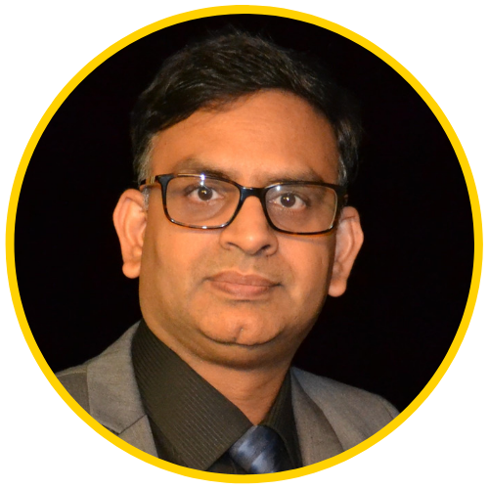
Dr. Sriram Rajagopalan
PhD, MBA, MS, BE
US, Canada, India, Vietnam, Belgium, Ireland, Greece, & Switzerland
Education
Work Experience
Training & Certification
Teaching & Training
PfMP, PgMP, PMP, SP, RMP, ACP, CSM, CSPO, ACC, CSD, SCT, CSOXP, SSBB, Instructional Designer, Speaker, Writer, and Author
Software Engineer, Team Leader, Business Analyst, Project Manager, Scrum Master, Agile Coach, Director, Vice President

Slide 3
Our Time Today
Review of Ten Commandments
Features of SpiraPlan®
Summarize with Q & A
Scaling Agile

Slide 4
Review of Ten Commandments

Slide 5
Ten Commandments
Establish Product Roadmap
Engage with Stakeholders gathering & reviewing Requirements
Align functionality based on Strategic Value Alignment
Prioritize and Groom Product Backlog for at least N+2 iterations
Estimate as a team
Increase backlog transparency to justify team-estimates
Use Themes as main goals
Plan for risk in Estimates by limiting hours/day for iteration
Manage the Agile Process
Manage flow and predictable team velocity commitments
Centralize and Accelerate task and testing transparency
Automate creating agile charts
Triage defects without breaking iteration commitments

Slide 6
Scaling Agile
Best Practices

Slide 7
Relate to the Essential Needs
More Awesome
Value
Awesome Value
Portfolio
Very Good
Value
Programs
Projects
Outcomes Generate Benefits
Realized Benefits Meets Strategic Objectives
Outputs
Produce Capabilities

Slide 8
Scaling Agile ISN’T JUST about Requirements
Identifies specific benefits, time period, measures
Business Case
Charter
Benefits Register
Roadmap
Justifies decision with formal benefits and future opportunities
Visual view of functionality, dependencies, and milestones
Authorizes the person to manage work and use resources

Slide 9
Scaling Agile ALSO Spans Four Dimensions
People Management
Leadership
Benefit Delivery
Retention
People
Process
Organization
Technology
Engineering Architecture
Code Coverage
Requirements Traceability
Quality Improvement
Risk Management
Integration Management
Stakeholder Management
Change Management
Strategy & Value
Product Roadmap
Product Backlog
Customer Satisfaction

Slide 10
Skills and Competencies
Enterprise
Program or Portfolio
Team
Accountable for Strategic Leadership to transform organizations through change management
Focus on Product Leadership through differentiation, price, innovation to generative competitive edge
Prioritization of Value through Voice of Customer, Voice of Business, and Financial Considerations
Accountable ownership on benefit delivery and sustenance through product management and marketing
Enhanced “Fast and Furious” feedback collection with focus on benefit maximization
Process & Tool improvements for operational excellence
Accountable for team level objectives with expertise over multiple functions
Adoption of stable, sustainable, and scalable processes to support continuous delivery
Evaluate and implement tools that focus on application lifecycle management for frequent releases

Slide 11
Skill & Competency Map
Portfolio
Enterprise Coach
SAFe Coach
Portfolio Manager
Product Manager
Product Owner
Team Coach
Program
Kanban
Lean
TQM
Product Manager
Program Manager
SAFe
TQM
Project Manager
Scrum
Prescriptive Analysis
6σ - GB
Management by Project
Engineering Architecture
Cloud Tools
Big Data
Project
CI
Code Optimization
CD
Release Train
Cloud Tools
XP Practices
TDD
Lean Process
HoQ
BDD
ATDD
Automation
Compliance
Technical
Responsive Design
User Experience
Coding Standards
Agile Scaling
Security
Individual
Team
Enterprise
* For Illustrative Purposes Only

Slide 12
Scaled Agile Framework
Scaled Agile (n.d.). Retrieved from https://www.scaledagile.com/enterprise-solutions/what-is-safe/

Slide 13
Nexus Model
Nexus Framework (n.d.). Retrieved from https://s3.amazonaws.com/scrumorg-website-prod/drupal/2016-09/NexusPoster17x11.pdf

Slide 14
Spotify Model
Spotify Tribe Engineering Model (n.d.) Retrieved from https://medium.com/@media_75624/exploring-key-elements-of-spotifys-agile-scaling-model-471d2a23d7ea

Slide 15
Basics of Scaling Agile
Always start with a strategic MVP
Build an adaptive team culture
Centralize an unified transparent product backlog
Develop an agile methodolgoy that fits
Explore Kaizen mindset

Slide 16
Scaling Agile with SpiraPlan

Slide 17
Always start with a Strategic MVP
Granularity
Dreams
Castles
Big House
Maintainable Home
2 BR, etc.
Idea
Epic 1
Theme C
Feature I
Need a
Epic 2
Theme D
Theme A
Theme B
Feature II
Need b
Need c
Various types of Requirements to suit program or project needs
Support for scenario steps and workflow for every type of requirement
Requirements
Package
Component
Time
T0
T10
T50

Slide 18
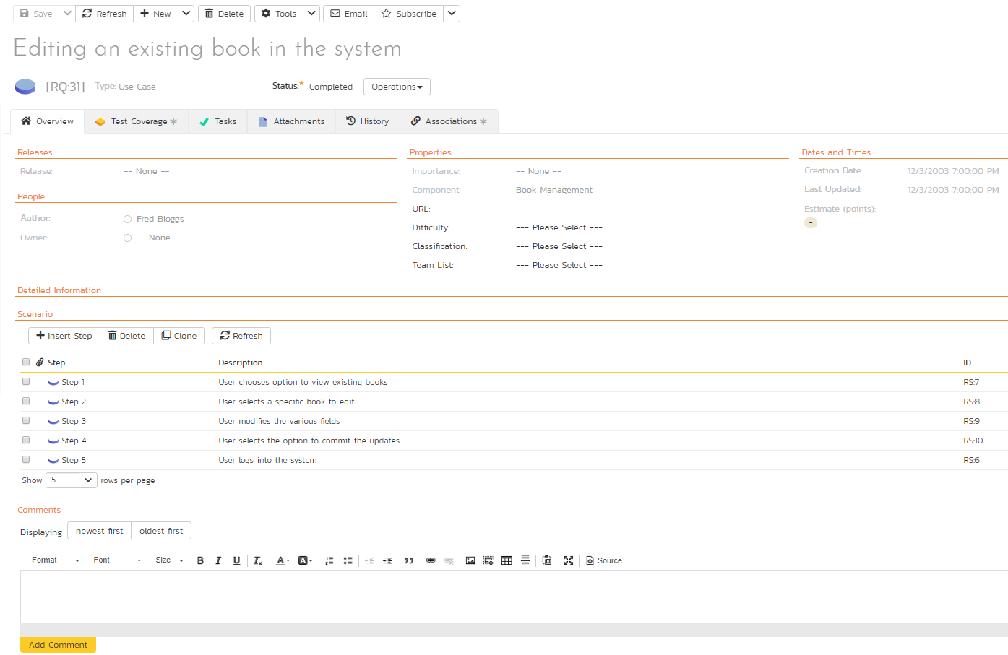
Building an adaptive team culture starts with stakeholders
Realizes DEEP property with more clarity
Helps with business value prioritization and alignment

Slide 19
Centralize task and testing transparency
Number of tasks (4) the team has identified to address this requirement
Visibility to fewer tasks and test cases mean trouble!
Number of test cases (4) the team has identified for acceptance testing.

Slide 20
One STOP to More Traceability

Slide 21
Develop an Agile methodology that fits You!
Several workflows
Product Specific Management
Custom Options
Custom Notifications
Risk Management
Numerous System Configs
Numerous Integration Options
Report Config Options

Slide 22
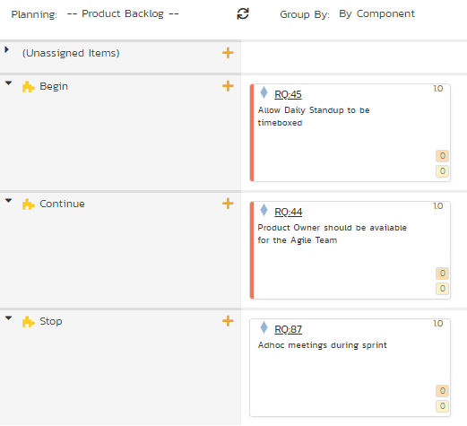
Explore Kaizen Mindset
Plan Releases and Iterations managing flow as lessons are learned
Manage a project for retrospectives to increase productivity

Slide 23
Explore Kaizen Mindset
Identify and address risks before risk manages your project!

Slide 24
Summary
Always Start with a Strategic MVP
Build adaptive team culture with stakeholders
Centralize task and testing transparency
Develop an agile methodology that fits you
Explore Kaizen Mindset

