Slide 1

Managing Agile Projects
@Inflectra | #InflectraCon

Slide 2
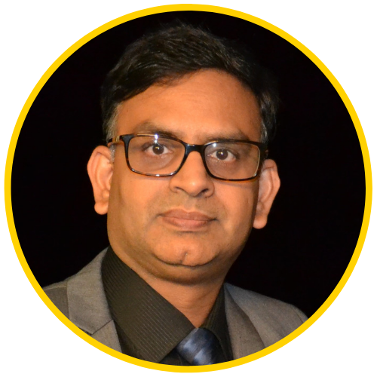

Dr. Sriram Rajagopalan
PhD, MBA, MS, BE
US, Canada, India, Vietnam, Belgium, Ireland, Greece, & Switzerland
Education
Work Experience
Training & Certification
Teaching & Training
PfMP, PgMP, PMP, SP, RMP, ACP, CSM, CSPO, ACC, CSD, SCT, CSOXP, SSBB, Instructional Designer, Speaker, Writer, and Author
Software Engineer, Team Leader, Business Analyst, Project Manager, Scrum Master, Agile Coach, Director, Vice President
@agilesriram

Slide 3
Our Time Today
Review of Agile Best Practices
Planning Board in
SpiraTeam® / SpiraPlan®
Summarize with
Q & A

Slide 4
Measuring Agile Initiatives
Measure of success has remained flat (considering # of respondents between 2018 and 2019)
Notable increasing needs that tools should support
Source: State of Agile Survey, Version One, 2018, 2019

Slide 5

Ten Commandments
Establish Product Roadmap
  Engage with Stakeholders gathering & reviewing Requirements
  Align functionality based on Strategic Value Alignment
  Prioritize and Groom Product Backlog for at least N+2 iterations
Estimate as a team
  Increase backlog transparency to justify team-estimates
  Use Themes as main goals
  Plan for risk in Estimates by limiting hours/day for iteration
Manage the Agile Process
  Manage flow and predictable team velocity commitments
  Centralize and Accelerate task and testing transparency
  Automate creating agile charts
  Triage defects without breaking iteration commitments

Slide 6
Establish Product Roadmap
How SpiraTeam/SpiraPlan supports this functionality

Slide 7
Requirements: Simple or Complex?
PMI claims the number of projects with increasing complexity raised from 35% in 2013 to 41% in 2018.

Slide 8

Requirements
When properly implemented and supported, the critical competency of developing and managing requirements enables the organization to meet stakeholder expectations, improve project performance, meet organizational benefits, and achieve tangible business outcomes.
(PMI, 2016, pg. 2)
When properly implemented and supported, the critical competency of developing and managing requirements enables the organization to meet stakeholder expectations, improve project performance, meet organizational benefits, and achieve tangible business outcomes.
(PMI, 2016, pg. 2)
Project Management Institute (2016). Requirements Management: A Practice Guide. Newtown Square, Pennsylvania.

Slide 9
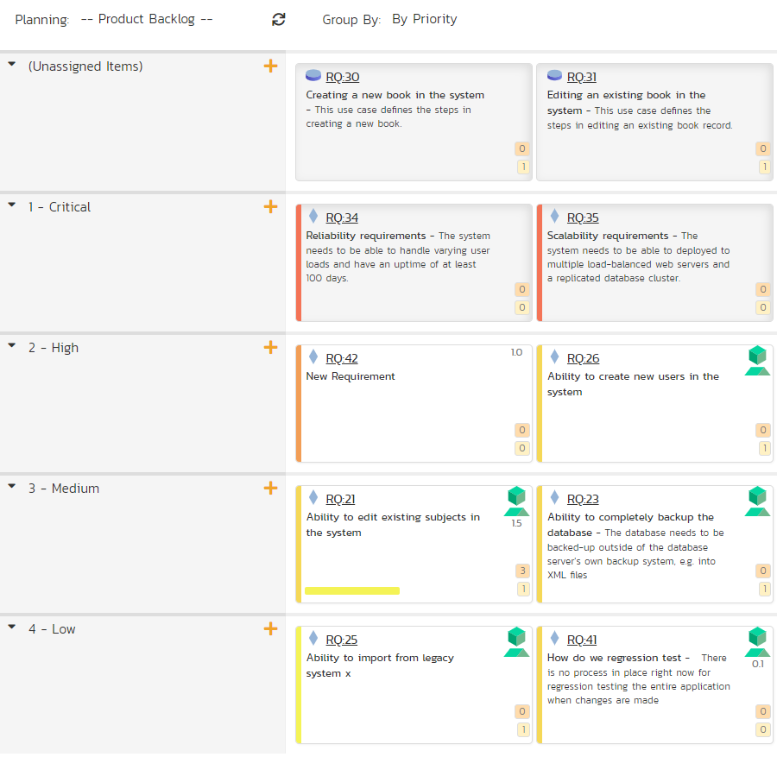
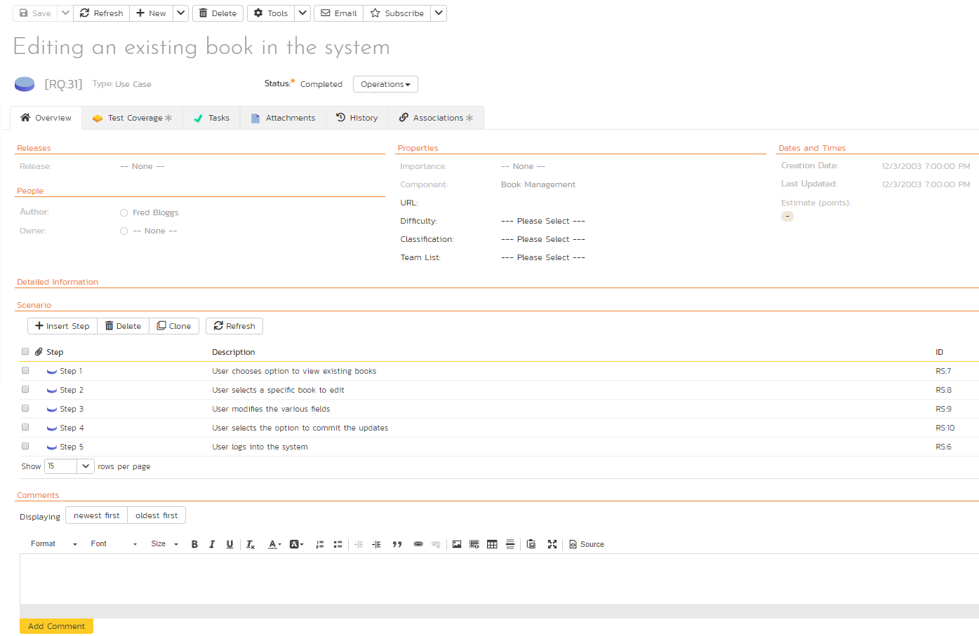
Engage with Stakeholders gathering & reviewing Requirements
Realizes DEEP property with more clarity
Helps with business value prioritization and alignment

Slide 10
Requirements Elicitation
What does the paying customer want?
What exciters can we add to keep the customer with us?
Customer Value Add
Business Value Add
Technical Value Add
Non-Value Add
Process Value Add
What types of documentation / training needed for users?
Are compliance documents needed to sustain business?
How to technology current to avoid risks from shelf-life?
How to avoid technical debt making platforms stable?
How to increase effectiveness by operational excellence?
How to enhance efficiency by continuous improvement?
What types of elements to retire that add no-value?
What types of process and procedure waste to eliminate?

Slide 11
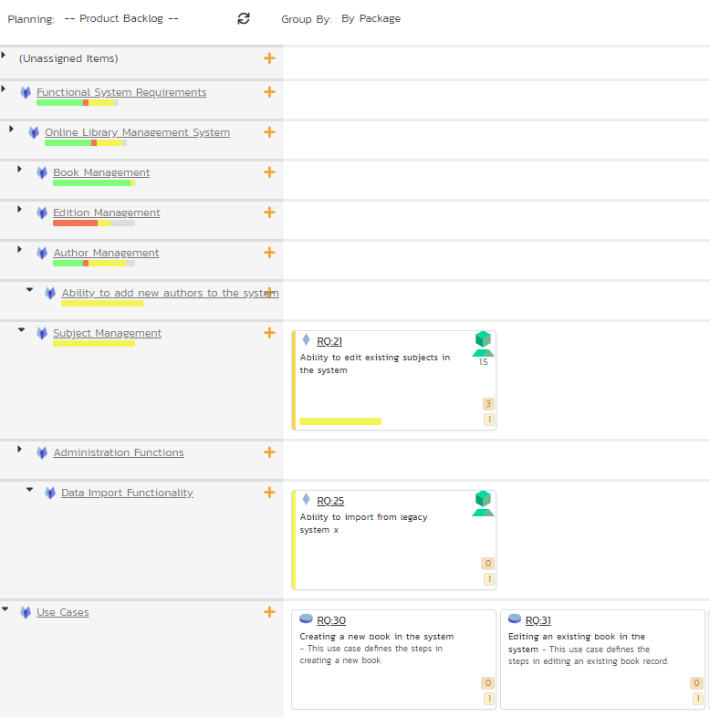
Align functionality based on Strategic Value Alignment
Categorizing requirements by value alignment

Slide 12
Requirements have a Lifecycle
Needs Assessment
Requirements Management
Requirements Elicitation
Requirements Analysis
Requirements Monitoring
Solution Evaluation

Slide 13
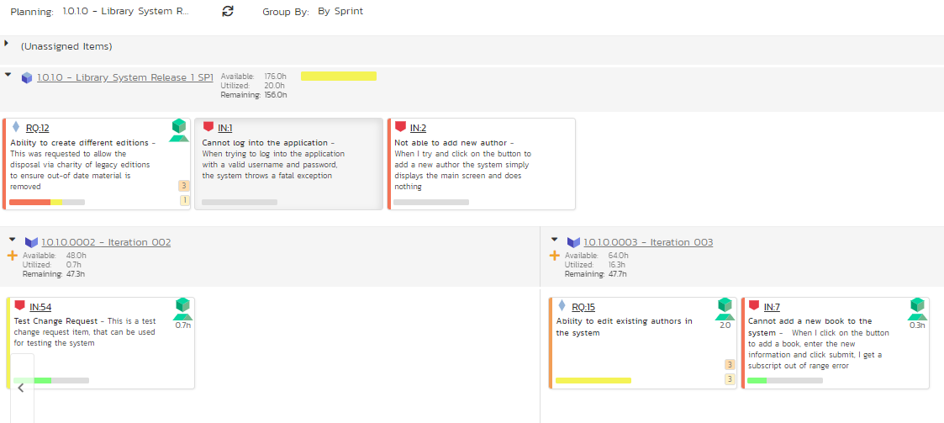
  Prioritize and Groom Product Backlog for at least N+2 Sprints
Current Iteration
Forecasting what the team needs to work on for two upcoming iterations

Slide 14
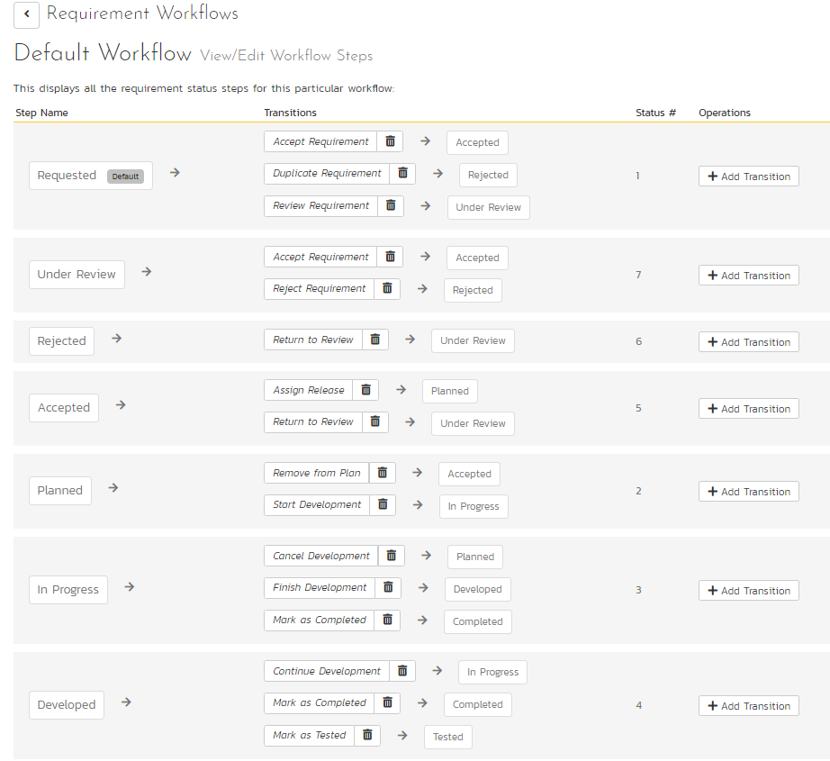
Wait! We have a Workflow Support too!
Customizable Workflow based on business needs
Supports agile principles of transparency, inspection, and adaptation.
Multiple workflows based on requirement types
Includes support for Digital Signature too!

Slide 15
Estimate as a Team
How SpiraTeam/SpiraPlan supports this functionality

Slide 16
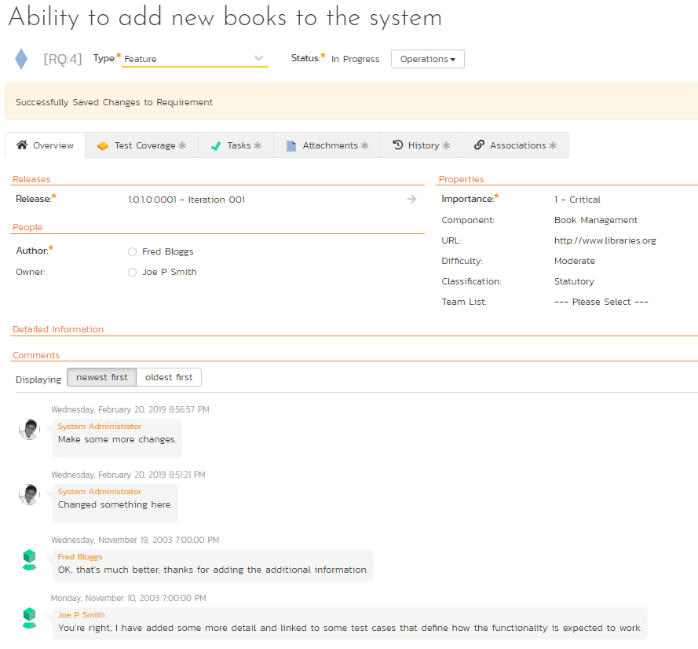
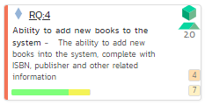
Increase backlog transparency to justify team estimates
Much of the collaboration is already happening without infringing on time commitments.
Planning sessions become more productive!
Auditable requirements making it easy for the team to commit story point estimates.
Facilitates remote, distributed, and virtual team collaboration.

Slide 17
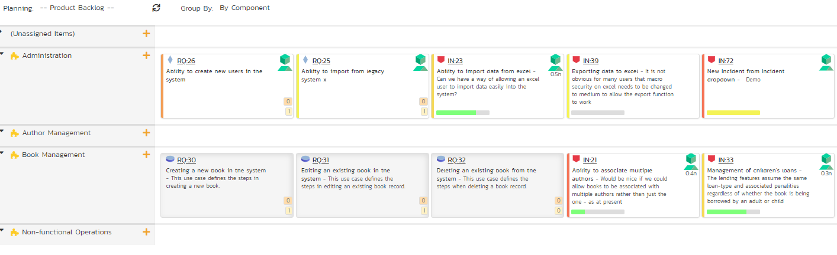
Use Themes as main goals
Aligns with the strategic product roadmap by mapping themes (components) in product backlog
Keep team engaged with releases and iterations

Slide 18
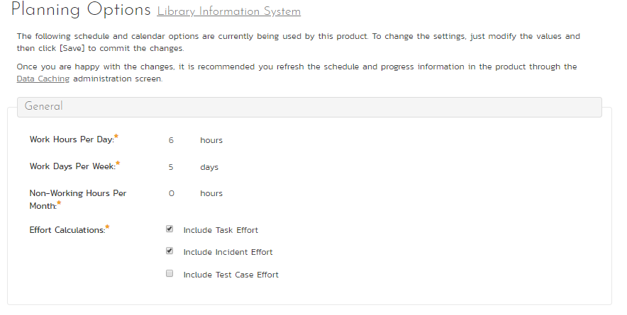
Plan for risk in Estimates by limiting hours/day for iteration
Life comes in the way! Whether it is company meetings or issues within the iteration, allowing for flex time mitigates risk.

Slide 19
Manage the Agile Process
How SpiraTeam/SpiraPlan supports this functionality

Slide 20
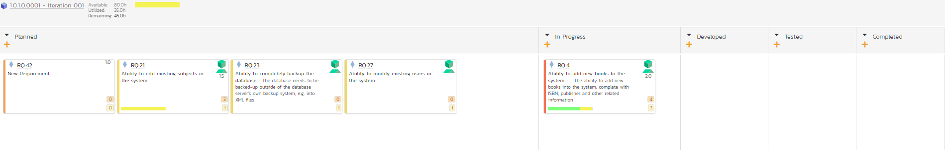
Manage flow and predictable team velocity
Managing flow using Kanban views identifies impediments to commitments and streamlines operations
Late Start and Late Finish tasks can be unearthed to reinforce team’s commitments serving as seeds during retrospectives

Slide 21
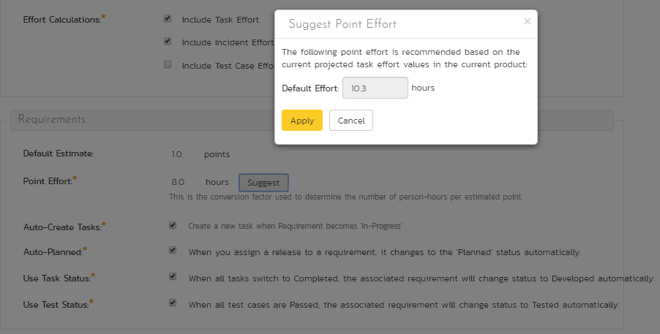
Manage flow and predictable team velocity
Based on previous work completed, a recommended hours/point is provided to manage team velocity commitments!

Slide 22
Centralize task and testing transparency
Number of tasks (4) the team has identified to address this requirement
Visibility to fewer tasks and test cases mean trouble!
Number of test cases (4) the team has identified for acceptance testing.

Slide 23
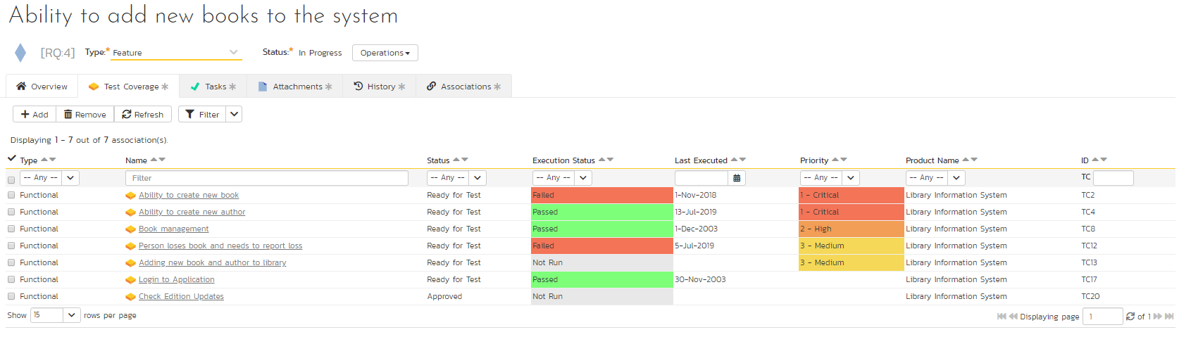
One STOP to More Traceability

Slide 24
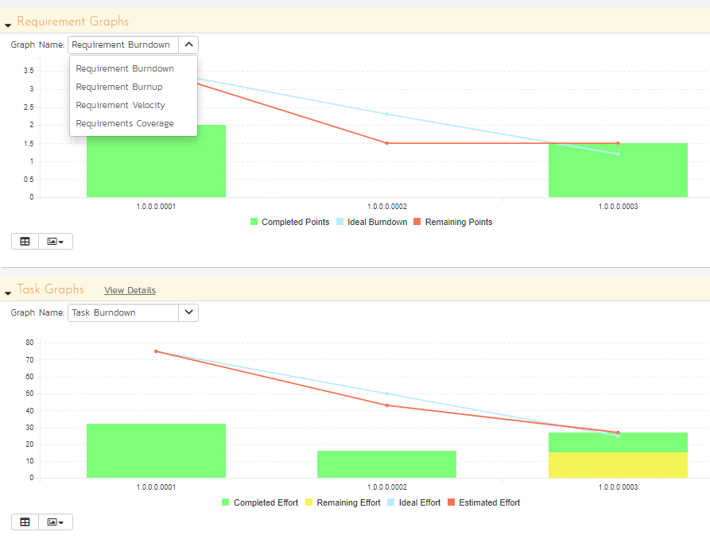
Automate creating agile charts
View burndown, burnup, velocity, or coverage quickly!
Several widgets available
View coverage on more artifacts!
Export data grid or image for additional discussions

Slide 25
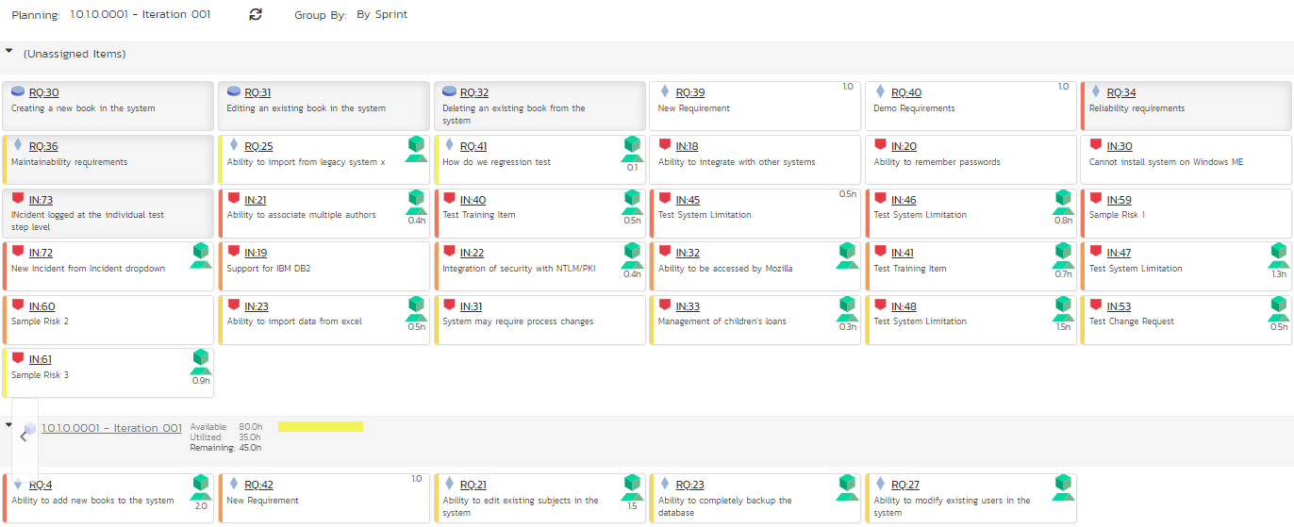
Triage defects without breaking iteration commitments
Not all defects identified need to be solved in that iteration unless the team finds it critical to story completion.
Defects are uniquely identified so that these can be addressed during the Daily Sprint or prioritized during Sprint planning.
Defects go through a separate customizable triage workflow as they are evaluated for the severity of impact.

Slide 26

Summary
Agile is a framework with a set of philosophies
Focus on agility by adopting practices that suit your needs
Focus on people, process, technology, and organizational needs

