Slide 1
How we plan and manage our
IT-projects with SpiraTeam
Customer Case Study: Generali
Internal

Slide 2
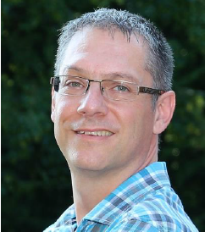
About me
Andreas Eckerle
Head of Test- & Quality Management at Generali Switzerland

Slide 3
Session Aims
Generali Group / Switzerland – Facts & Figures
Where we started
What we achieved within “ALBIS”
SpiraTeam – setup, structure and reporting
SpiraTeam – interfaces
SpiraTeam – looking back- and forwards
Q & A

Slide 4

Generali worldwide
Generali Group
Facts & Figures

Slide 5
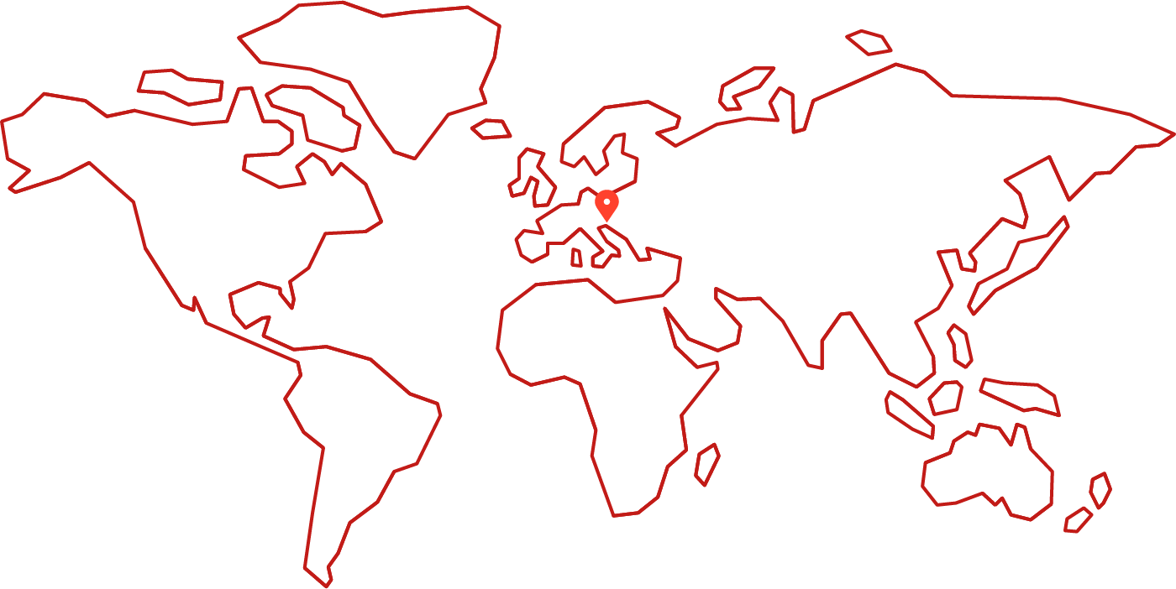
Founded 1831 in Trieste
Generali worldwide

Slide 6
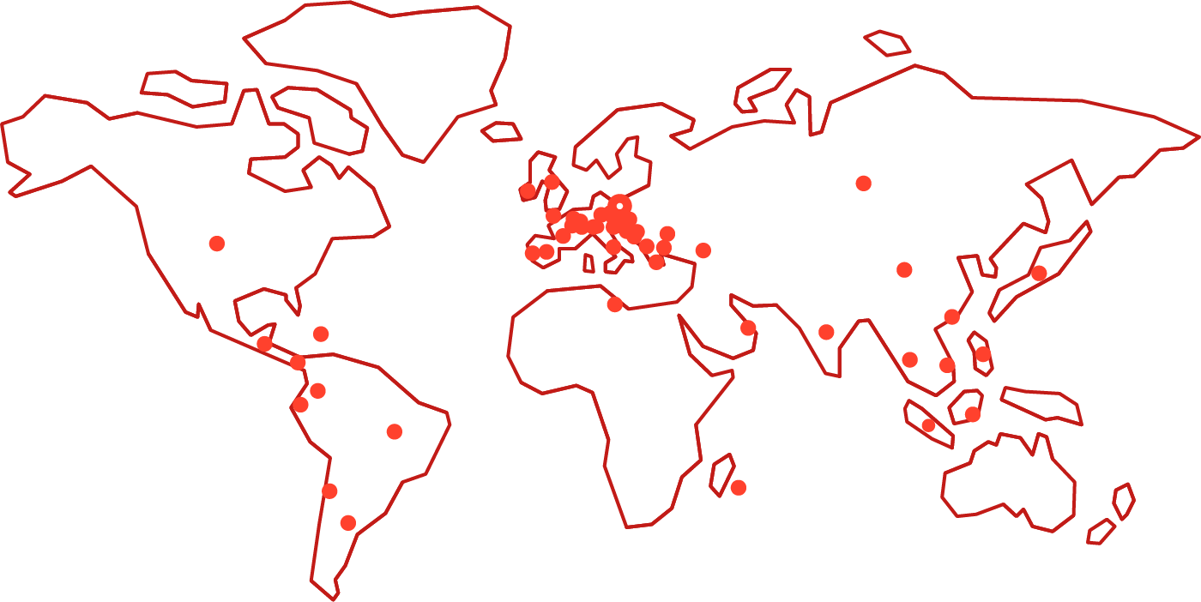
Represented in 60 countries around the world
Generali worldwide

Slide 7
Facts
Generali worldwide
71´000 employees
61 million customers
EUR 70.5 billion in booked premiums

Slide 8

Generali Switzerland
Generali Switzerland
Facts & Figures

Slide 9
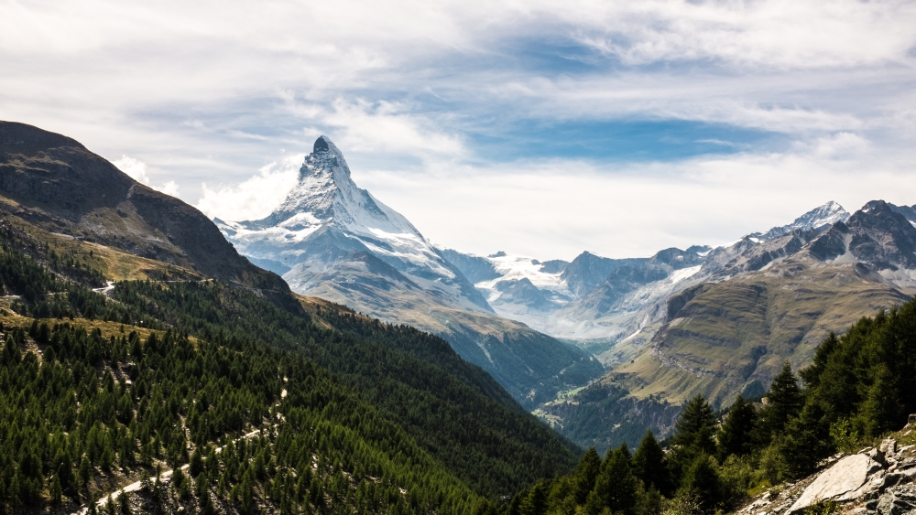

Slide 10
Switzerland vs. USA
Generali Switzerland
Switzerland

Slide 11
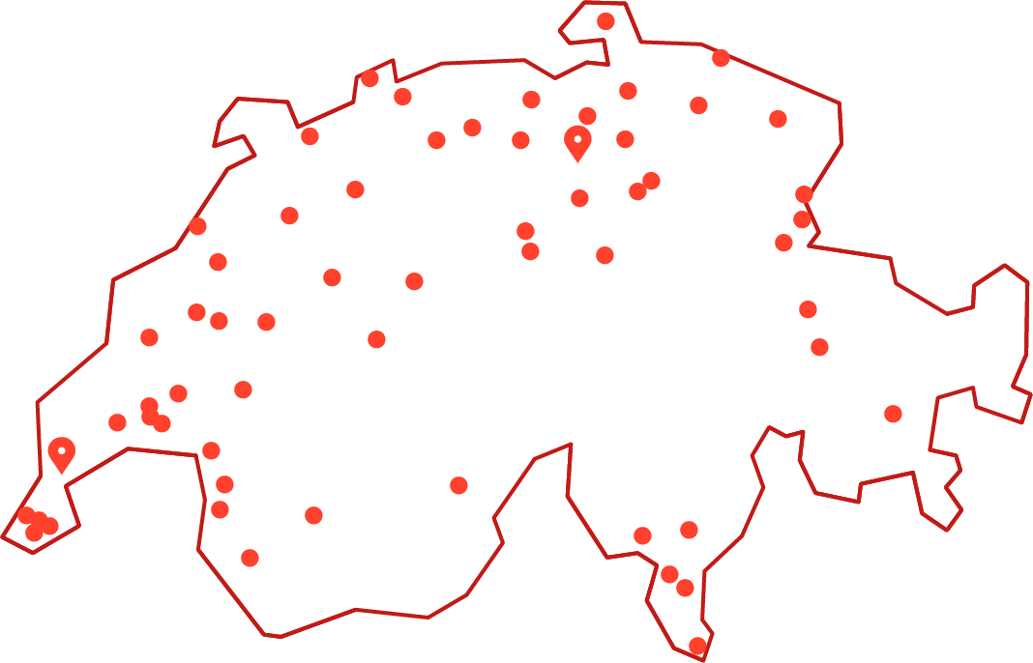
Two head offices: Nyon and Adliswil and 56 locations
Generali Switzerland
Adliswil
Nyon

Slide 12
Facts
Generali Switzerland
1´800 employees
1 million customers
CHF 2 billion in booked premiums

Slide 13
Session Aims
Generali Group / Switzerland – Facts & Figures
Where we started
What we achieved within “ALBIS”
SpiraTeam – setup, structure and reporting
SpiraTeam – interfaces
SpiraTeam – looking back- and forwards
Q & A

Slide 14

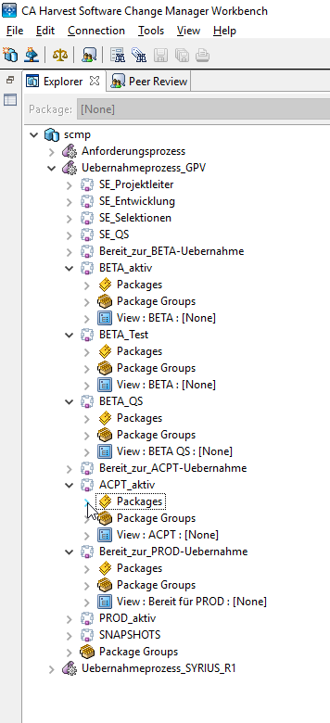
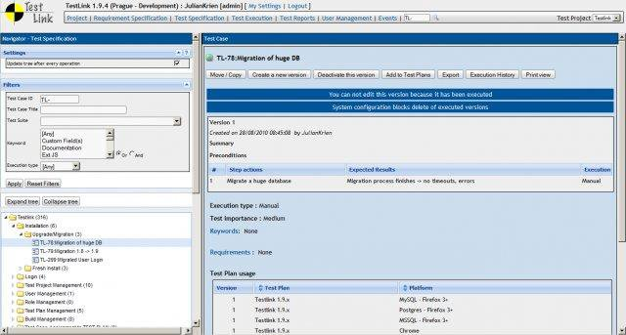


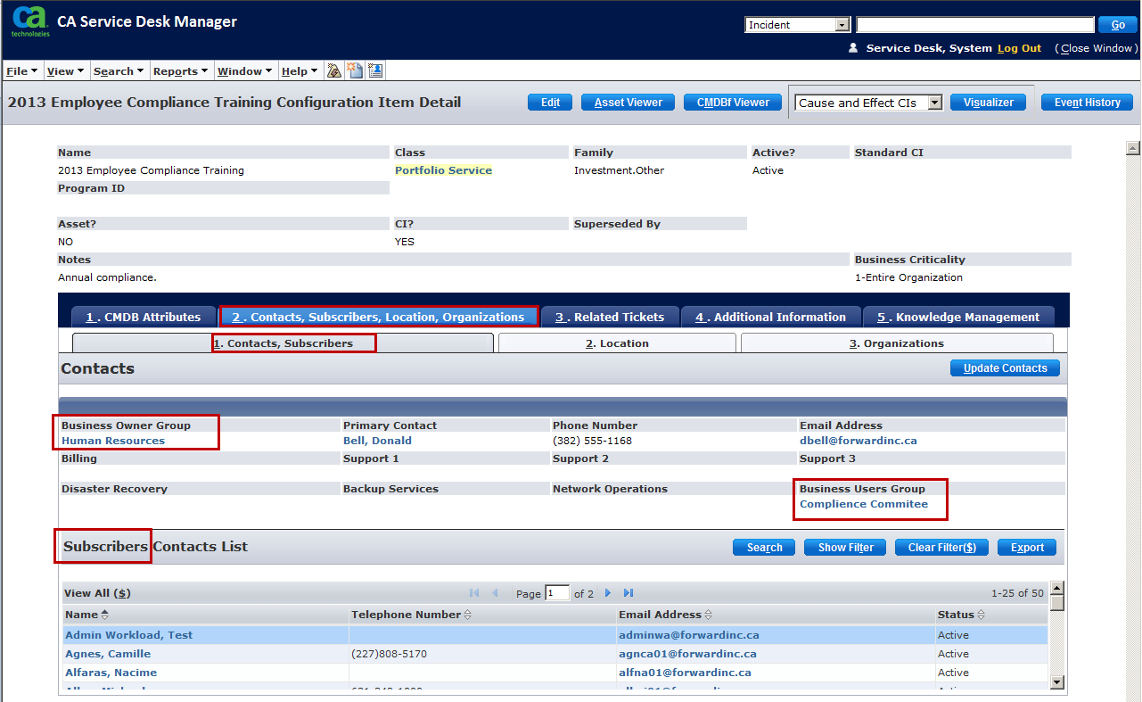

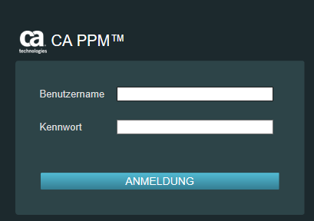


Where we started
In our ancient years
we documented requirements and the related test cases
…. without any inner-connection between them
…. and in different tools like:

Slide 15
Session Aims
Generali Group / Switzerland – Facts & Figures
Where we started
What we achieved within “ALBIS”
SpiraTeam – setup, structure and reporting
SpiraTeam – interfaces
SpiraTeam – looking back- and forwards
Q & A

Slide 16
What we achieved
Project «ALBIS»:
Scope of the project:
Exchange of the external infrastructure vendor, this includes
Building two new fail-safe Data Center incl. all related Server ( ~2’800) and Data Bases (~2’300)
New security zone concepts (Client / Network)
Roll out of new Client infrastructure (~4’000) incl. Skype for Business
Upgrade of all client applications (~700) to be compatible with Windows 10
Migration of all core applications (~60) to the newest server version (Linux, Unix and Windows)
Migration of ~850 batches (incl. a new tool for “batch job steering”)
Migration of all Data (File - / Group - & Role shares)
Time frame: 24 months

Slide 17

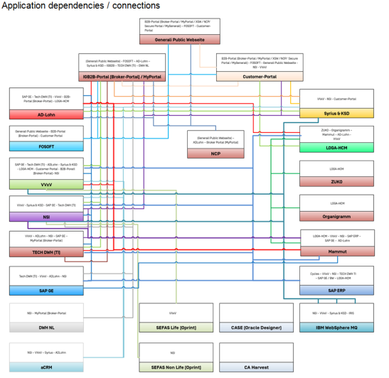
What we achieved
Test Scope and Environments in the «ALBIS» Project:
Team TCS (India offshore)
Test Stages:
Core Applications:
Quality criteria to be checked:
DEVL
Functionality
Security
Availability
Performance
Consistency
Fault Tolerance
Recoverability
Co-existence
Inter-operability
Team TCS (India onshore)
TEST
Team Nyon (CH)
ACPT
PROD
Team Adliswil (CH)
Rules: Data privacy
Not all Teams can connect to every Stage.
It’s not allowed to see Testcases for ACPT or PROD for “offshore” people

Slide 18
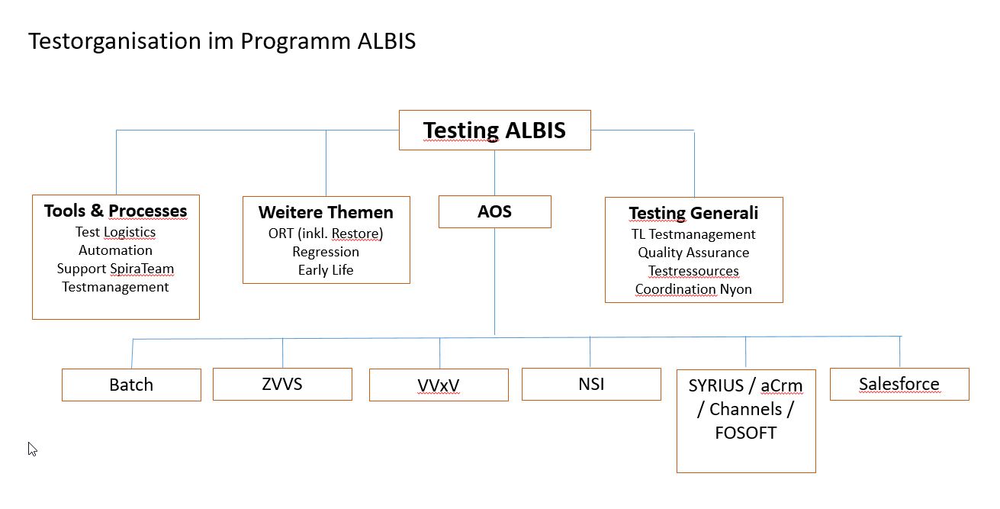
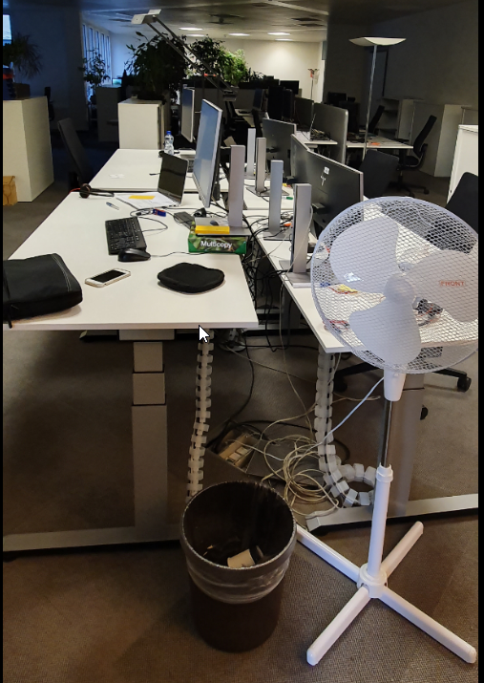
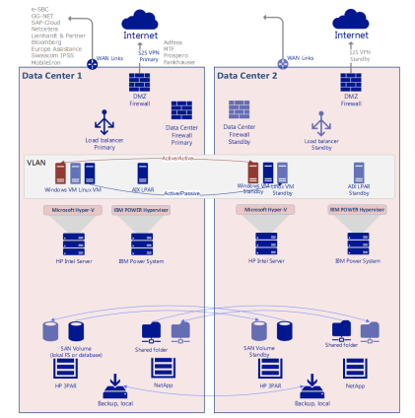

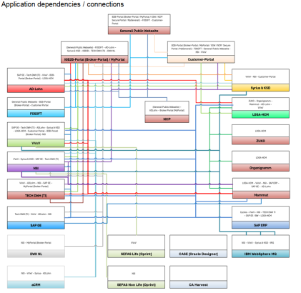
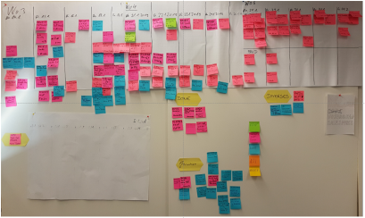
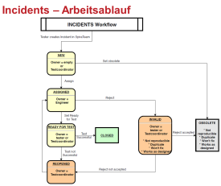



What we achieved
We had a «PLAN»:
Requirements
Service Level
Standards
Q-Criteria
People / rooms
Organization
Input
Infrastructure
Application / Test strategy
Process model
Tools
Workflow
Import / Export
Automation
Performance

Slide 19
What we achieved
Quantity aspects and involved people:
Quantity aspects:
6’622 Testcases recorded in SpiraTeam
20’000 Test runs between Feb 2018 and June 2019
Track record: 780 test runs on June 10th, 2019 – productive cutover
2’365 Incidents raised (66% of them have been solved within 2 weeks time)
330 Requirements
830 Tasks
2’002 Test sets
8 Releases (Phases / Stages)
Involved people
10 Test managers (coordinators & coaches)
14 members of testing core team
160 business testers
38 Developer
16 System Engineers

Slide 20
Session Aims
Generali Group / Switzerland – Facts & Figures
Where we started
What we achieved within “ALBIS”
SpiraTeam – setup, structure and reporting
SpiraTeam – interfaces
SpiraTeam – looking back- and forwards
Q & A

Slide 21
SpiraTeam – Setup, structure and reporting
General Risks in Test Management: :
Based on the de-centralized organisation and the parallel Test Execution on more than one stages it was absolutely crucial to get the right information at the right time without having duplicated test artefacts.
Additionally it should be easy to find already existing Testcases and to get the information about the state per Application and Environment, so we build:
1 SpiraTeam Project (ALBIS)
Per environment we used 1 Release (DEV, TEST, ACPT, PROD)
For privacy policy reasons, we used a role with “limited view” to only see incidents and additionally organisatoric facts that are owned by that role keeper (because not all Environments are masked)
We used components for every application (1 component per application)
We executed testcases in dedicated testsets per area / user
We used the .xls Importer to create the testcases external and export them to SpiraTeam
We used Requirements on a Minimum level, only 1 Requirement per Client Application; no workflow
One simple Incident Workflow
The folder structure in the testcase section based on the known Business application Level (Area)
Only 6 roles to manage people and their interests in the SpiraTeam Project

Slide 22
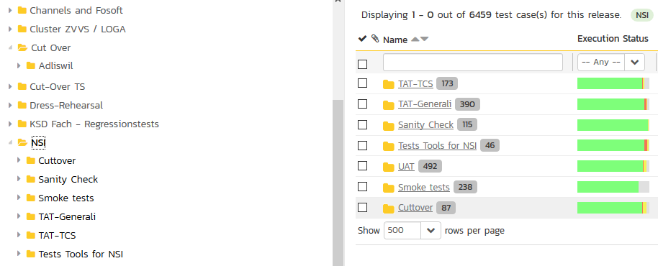

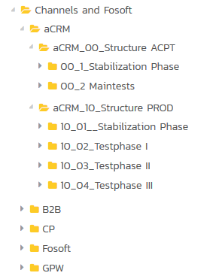
SpiraTeam – Setup, structure and reporting
Test Cases structure, application /process level:
Incident Workflow with roles:
Test Set structure, application /process level:

Slide 23
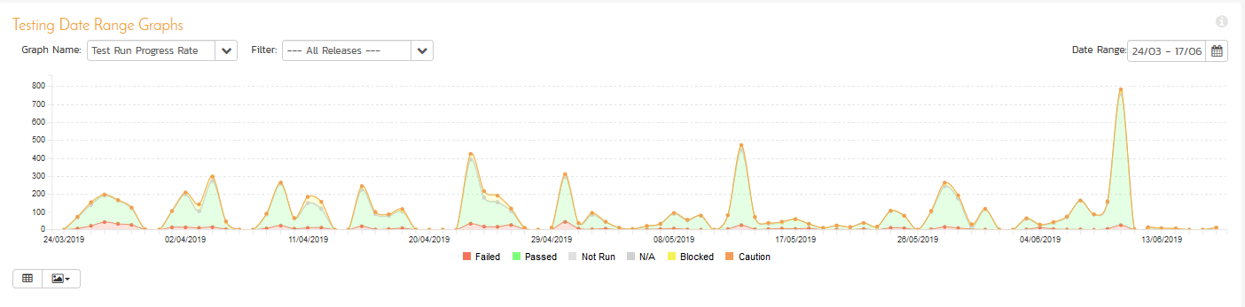
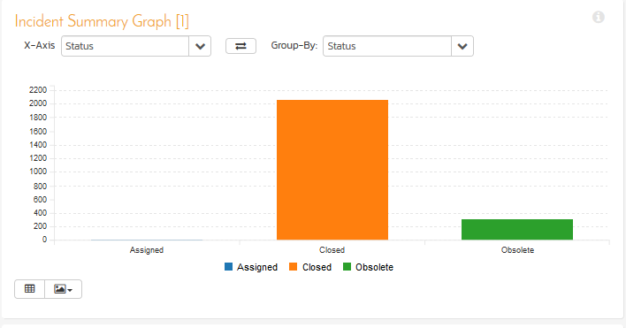
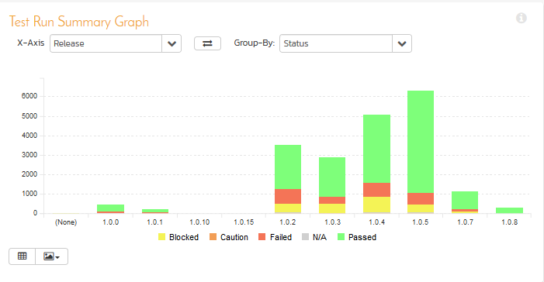
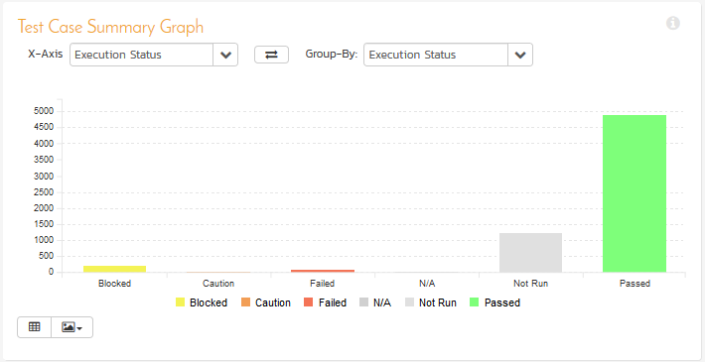
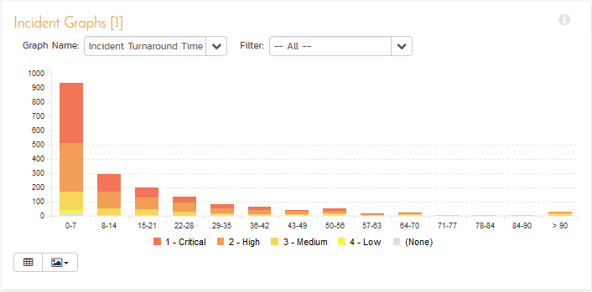
SpiraTeam – Setup, structure and reporting
How we reported the actual situation on a daily base:
For a fast overview we used the project dashboard and the widgets in the report section:

Slide 24
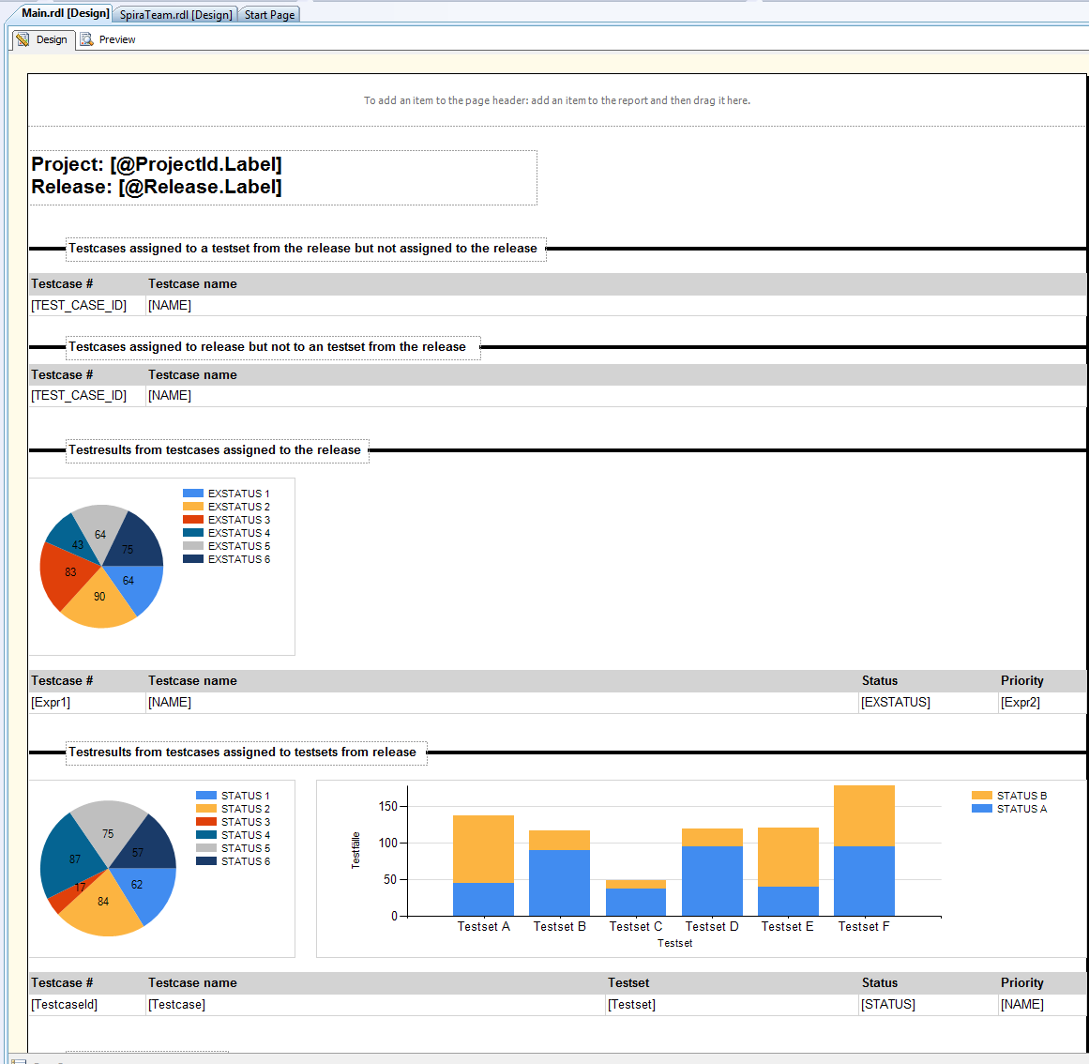
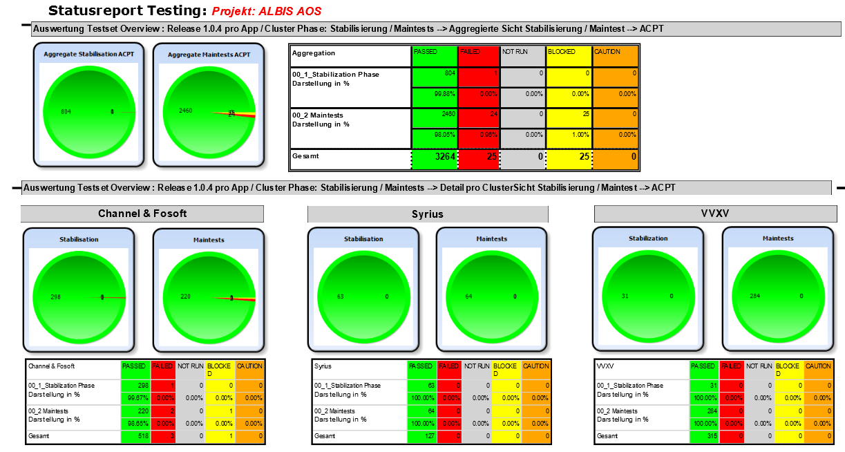
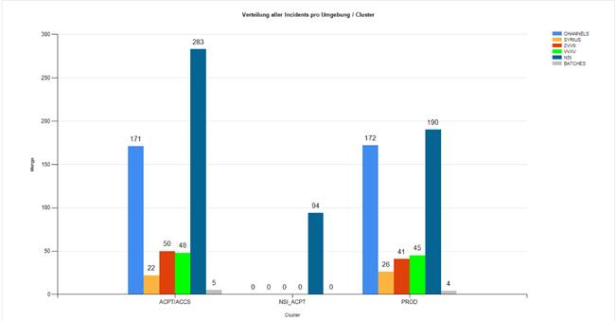
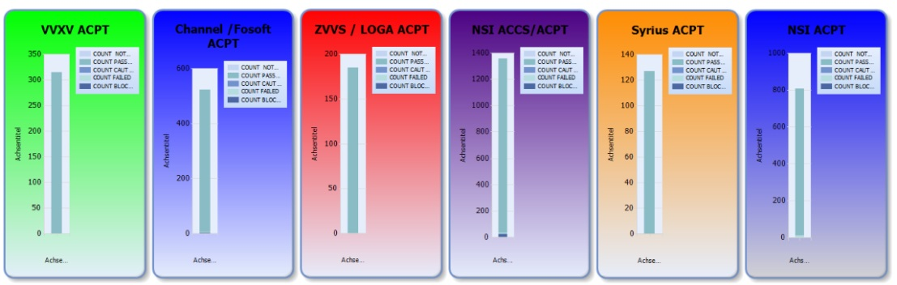
SpiraTeam – Setup, structure and reporting
How we reported the actual situation on a daily base:
For the management reports we used the SSRS (SQL Server Reporting Server) from Microsoft:

Slide 25
Session Aims
Generali Group / Switzerland – Facts & Figures
Where we started
What we achieved within “ALBIS”
SpiraTeam – setup, structure and reporting
SpiraTeam – interfaces
SpiraTeam – looking back- and forwards
Q & A

Slide 26
SpiraTeam – Interfaces
During ALBIS we integrated the following interfaces:
Integration into Jira
  For Issue Synchronisation between Generali and the new external infrastructure Vendor
Integration into Ranorex Testautomation
  For being able to conduct our existing regression test sets
Build an internal Integration into the CA Ticketing Tool (via SpiraTeam API)
Used import / export via .xls- and .doc-Addon
  To make life easier for the business while creating their test cases
Started to use the Testlink Integration for migration of the testcase collection to SpiraTeam

Slide 27

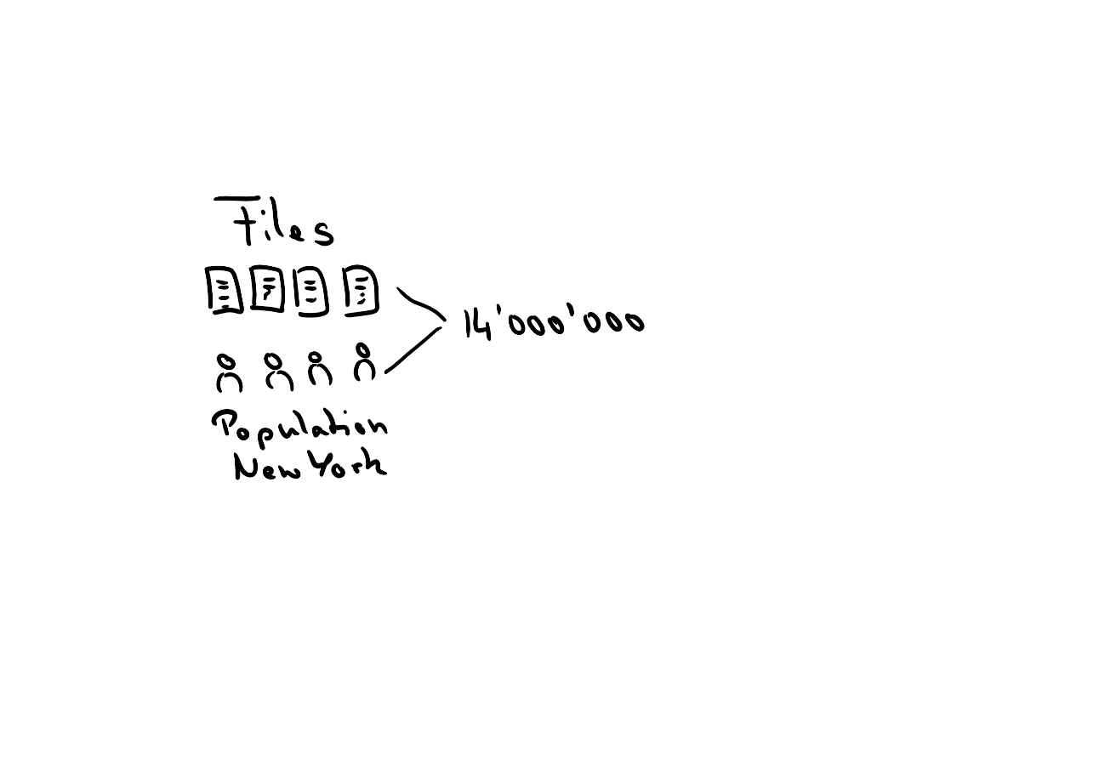
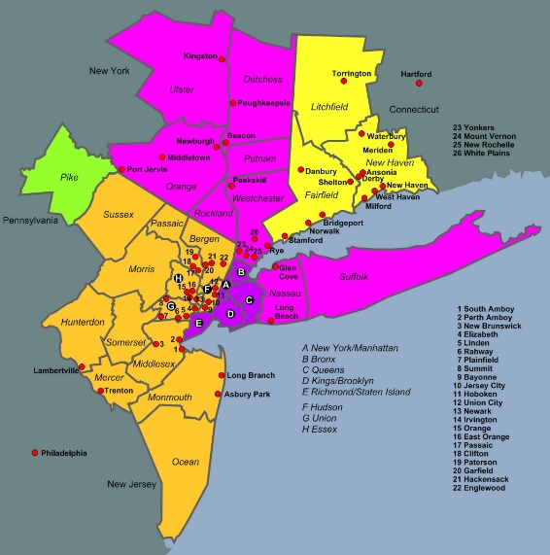
ALBIS – Yes. We made it!
How much data did we migrate?
580 Terabytes of data
  That equals 580’000 GB
  If we burn all this data onto CDs and stack them to a tower
This tower would have become 70 meters higher than the Mount Everst
How many files did we move?
A total of 30 Terabytes of data we moved to the new provider
  That corresponds to 14 million files
  That means around 1 file per inhabitant of the New York Metropolitan Area

Slide 28
Session Aims
Generali Group / Switzerland – Facts & Figures
Where we started
What we achieved within “ALBIS”
SpiraTeam – setup and structure
SpiraTeam – interfaces
SpiraTeam – looking back- and forwards
Q & A

Slide 29

SpiraTeam – looking back- and forwards
16.08.2015 – 16.08.2019

Slide 30
SpiraTeam – looking backwards
Today in SpiraTeam we
are Managing more than 65 (maintenance) projects for our Core applications
have more than 570 named users
200 concurrent users licenced
We are using intensively the following features of SpiraTeam:
Test Management - Release Management
Defect Tracking - Custom Reports
Automated Testing - …
And we started using:
Requirements Management for our IFRS 9/17 project

Slide 31
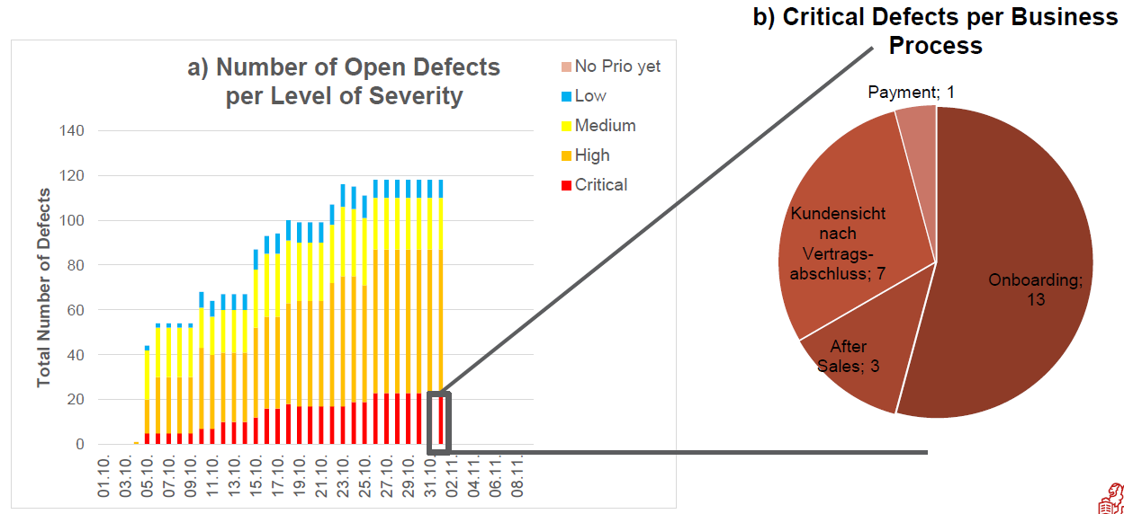
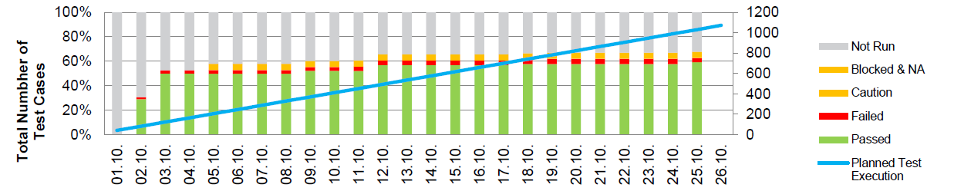
SpiraTeam – looking forwards
To fulfill our privacy and security policy we need more features to limit the access to SpiraTeam Artefacts
It should possible to limit the Field «Components» to a «single selection»
Some translation enhancements in the .xls Importer for «french character set» are needed
Enhancements in the reporting area
  E.g. daily progress in the test execution area – Plan vs. Actual
  Severity of open defects & focus on critical defects

Slide 32
SpiraTeam – looking forwards
We plan to
integrate our SpiraTeam to the existing LDAP for a better and easier user-management
show up the advantages of SpiraTeam to the business to enable the business requirement engineers to use the tool
enhance the usage of the custom reports section to fulfill more «reporting» needs
create a Generali User Guide «How to use SpiraTeam Internal»
use SpiraTeam in programs like IFRS 9/17 to cover the overall traceability
  (Reqiurements – Tests – Incidents – User Aceptance)

Slide 33

Any questions??
If not – thank you very much for your attention!

Slide 34
Inflectra Schweiz
c/o Zaar Teach-IT
St. Gallerstrasse 40
CH 8853 Lachen
markus.zaar@inflectra.com
Generali Switzerland
Andreas Eckerle
Head of Test- & Quality Management
andreas.eckerle@generali.com

