Slide 1

Testing 2
Advanced Test Management
@Inflectra | #InflectraCon

Slide 2
Remco Putker
Owner, Robust-IT
Program Manager, EY
@RPutker

Slide 3
Session Aims
Advanced test management techniques
Manage requirements and release test case coverage
Explore exploratory testing
Test sets with different owners for E2E testing

Slide 4
But first…
A short introduction

Slide 5
The Netherlands?

Slide 6
The Netherlands!

Slide 7
Curriculum

Slide 8



Curriculum in a timeline
CMG
EclipseIT
Parnassia
Catalyst Interactive Europe
Center Parcs
Facilicom
PostNL
Ernst & Young
Robust-IT
1999
now
Consultant
Entrepreneur
Manager
Entrepreneur
www.robust-it.org | r.putker@robust-it.org | +31 6 24 50 41 82

Slide 9
And…
Why am I here?

Slide 10
Why am I here?
I 🧡 SpiraTest / SpiraTeam / SpiraPlan

Slide 11
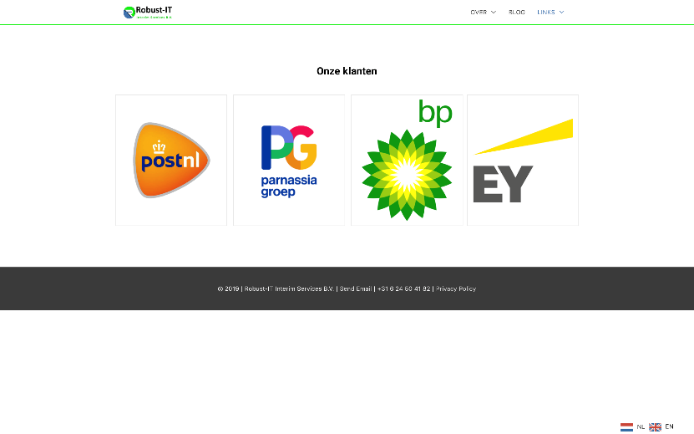
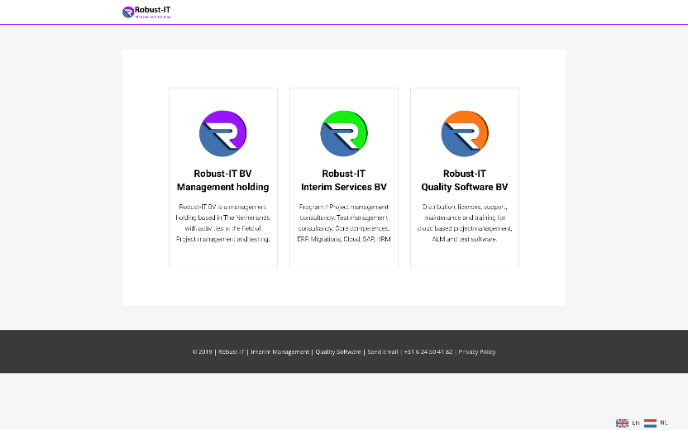
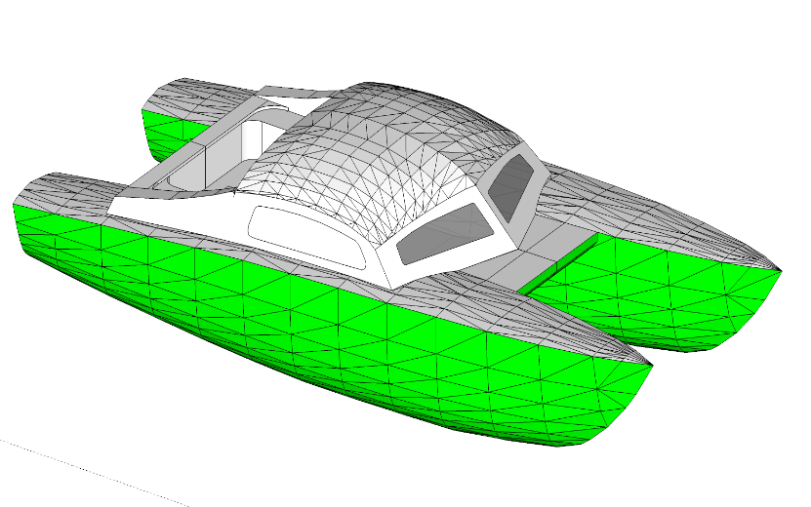


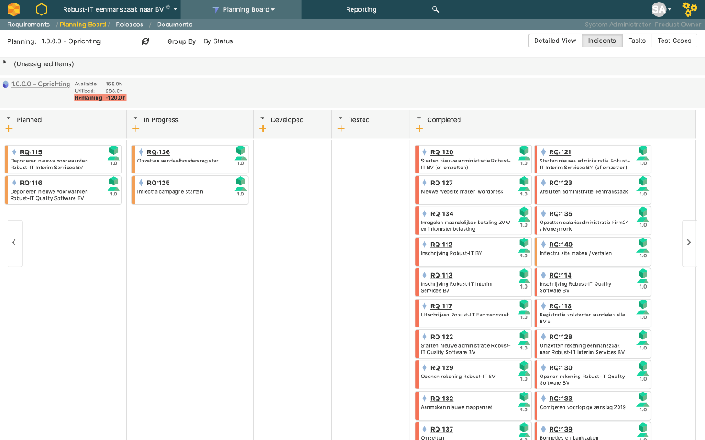
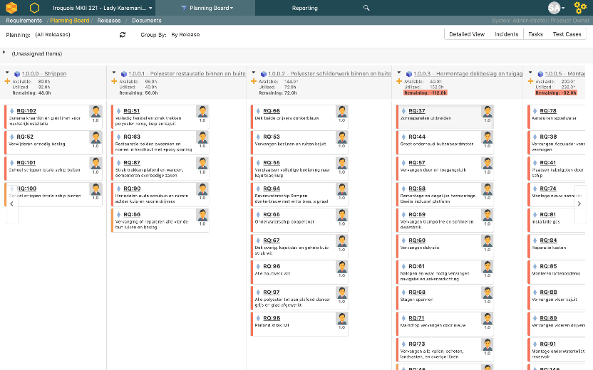
In 🧡 with an ALM tool 🤔?
Even (re)building a boat for my family using Spira as a scrumboard
I Used Spira for All projects for all customers since 2014
Created a Spira backlog for creating my own holding and legal entities

Slide 12
Why am I here?
I 🧡 SpiraTest / SpiraTeam / SpiraPlan
15 projects / 4 multinational organizations / waterfall to scrum and back

Slide 13
Spira fits all → context
USP
SaaS
Platform and tool independent
Always traceable, always consistent
Integrated ALM solution
Fully adaptable
Value for money
Backwards compatible
Projects
Infrastructural projects
Implementations
IaaS and SaaS migrations
Mergers
Immense volumes of artifacts and users
Running projects and regular business
Non-IT projects

Slide 14
Spira fits all → Methodology
Waterfall
RAD
RUP
SCRUM
Agile
DEVOPS
OOA/OOD
TDD
Etc…

Slide 15
Why am I here?
I 🧡 SpiraTest / SpiraTeam / SpiraPlan
15 projects / 4 multinational organizations / waterfall to scrum and back
Certified solution provider for Inflectra BeNeLux

Slide 16
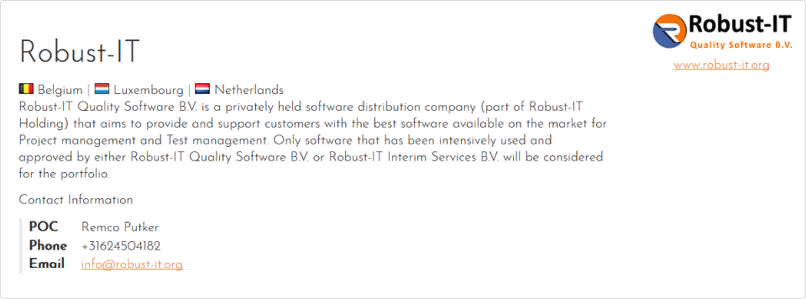

Robust-IT and Inflectra

Slide 17
Advanced test management techniques

Slide 18
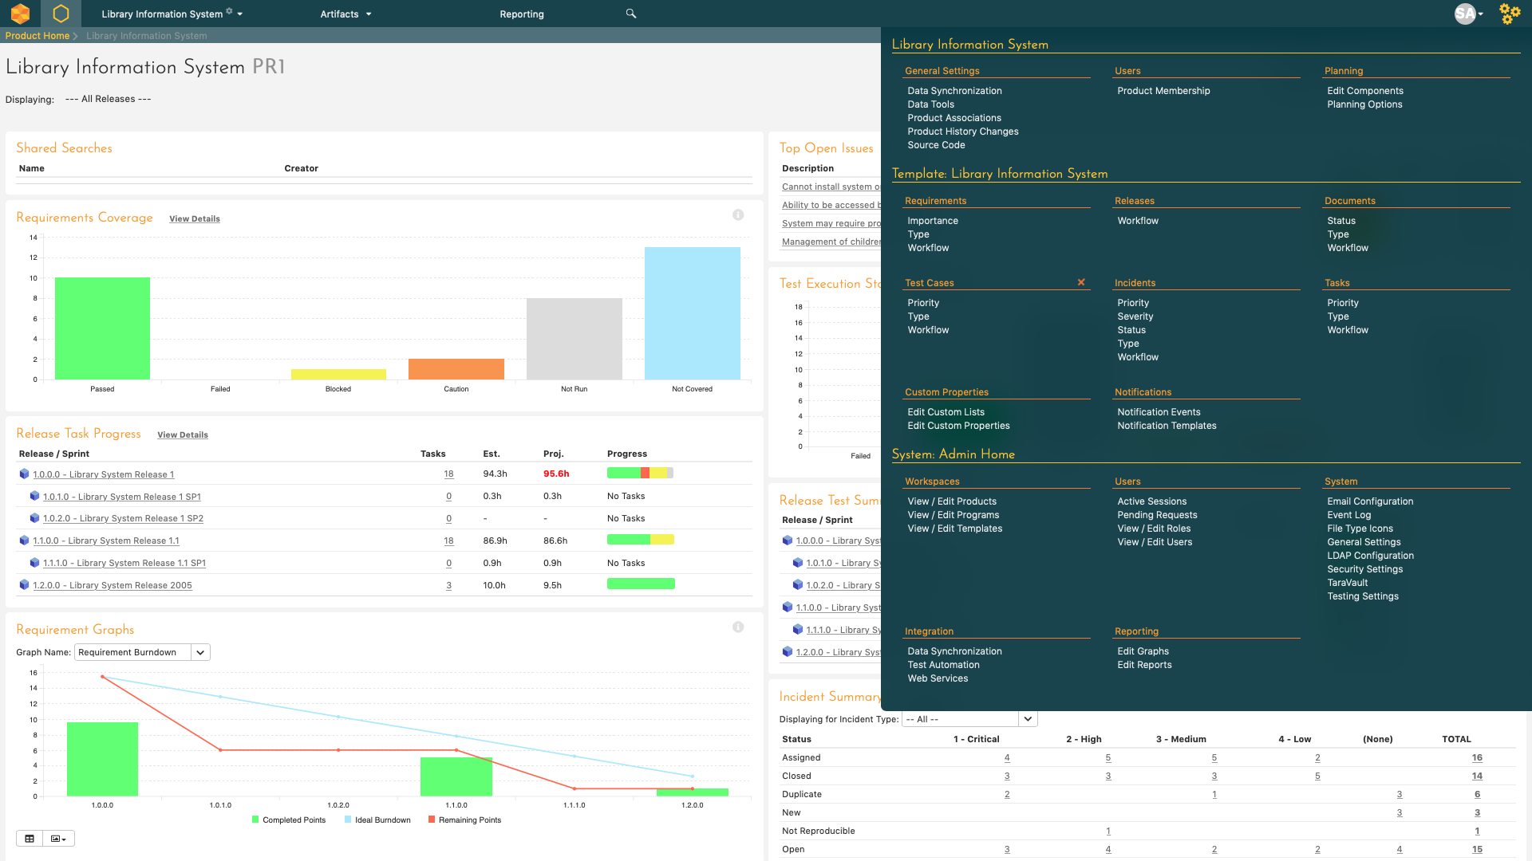
Start with configuration

Slide 19
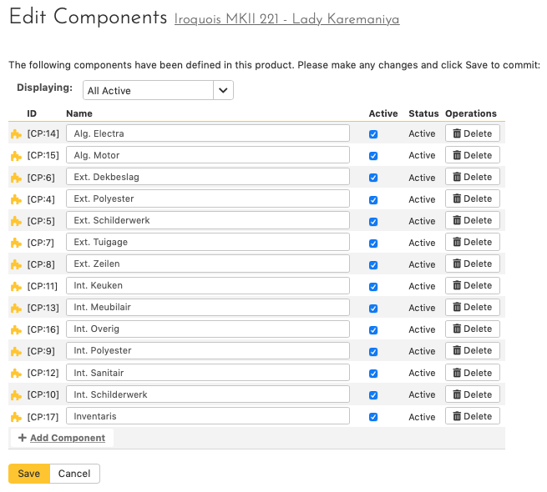
Configuration
Components

Slide 20
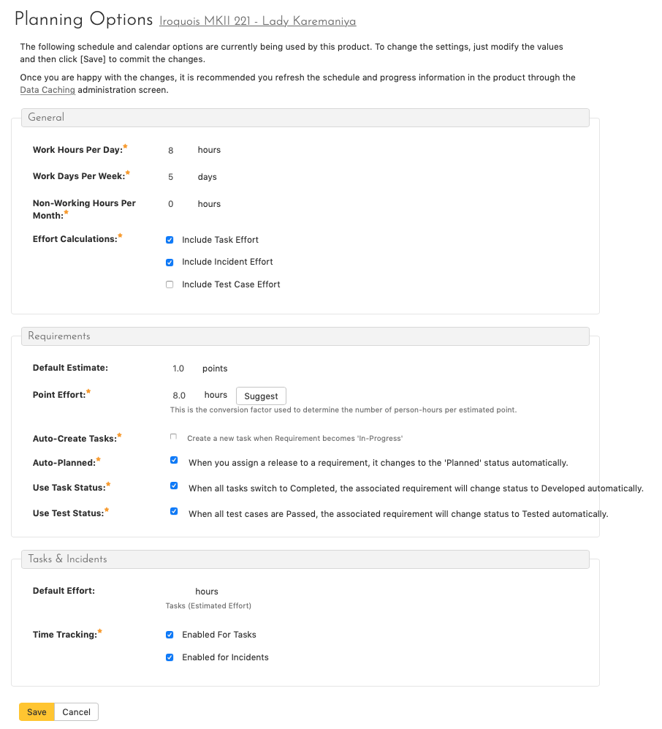
Configuration
Components
Planning options

Slide 21
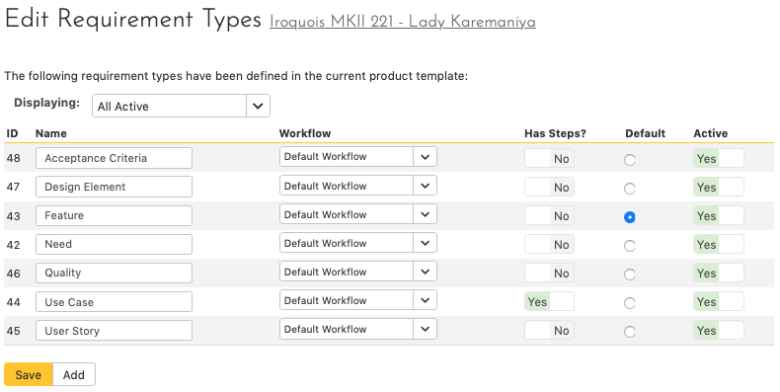
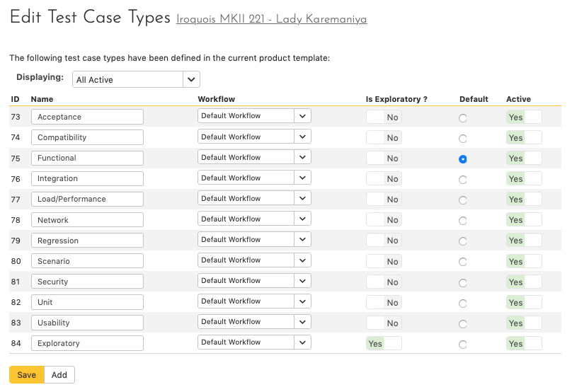
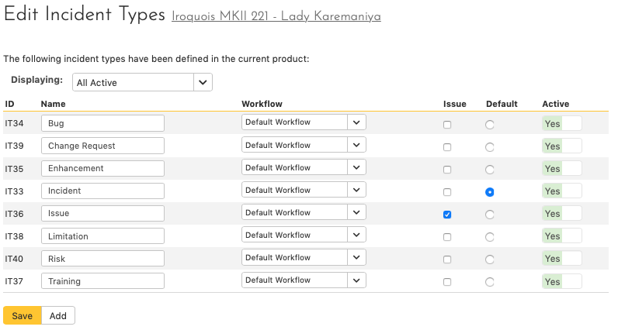
Configuration
Components
Planning options
Artifact type

Slide 22
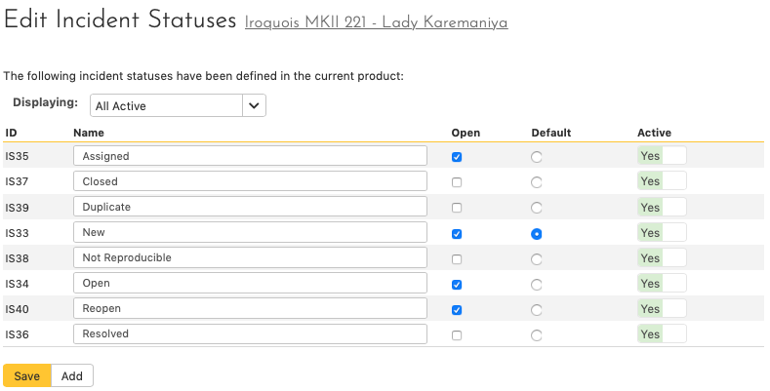
Configuration
Components
Planning options
Artifact type
Incident status

Slide 23
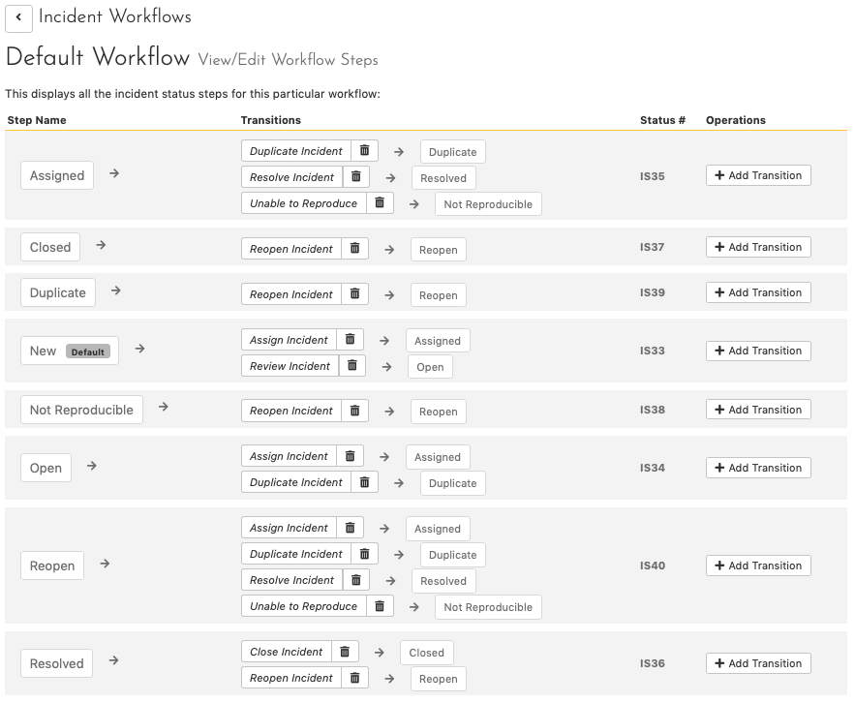
Configuration
Components
Planning options
Artifact type
Incident status
Incident workflow
Start status
Transitions
End status

Slide 24
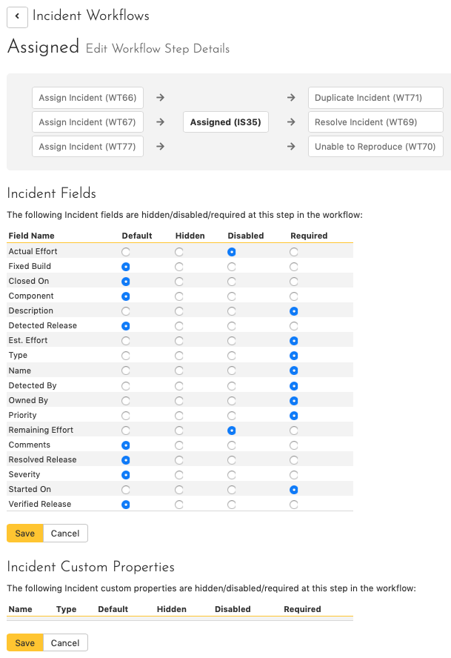
Configuration
Components
Planning options
Artifact type
Incident status
Incident workflow status
Field properties

Slide 25
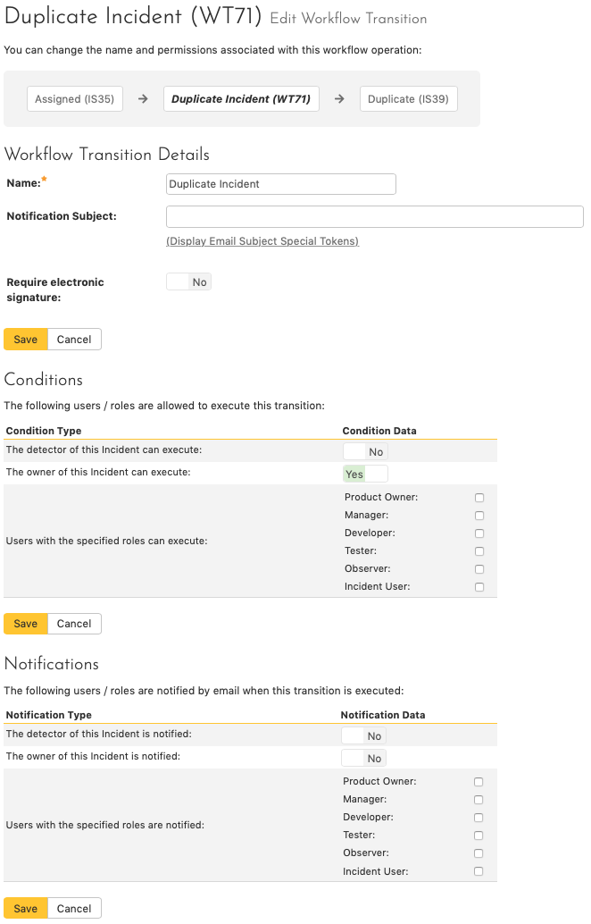
Configuration
Custom notification
Components
Planning options
Artifact type
Incident status
Incident workflow transitions
Who can execute?
Who is notified?

Slide 26
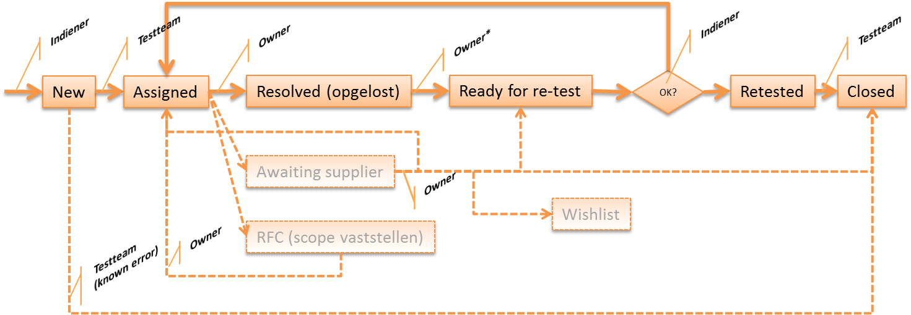
Configuration
Components
Planning options
Artifact type
Incident status
Incident workflow example

Slide 27
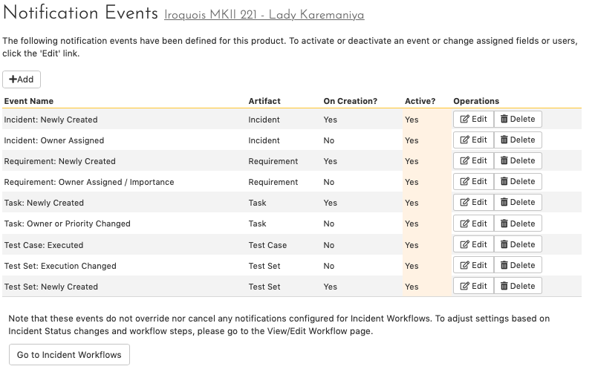
Configuration
Components
Planning options
Artifact type
Incident status
Incident workflow
High level notification settings

Slide 28
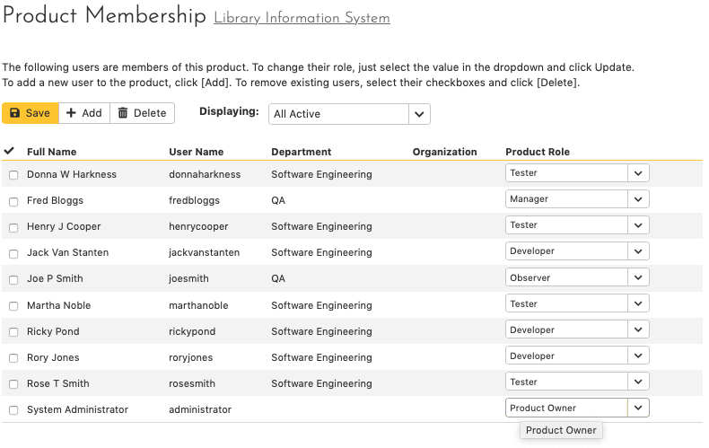
Configuration
Components
Planning options
Artifact type
Incident status
Incident workflow
High level notification settings
Setup the team

Slide 29
Manage requirements and release test case coverage

Slide 30
Manage requirements
Classic list view
Plan board

Slide 31
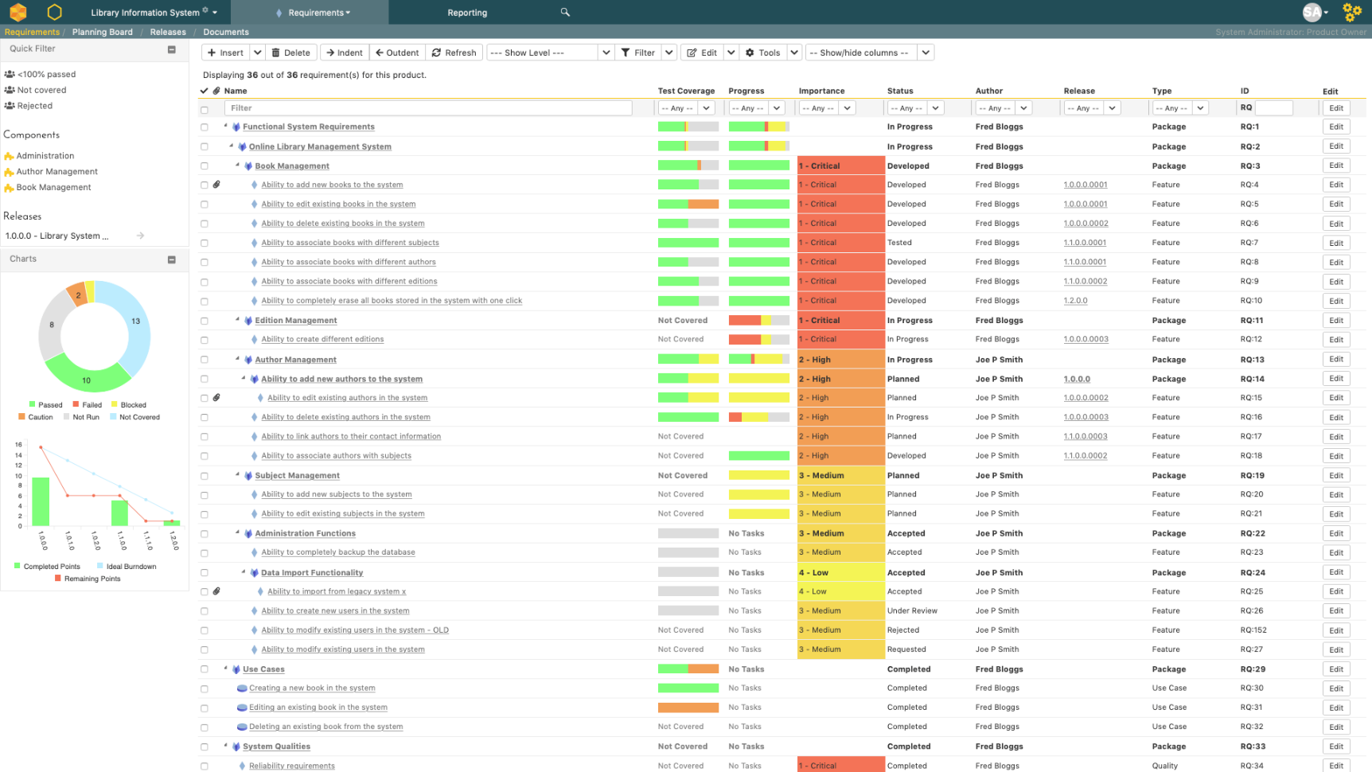
Classic list view
Structured in groups

Slide 32
Classic list view
Structured in groups
Test coverage

Slide 33
Classic list view
Structured in groups
Test coverage
Task progress

Slide 34
Classic list view
Structured in groups
Test coverage
Task progress
Importance and other relevant fields

Slide 35
Classic list view
Structured in groups
Test coverage
Task progress
Importance and other relevant fields
Saved filters

Slide 36
Classic list view
Structured in groups
Test coverage
Task progress
Importance and other relevant fields
Saved filters
Aggregation by component / release

Slide 37
Classic list view
Structured in groups
Test coverage
Task progress
Importance and other relevant fields
Saved filters
Aggregation by component / release
Graphs and burndown charts

Slide 38
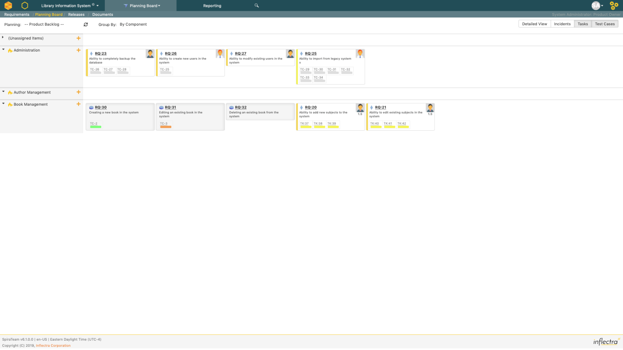
Plan board Backlog
Product break down by component

Slide 39
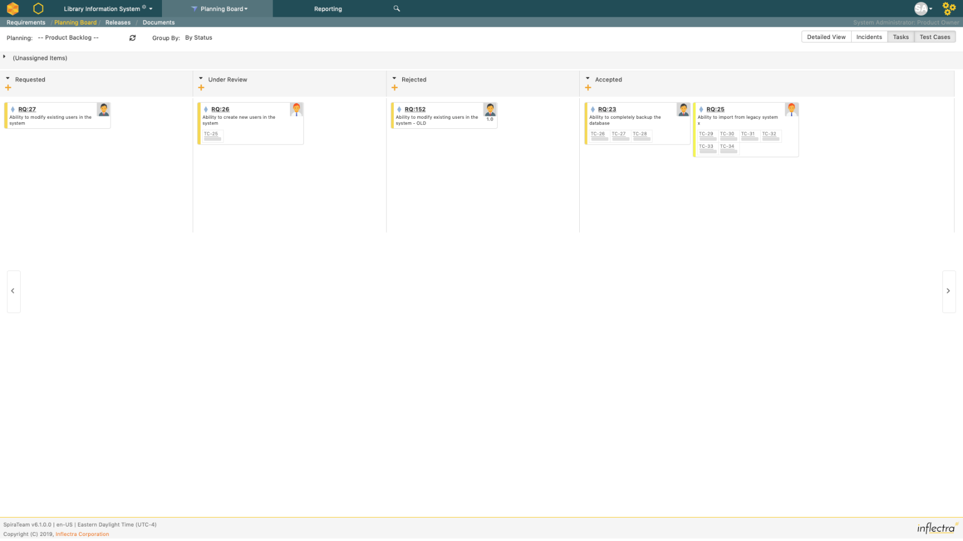
Plan board Backlog
Product break down by component
Requirement refinement in backlog

Slide 40
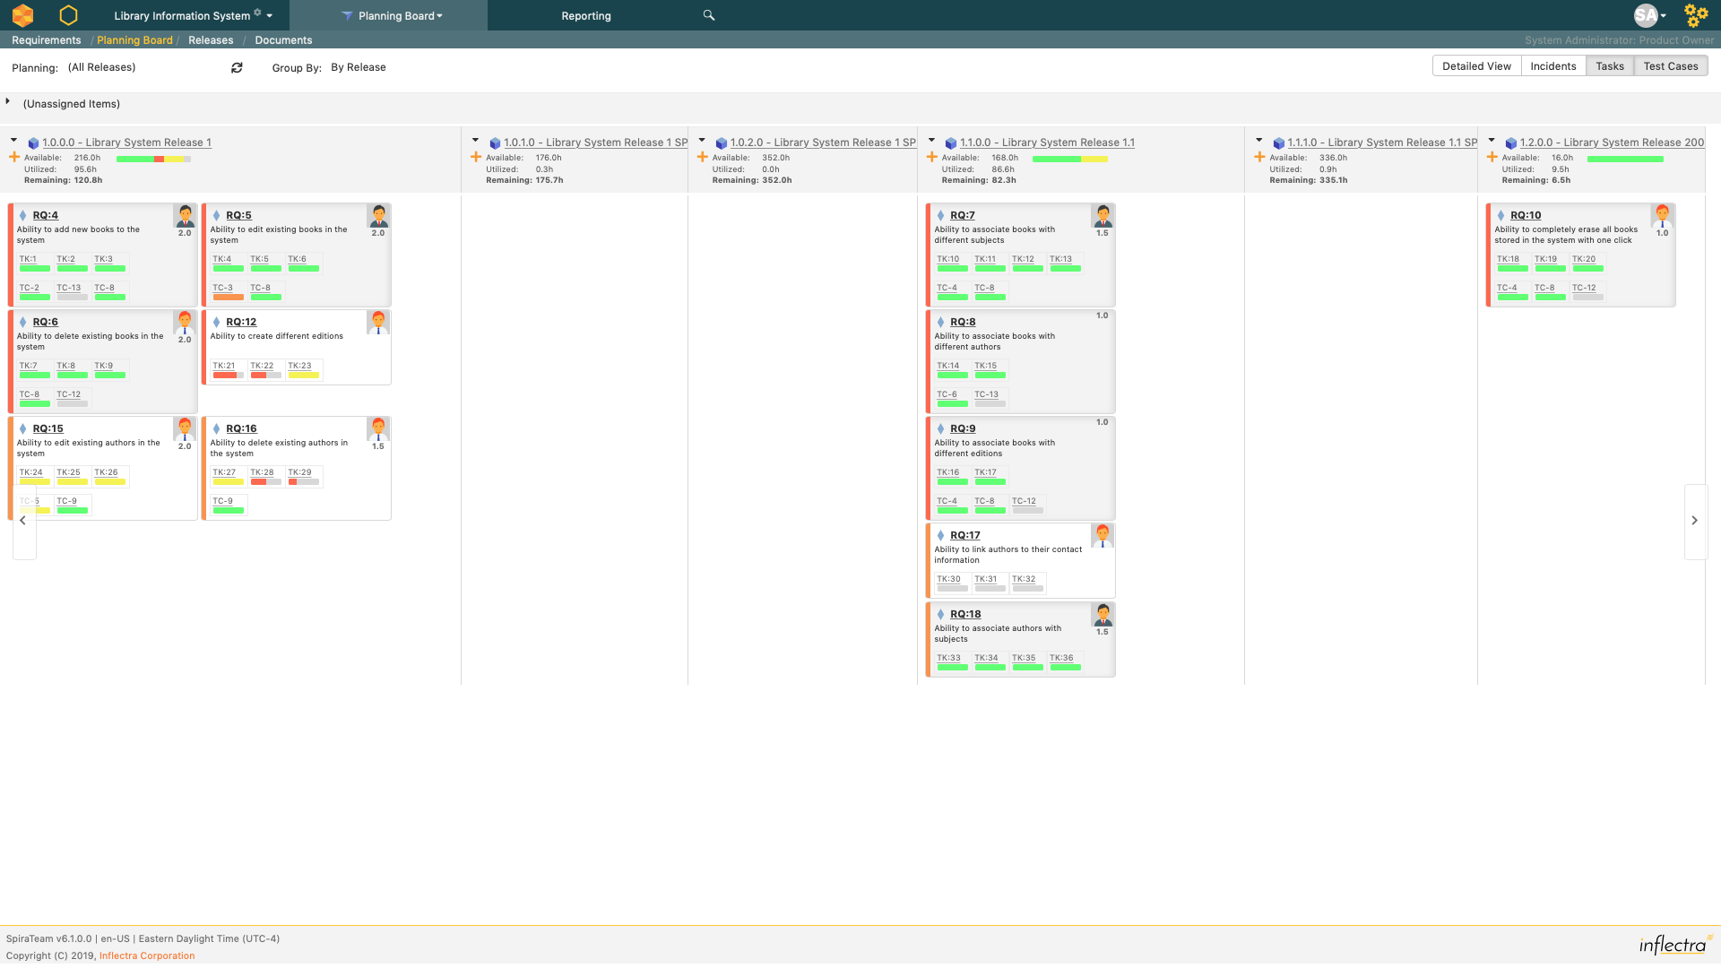
Plan board Backlog
Product break down by component
Requirement refinement in backlog
Release / sprint planning

Slide 41
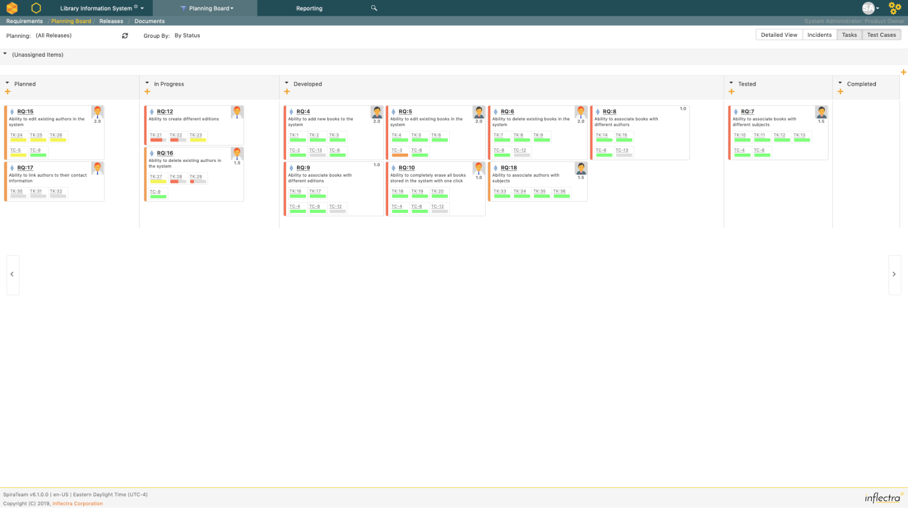
Plan board Backlog
Product break down by component
Requirement refinement in backlog
Release / sprint planning
Kanban board for realisation

Slide 42
Plan board Backlog
Product break down by component
Requirement refinement in backlog
Release / sprint planning
Kanban board for realisation
Highlights
Waterfall and agile compatible
Drag and drop
All information at a glance
  Owner
  Description
  Priority
  Test cases and status
  Tasks and status

Slide 43
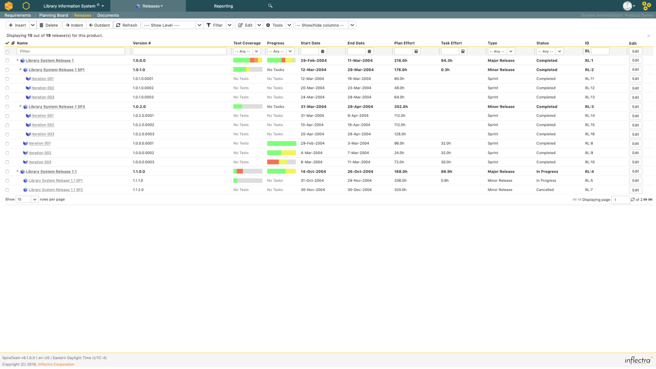
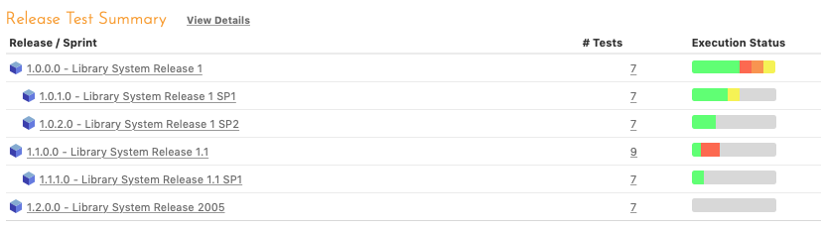
Release test case coverage
Assign testcases to releases
  Populate through the release
  Select the release in the test case
  Add in bulk from the test case list
Execute the test case for a specific release
Coverage and result will be visible at release level in release menu and dashboard

Slide 44
Explore exploratory testing

Slide 45
Exploratory testing in Spira
Available since v5.3 Q3’17 but very well ‘hidden’
Test type defines test execution mode
  Regular → test run created and modified, based on static test case
  Exploratory → test run created and modified, test case optional modified
Both test case and test run editable during test execution
Switching between modes possible
Possibility to create both tasks and incidents during test execution

Slide 46
It all starts…
…with the type
But more types can be configured as well
Default there is one specific testcase available
More types can be configured as exploratory test case types
Default test type for exploratory testing

Slide 47
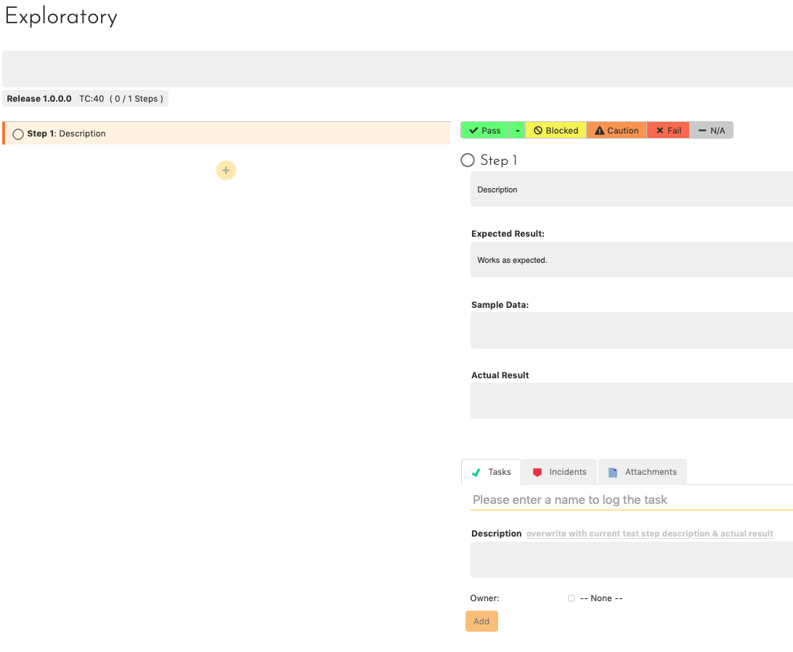
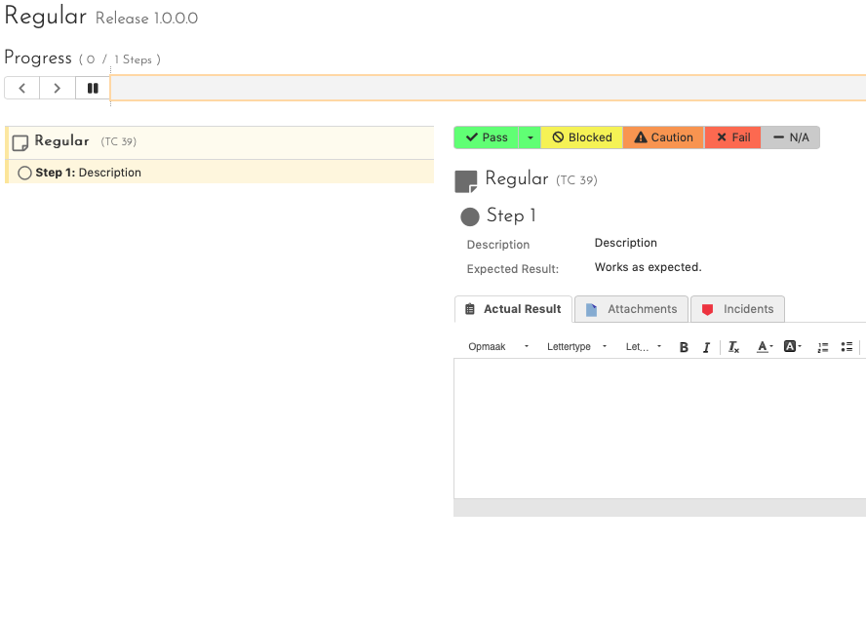
What’s the difference
Status bar
Add test steps
Full test case editable
Actual result
Tasks added

Slide 48
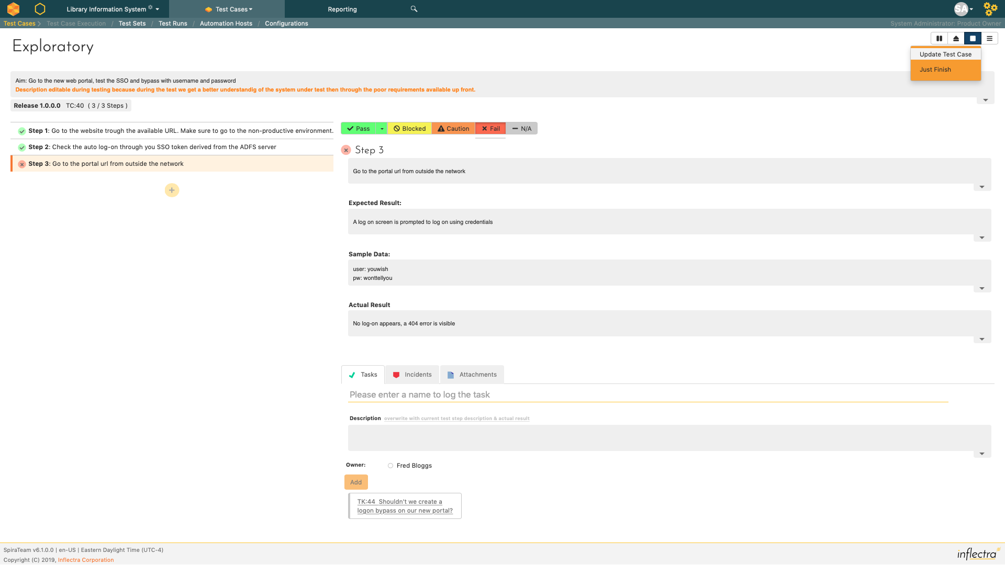
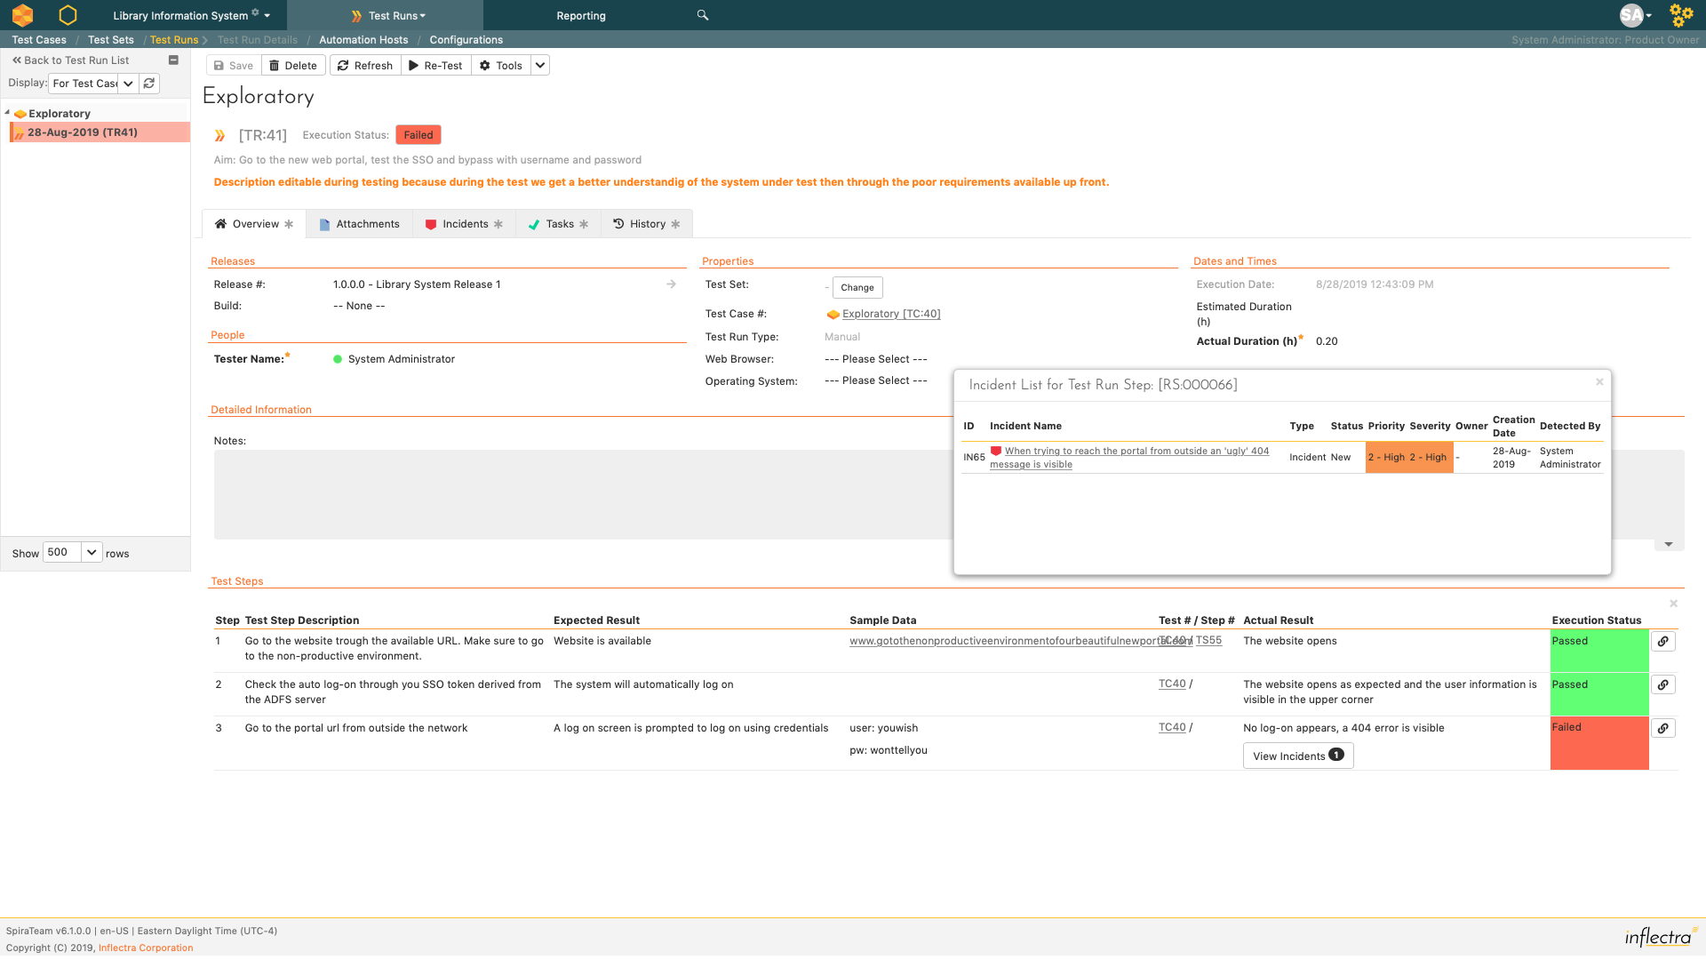
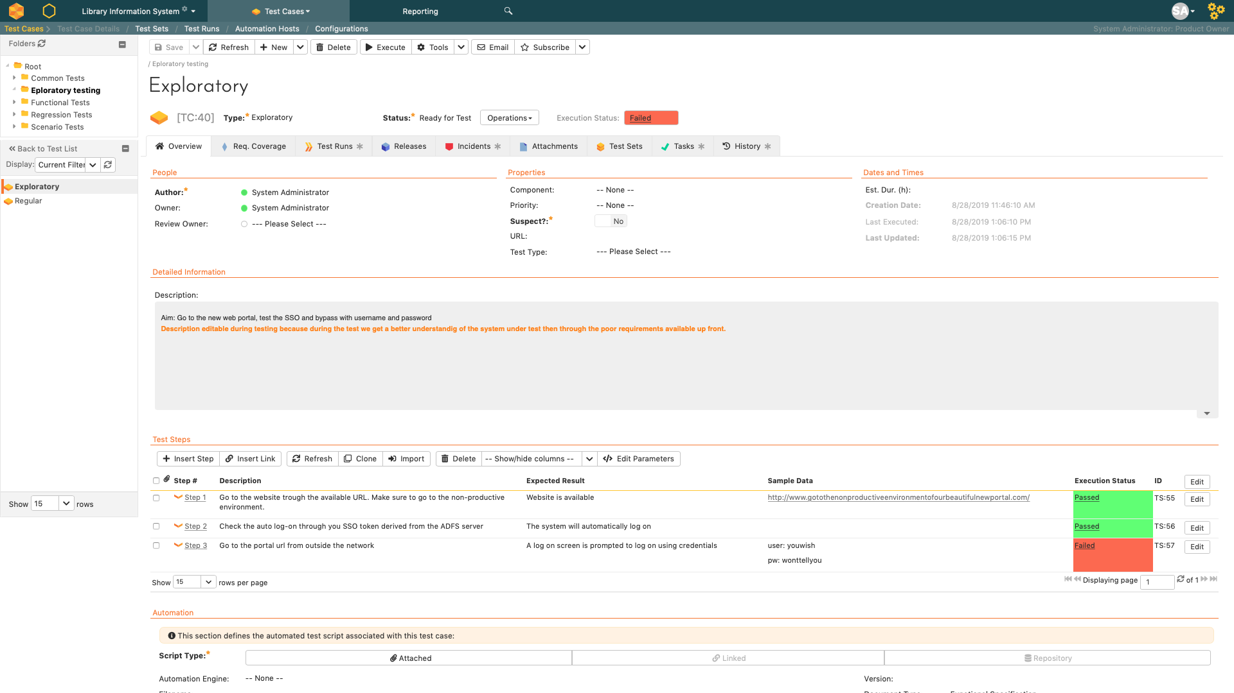
An example…
Task
Incident
Description changed during test
Incident
Task
Incident
Update testcase
Test run
3 steps added
Incident created
TC Changes
Task created
Last results
Result
TC Changes
Incident

Slide 49
Test sets with different owners for E2E testing

Slide 50
Test sets… why?
Assign one or more test cases to multiple owners
Sequentially execute multiple test cases at once
Create a set of test cases e.g. for regression testing

Slide 51
Test sets… I don’t use it very often
At test case level only the last result is visible, this can ’blur’ reality
Also true for requirements and releases
Adding a test set to a release won’t plan the test cases for the release

Slide 52
Test sets… when I needed them?
SAP BPC cloud implementation at PostNL
Multiple stakeholders spread over four countries
Same products to be accepted by all
Limited Spira knowledge with stakeholders, one test set execution per stakeholder with direct link and instruction was enough

Slide 53
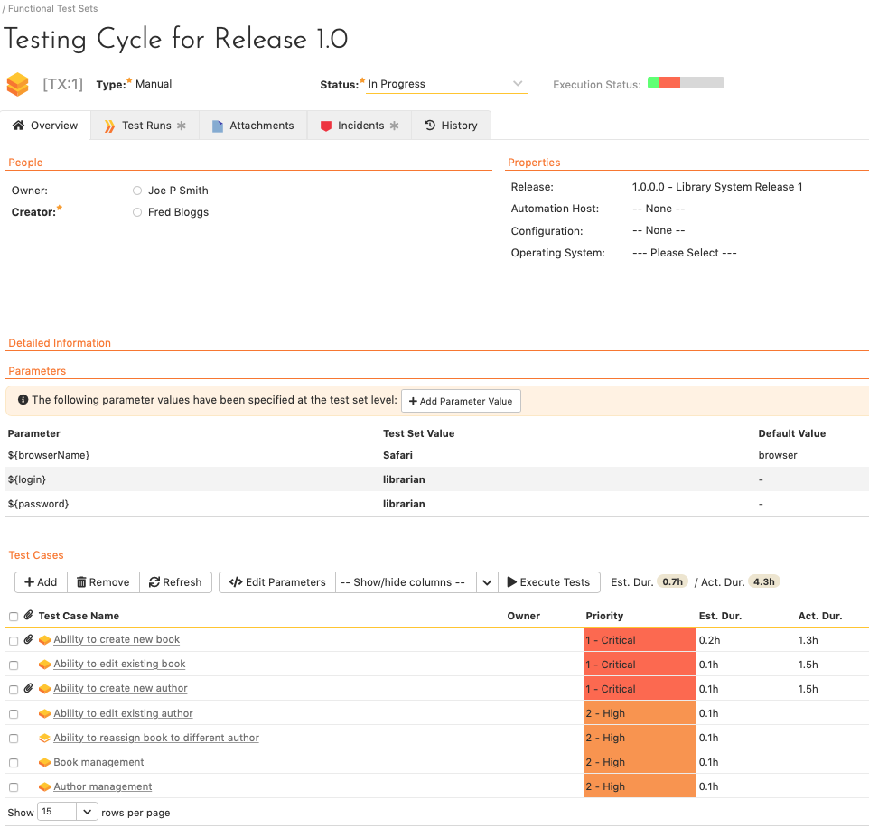
Short overview
One test set
To run at once
One owner
Multiple test cases

Slide 54
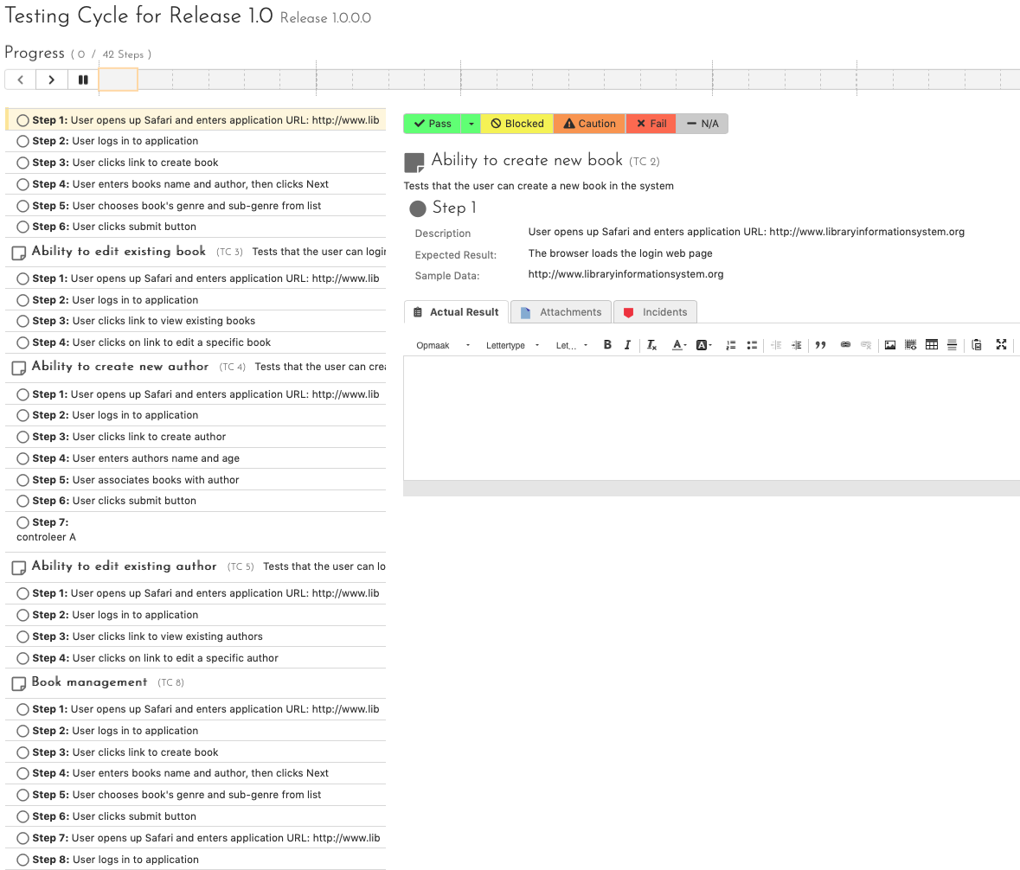
Short overview
One status bar
All steps sequential
Grouped by test case

Slide 55
Wrap-up
With 20 years of experience Spira is the best ALM tool I’ve used
A little configuration is necessary and Spira allows you to do so
Spira does support all methodologies from waterfall to scrum
Out of the box the requirements management functionality is sublime
Adding exploratory testing to the toolkit is a great improvement
Test sets can be essential and valuable within their limitations

