Slide 1

Spira Concepts
How We Designed Spira To Be Used
(aka Spira 101)
@Inflectra | #InflectraCon

Slide 2

Adam Sandman
Director, Inflectra
Programmer from the age of 10
Working in the IT industry for over 20 years
Adam lives in Washington, DC, USA
@adammarksandman

Slide 3
Adam Sandman
Adam Sandman was a programmer from the age of 10 and has been working in the IT industry for the past 20 years.
Currently Adam is Director at Inflectra Corporation, where he is interested in technology, business and innovation.
Adam lives in Washington, DC, USA
@adammarksandman

Slide 4
Session Objectives
We will walk through the overall workflow for using Spira: creating products and programs, setting up a product with artifacts and customizations.
The product configuration will cover the full application lifecycle, including requirements, test cases, tasks, releases, sprints, risks, and incidents.

Slide 5
The Inflectra® Product Suite
KronoDesk®
IT Support & Help Desk Ticketing
SpiraPlan®
Agile Program & Portfolio Management
SpiraTeam®
Application Lifecycle Management (ALM)
SpiraTest®
Requirements, Test Management
& Bug Tracking
TaraVault® - Source Code Management
Rapise®
Test Automation (Web, GUI, Services)

Slide 6
The Spira™ Platform
KronoDesk®
IT Support & Help Desk Ticketing
SpiraPlan®
Agile Program & Portfolio Management
SpiraTeam®
Application Lifecycle Management (ALM)
SpiraTest®
Requirements, Test Management
& Bug Tracking
TaraVault® - Source Code Management
Rapise®
Test Automation (Web, GUI, Services)

Slide 7
Philosophy of Spira

Slide 8


Productivity from Day One
Less Time Doing:
More Time Doing:
No plugins, customization or configuration needed day one

Slide 9

If all you have is an ‘issue’ tracker…
Then everything is an issue…

Slide 10
Some Design Decisions
Unique artifacts (requirement, test case)
Default workflows and standard fields
Orchestration and workflow between artifacts (vs. customizability)

Slide 11
1. Getting Started

Slide 12
Approach to using Spira
Create Product
Add Users to Product (Membership)
Follow Product Workflow:
Requirements Planning
Test Planning
Sprint Planning
Schedule & Resourcing
Tracking & Execution

Slide 13
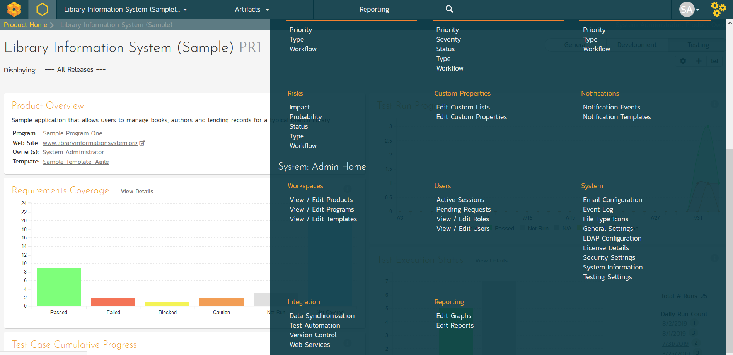
Administration Menu

Slide 14
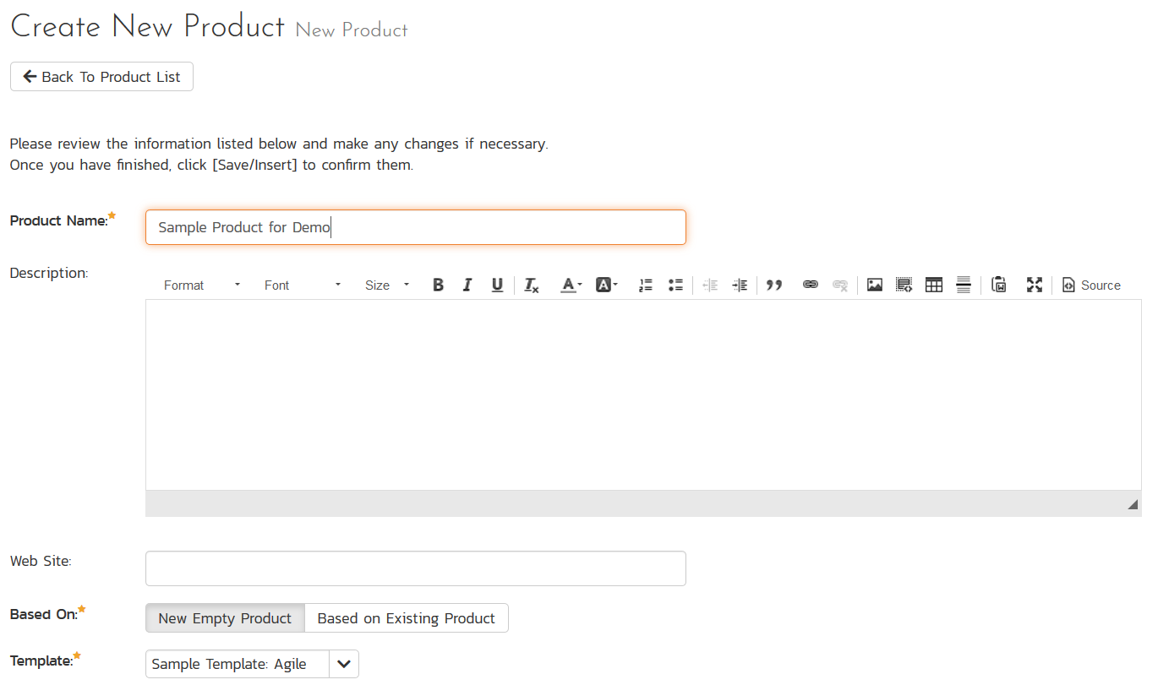
Administration – Add Product

Slide 15
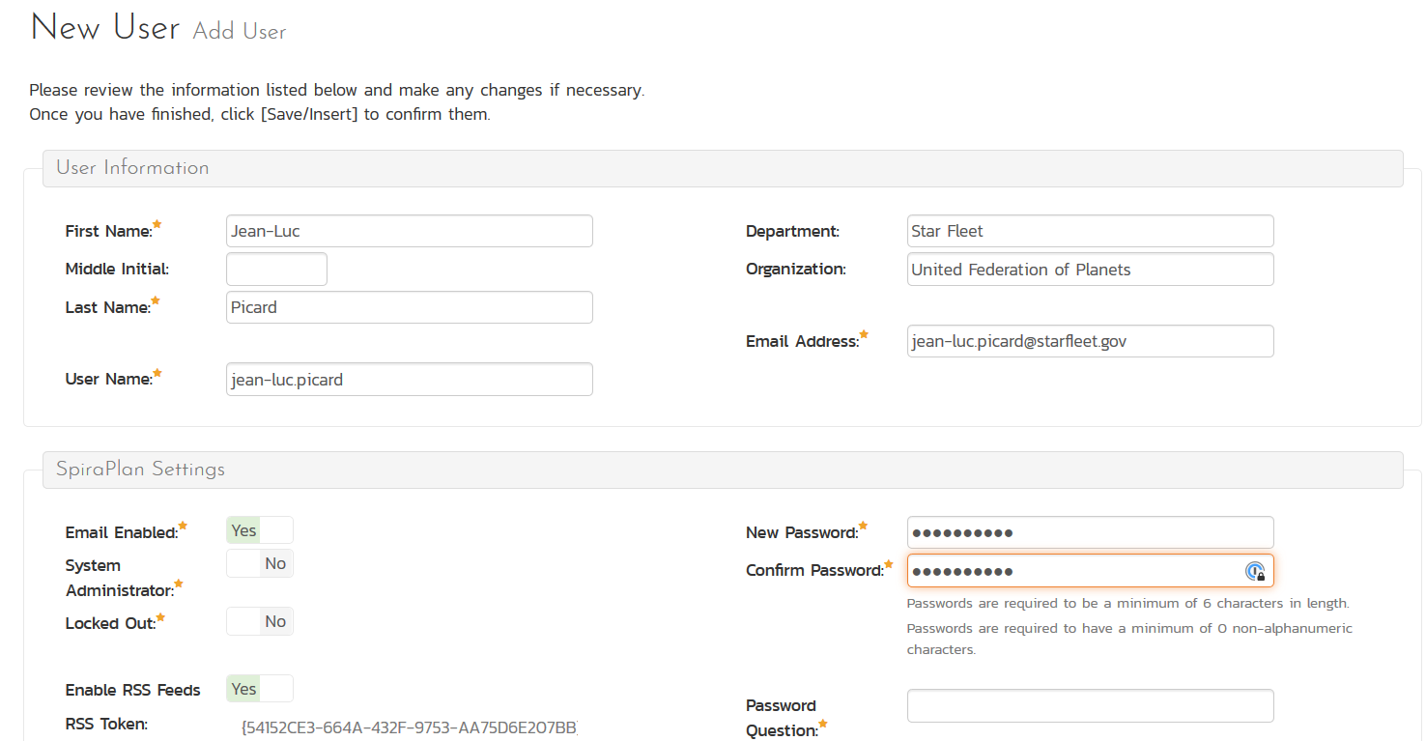
Administration – Add User

Slide 16
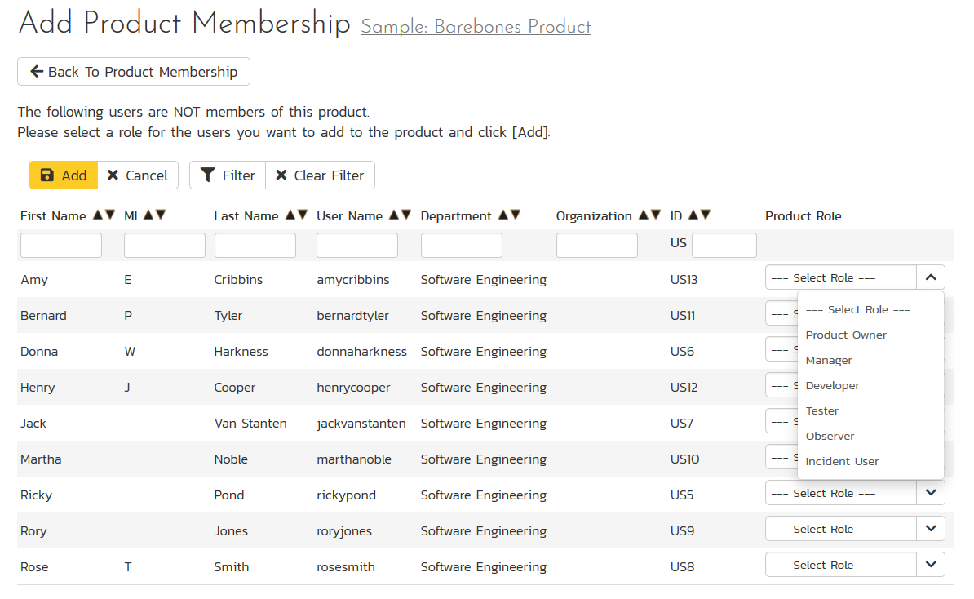
Administration – Membership

Slide 17



2. Requirements Planning
Requirements
Releases
Sprints

Slide 18

Artifact Relationships
Requirements
Release
Requirement Step
Sprint
Requirement Step
Sprint
Requirement Step
Sprint

Slide 19
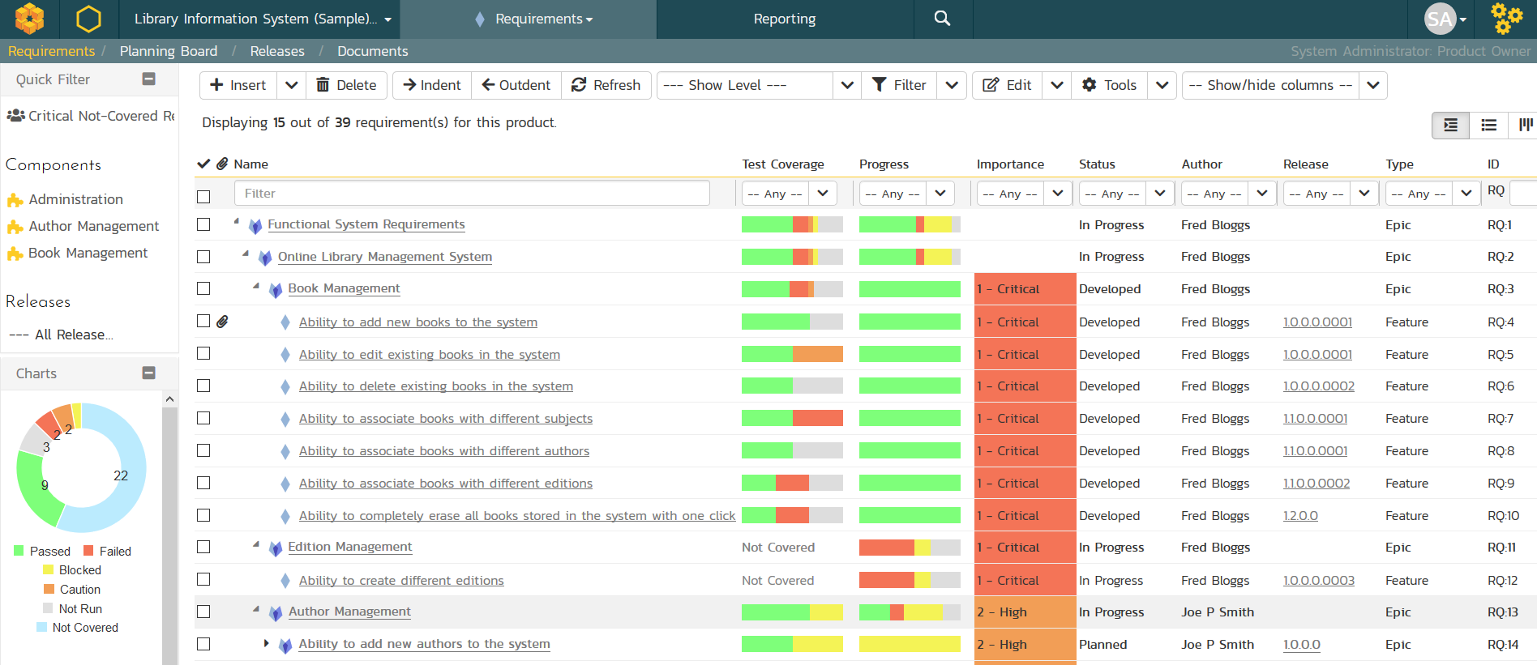
Requirements Creation

Slide 20
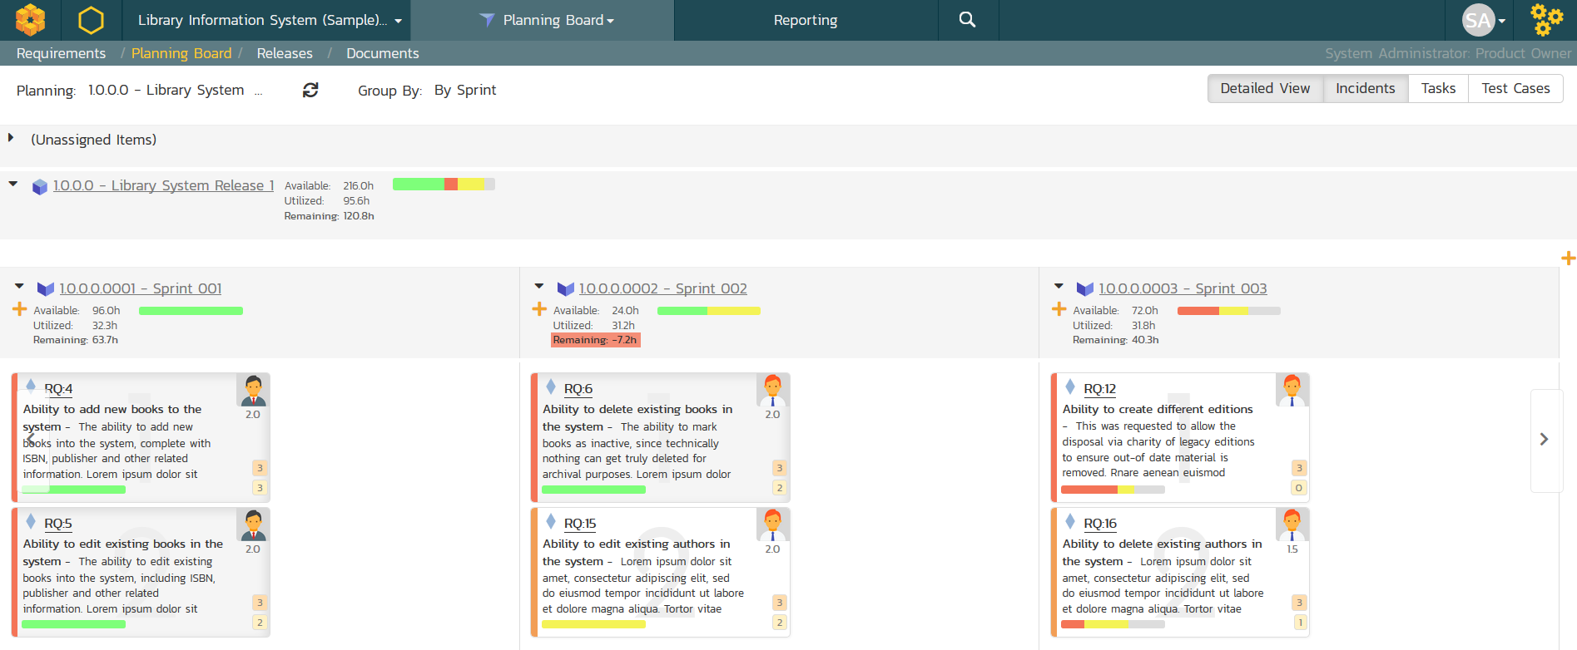
Requirements Planning

Slide 21


3. Test Planning
Test Cases
Test Steps

Slide 22
Artifact Relationships
Requirements
Test Case
Test Step
Release
Test Step
Test Step

Slide 23
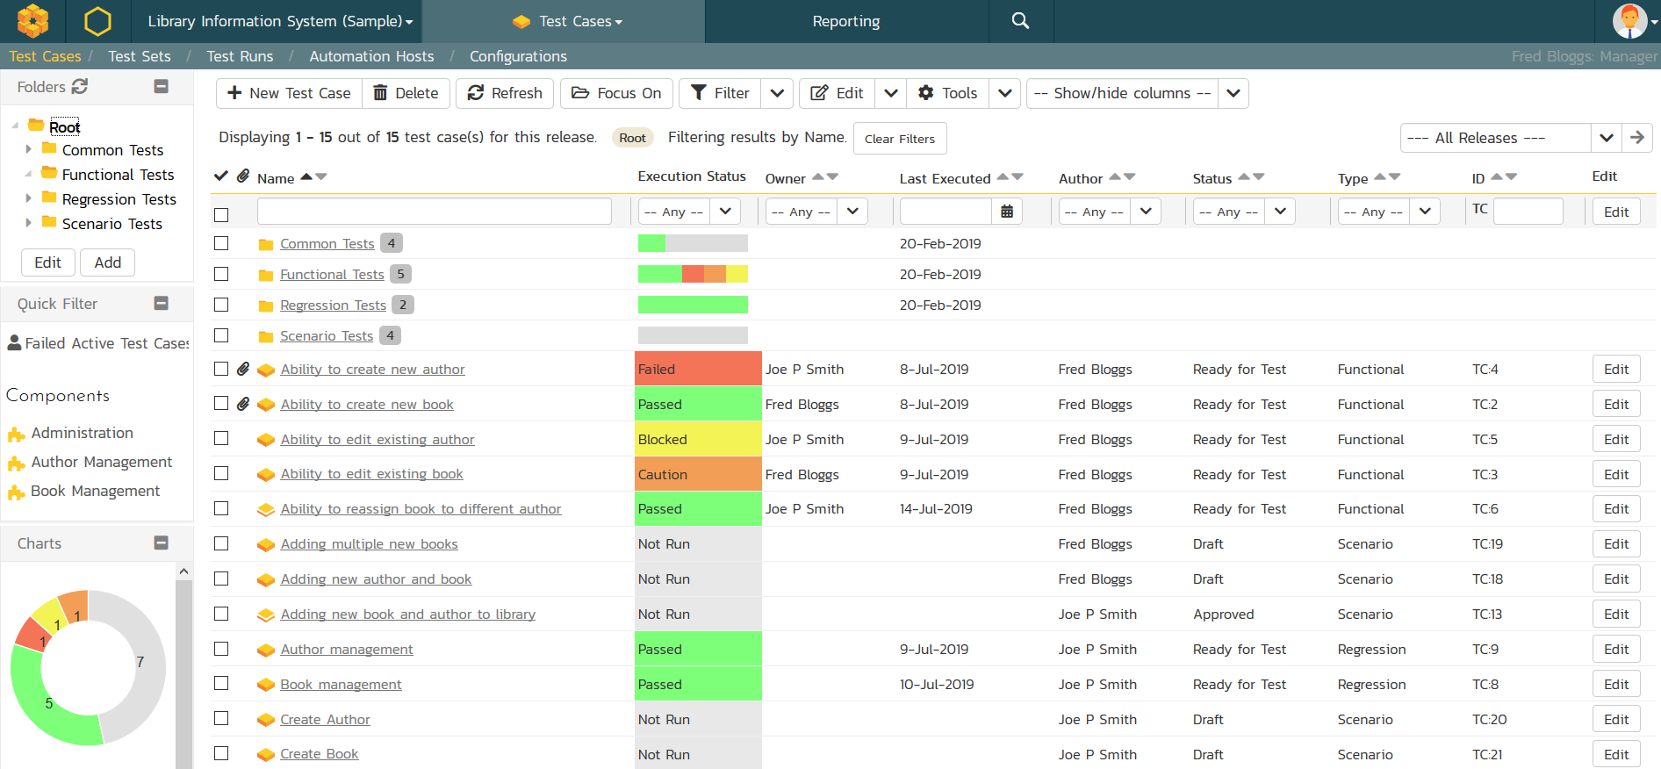
Test Case Management

Slide 24
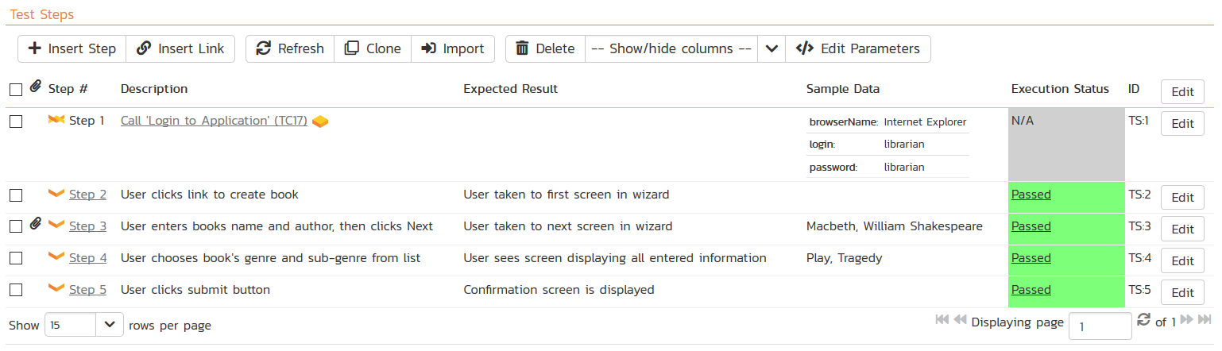
Test Step / Script Creation

Slide 25
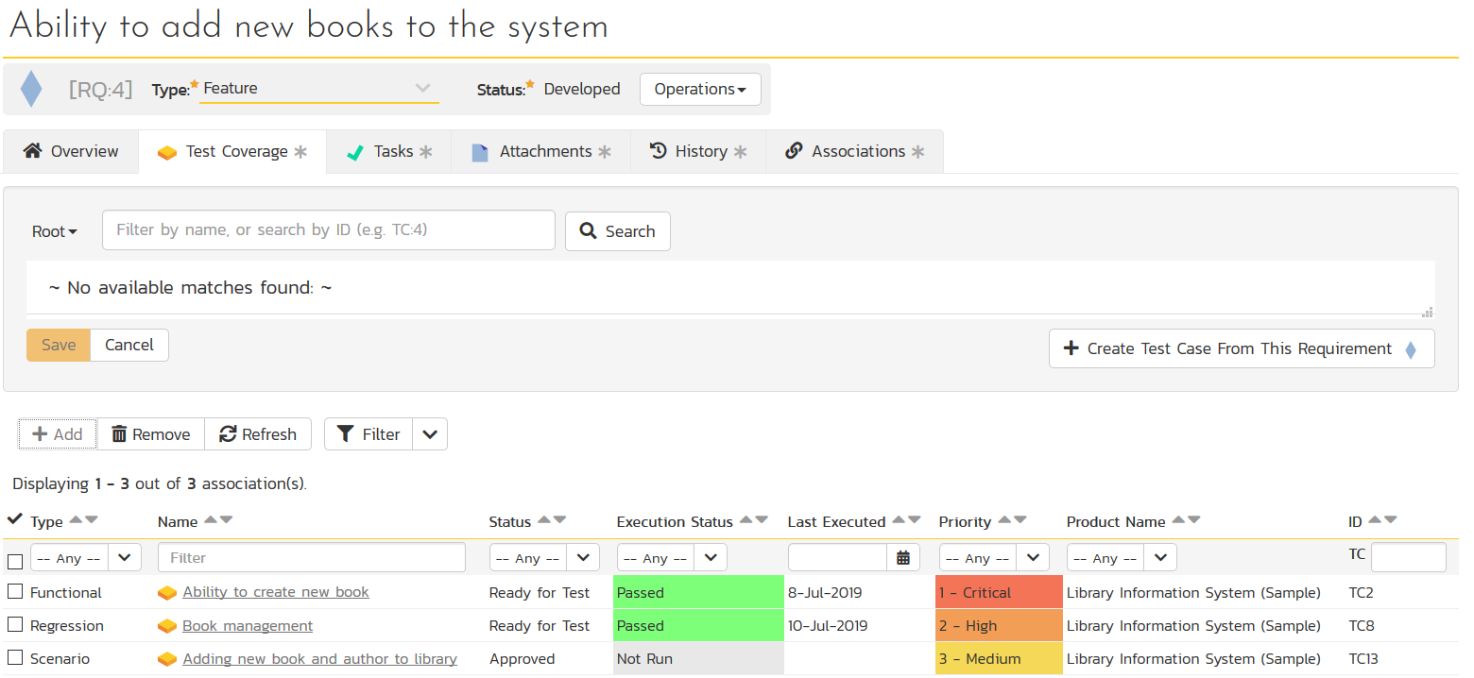
Test Coverage

Slide 26


4. Sprint Planning
Requirements
Tasks
Sprints
Incidents

Slide 27
Artifact Relationships
Requirements
Release
Task
Sprint
Task
Sprint
Task
Sprint
Incident

Slide 28
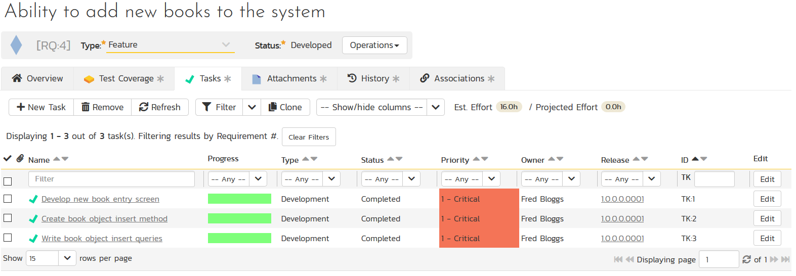
Requirements – Task Elaboration

Slide 29
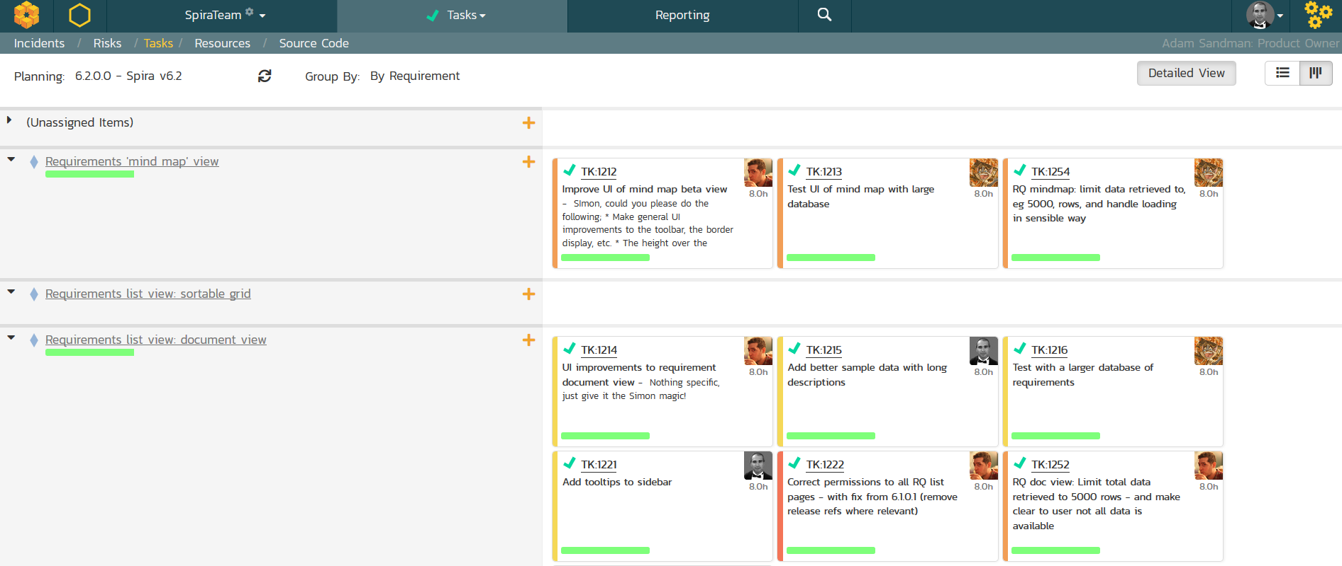
Sprint Planning

Slide 30
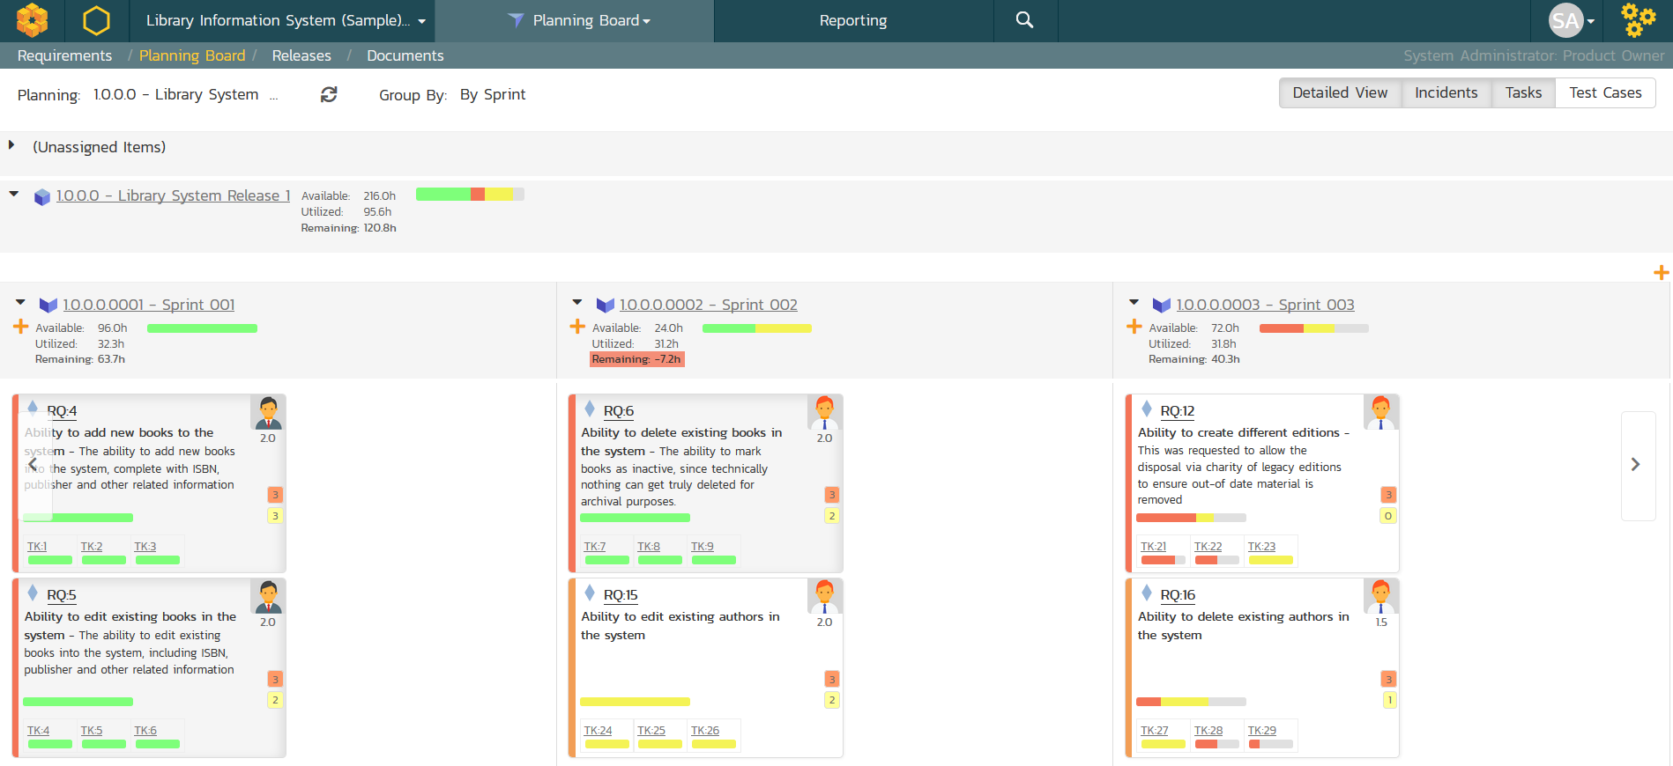
Sprint Planning

Slide 31

5. Scheduling & Resourcing
Tasks
Test Sets
Incidents

Slide 32

Artifact Relationships
Sprint
Resources
Test Set
Resource
Task
Resource
Incident
Resource

Slide 33
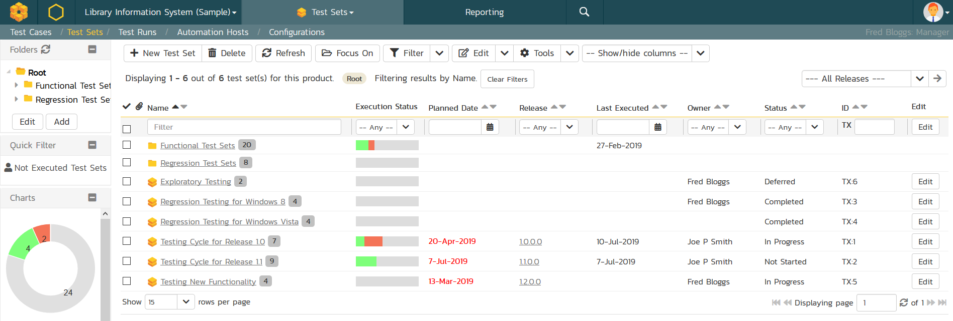
Test Scheduling – with Test Sets

Slide 34
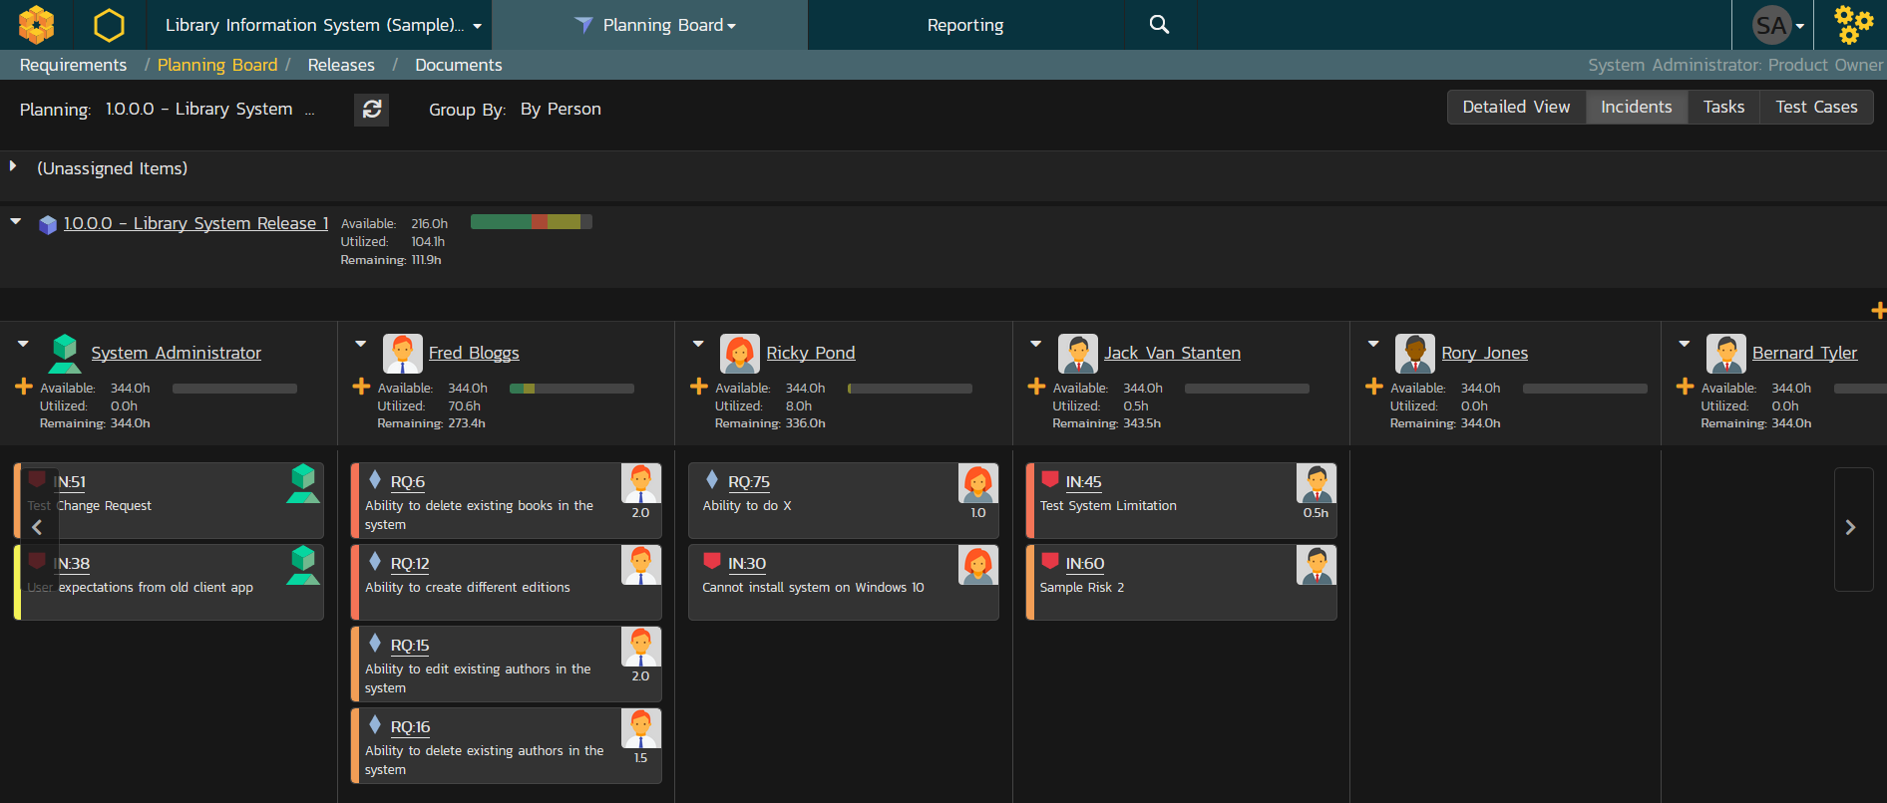
Task Scheduling

Slide 35
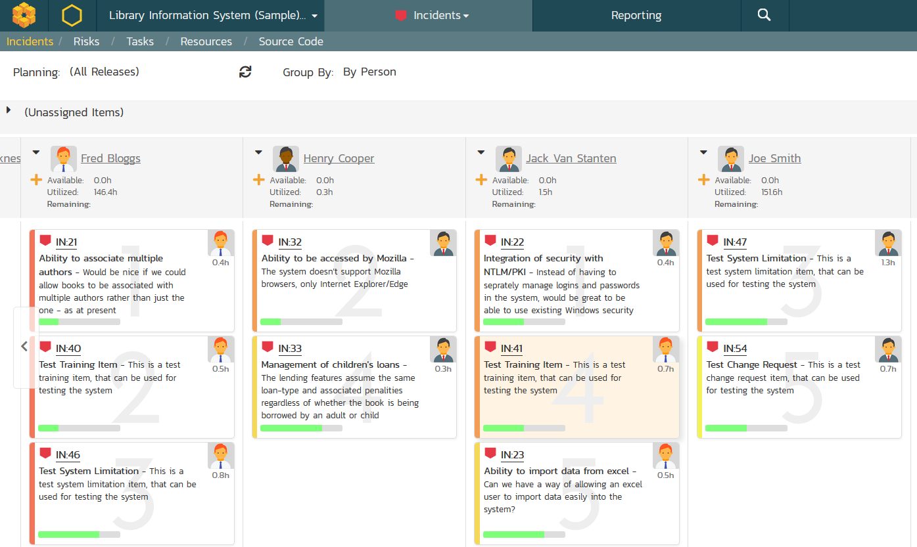
Incident Scheduling

Slide 36
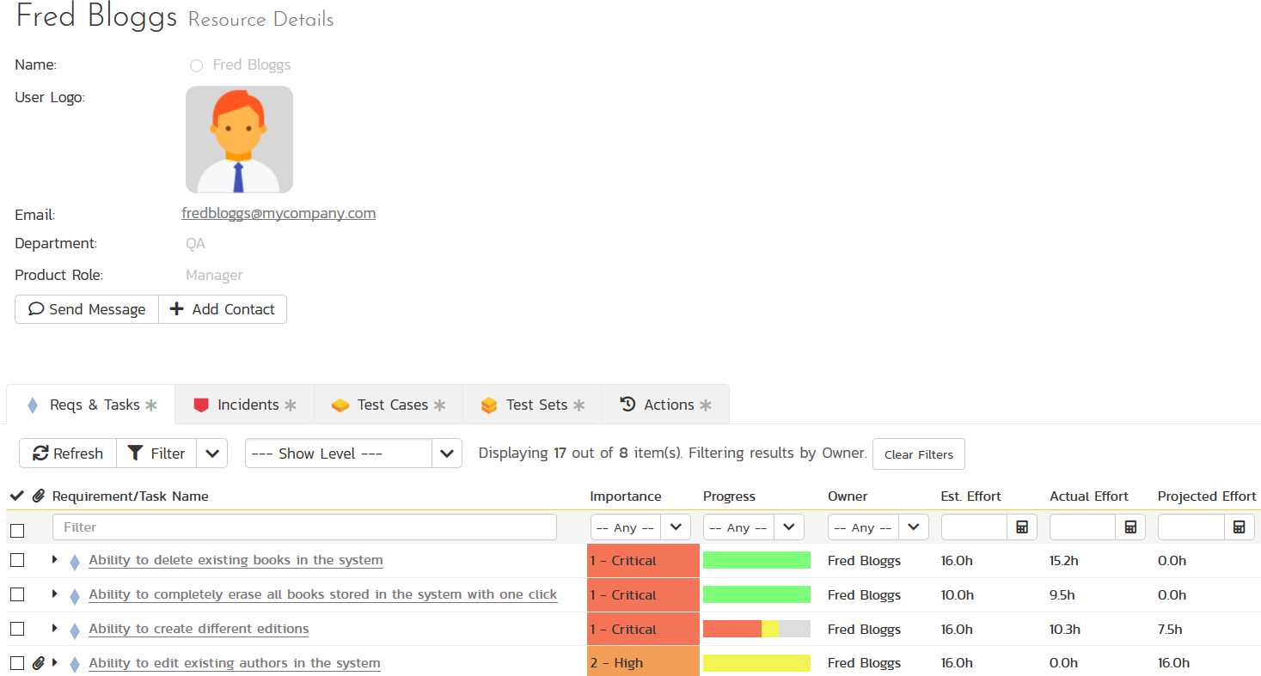
Resource Management

Slide 37


6. Tracking & Execution
Tasks
Risks
Incidents
Test Runs

Slide 38
Artifact Relationships
Resource
Requirements
Test Run
Incident
Task
Incident
Task
Risk

Slide 39
Test Execution

Slide 40
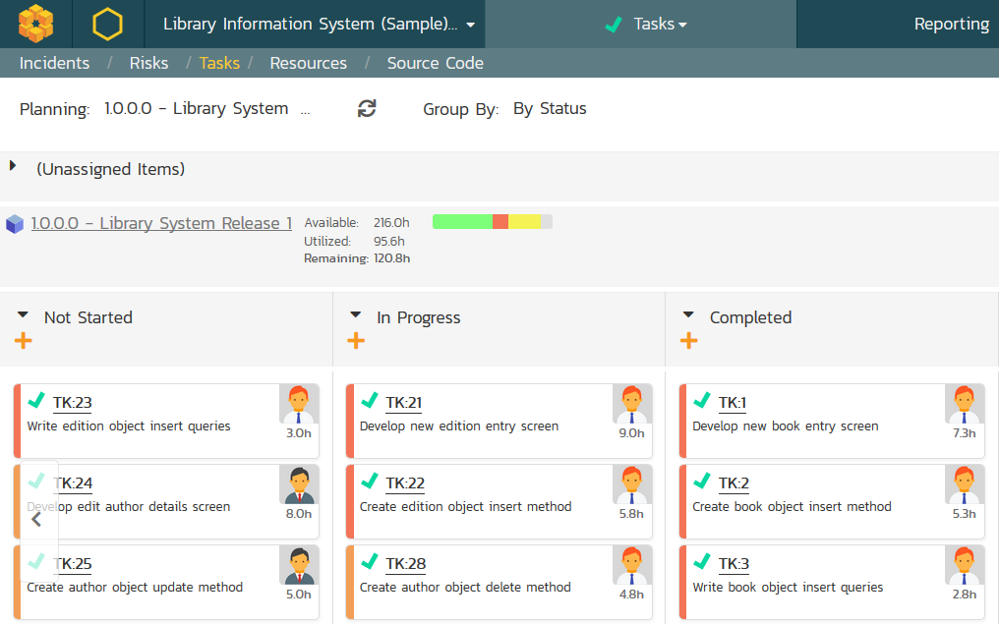
Task Tracking

Slide 41
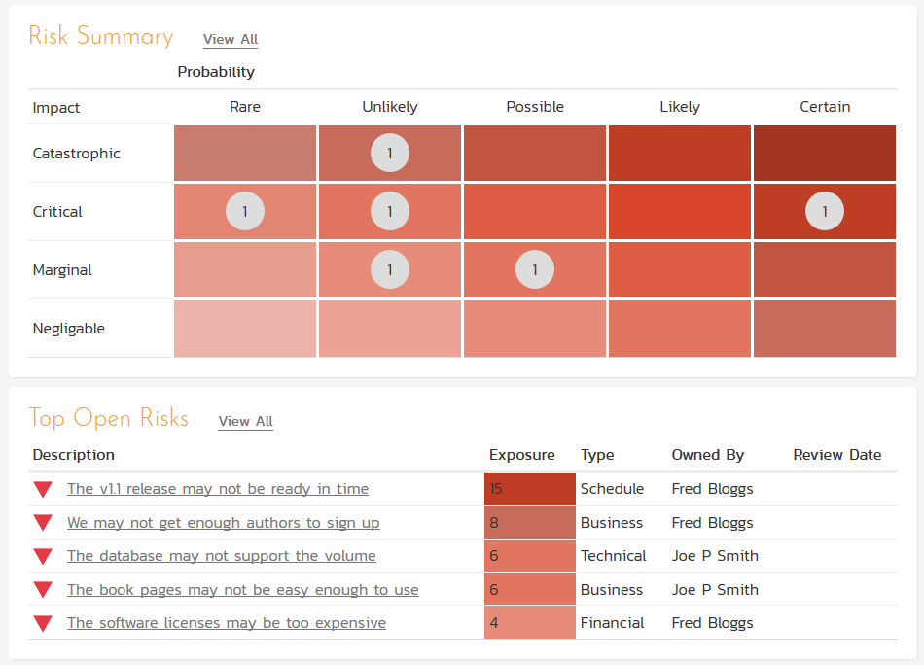
Risk Management

Slide 42
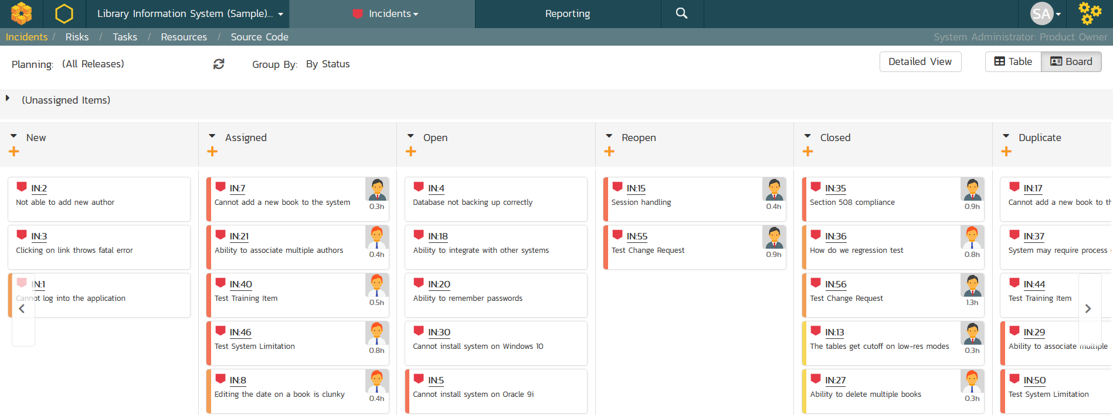
Incident Tracking

Slide 43
Wrap Up

Slide 44
Key Takeaways
Spira has been designed to minimize configuration time and maximize productivity
It has a range of specialized artifacts that work together across the lifecycle
You should use the features of the system that make sense for your project scope/size

Slide 45
Questions?

