Slide 1
Company Overview
®

Slide 2
Who Are We?

Slide 3
Inflectra, by the numbers
Founded in 2006 to make software creation easier
80,000 users in over 5,000 companies worldwide
We Focus on our customers – not pleasing investors
11 global sales offices and partners across the globe
Delivering frequent releases both cloud and on-premise
Data centers where customers need them most
North America, Europe, Asia-Pacific
Notes:
This has been central to the ethos of the company since it’s beginning.
We’ve been in business for 13 years. We may still be small compared to others in the market, but we believe we truly punch above our weight.
A large part of that is because we focus on developing features for us and our users, not to please short term investors. This may impact our company growth – but it also makes us a sustainable grounded business.
That’s why we are never in maintenance mode. We are always pushing ourselves to improve our products, help our customers wherever they are

Slide 4
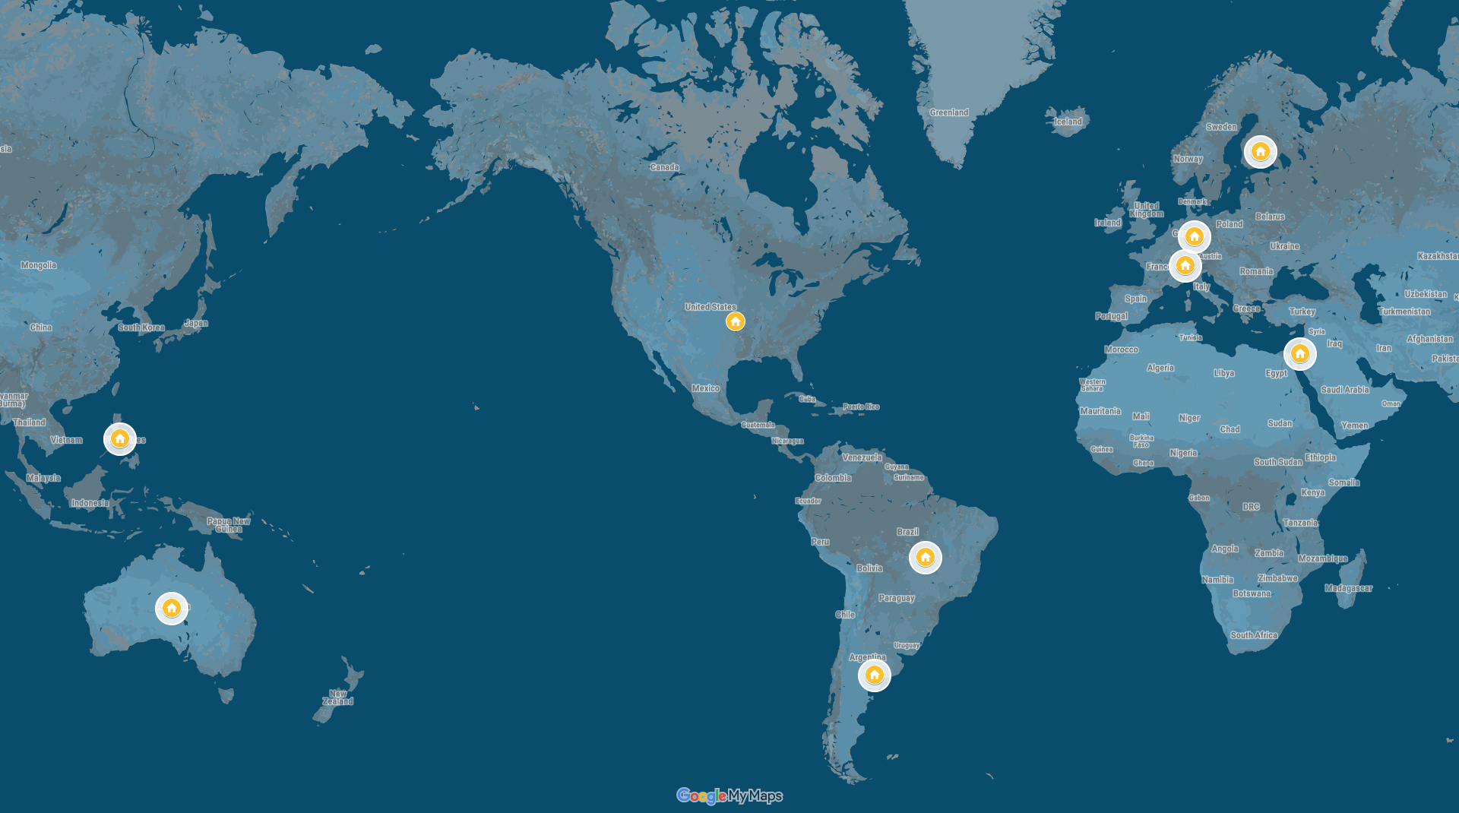
Our Global Offices

Slide 5
Representative Customers
We have ~ 80,000 users in 5,000+ companies worldwide:
Energy & Industrial
Financial & Business Services
Government & Defense
Information Technology
Healthcare & Bio-Technology
Telecommunications
Retail & Consumer Goods
Transportation & Hospitality

Slide 6
Our Data Center Locations

Slide 7
Global Partner Network
North America
South America & Mexico
Asia
Europe
Australia
Middle East & Africa

Slide 8
How Are We Different?

Slide 9
harmony
Notes:
Make great products
Help you work together
Help you deliver your products faster, more easily, with less pain, and less stress
At a grand scale – we’re passionate about making products that you will find transformative to how you work.
We both want to use our tools every day to help you do a whole number of complex things, and at the same time get out of your way so you don’t need to worry about SpiraPlan and can instead focus on helping your own customers

Slide 10
How Do We Foster Harmony?
Across Disciplines
Through Simplicity
Across Ecosystems

Slide 11
Harmony Across the Disciplines
Testers
Developers
Managers
We consider each of these three stakeholders groups when designing our products, so that everyone in teams can get the most out of our products.

Slide 12
Simplicity = Productivity from Day One
Less Time Doing:
More Time Doing:
No plugins, customization or configuration needed day one

Slide 13
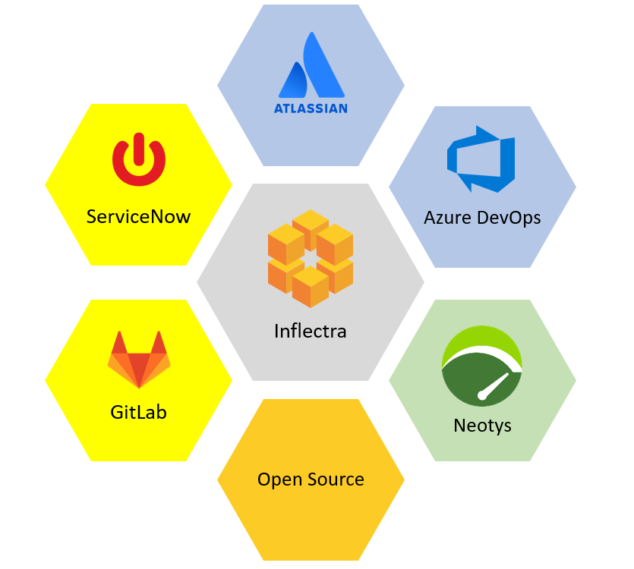
Harmony Across Ecosystems
We recognize that you need to integrate our solutions with other tools and systems
We make this easy and straightforward so you can get working faster & easier

Slide 14
We offer unique features for different industries
While offering simplicity and usability for everyone

Slide 15
Specific Features for Regulated Industries
Auditability and end-to-end traceability
Data Privacy, Security baked in
Generation of Compliance Documentation
Workflows & Electronic Signatures
Integrated Risk Analysis and Management

Slide 16
What do we do?

Slide 17
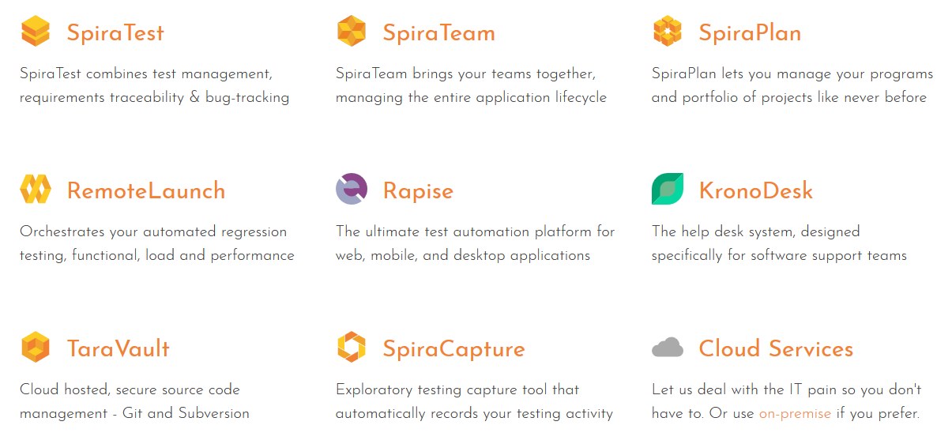
Our Products

Slide 18
How the Inflectra® Suite Fits Together
KronoDesk®
IT Support & Help Desk
SpiraCapture™
Exploratory Testing
SpiraPlan®
Agile Program & Portfolio Management
SpiraTeam®
Application Lifecycle Management (ALM)
SpiraTest®
Requirements, Test Management
& Bug Tracking
TaraVault® - Source Code Management
Rapise®
Test Automation (Web, GUI, Services)

Slide 19
Core Spira™ Platform
QA tools
Product management
Agile planning
Source code
Programs & portfolios
Risk management
Notes:
You can see our focus on these groups in our flagship application SpiraPlan. We make sure that each group is helped in a balanced way. And over the course of a few releases we aim to roll out features that each group can benefit from

Slide 20
The Wider Inflectra® Ecosystem
Test automation: Rapise
Test integration: RemoteLaunch
Integrations: CI/CD, IDEs, unit tests
Source code hosting: TaraVault
Syncing: Jira, Azure, HP, ServiceNow
Helpdesk support: KronoDesk
Notes:
We adopt the same pattern across all the wider Spira ecosystem of products and services
We have integrations, dedicated applications, and addons that meet the needs of each core group

Slide 21
Overview of our products

Slide 22
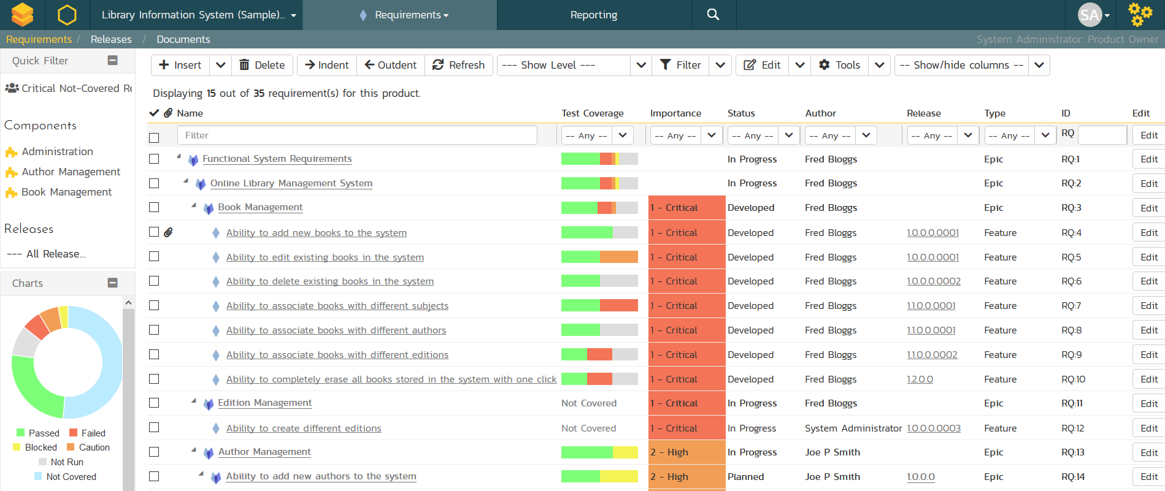
SpiraTest® - Requirements & Test Mgt
Requirements, test and defect management - integrated
End-to-end traceability and real-time reporting

Slide 23
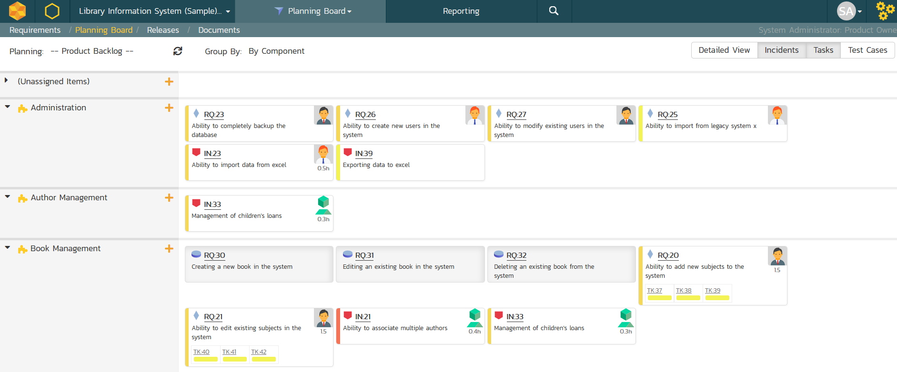
SpiraTeam® - Agile Planning & Tracking
All of the SpiraTest features, plus agile project management
Supports Scrum, Kanban, waterfall & hybrid projects

Slide 24
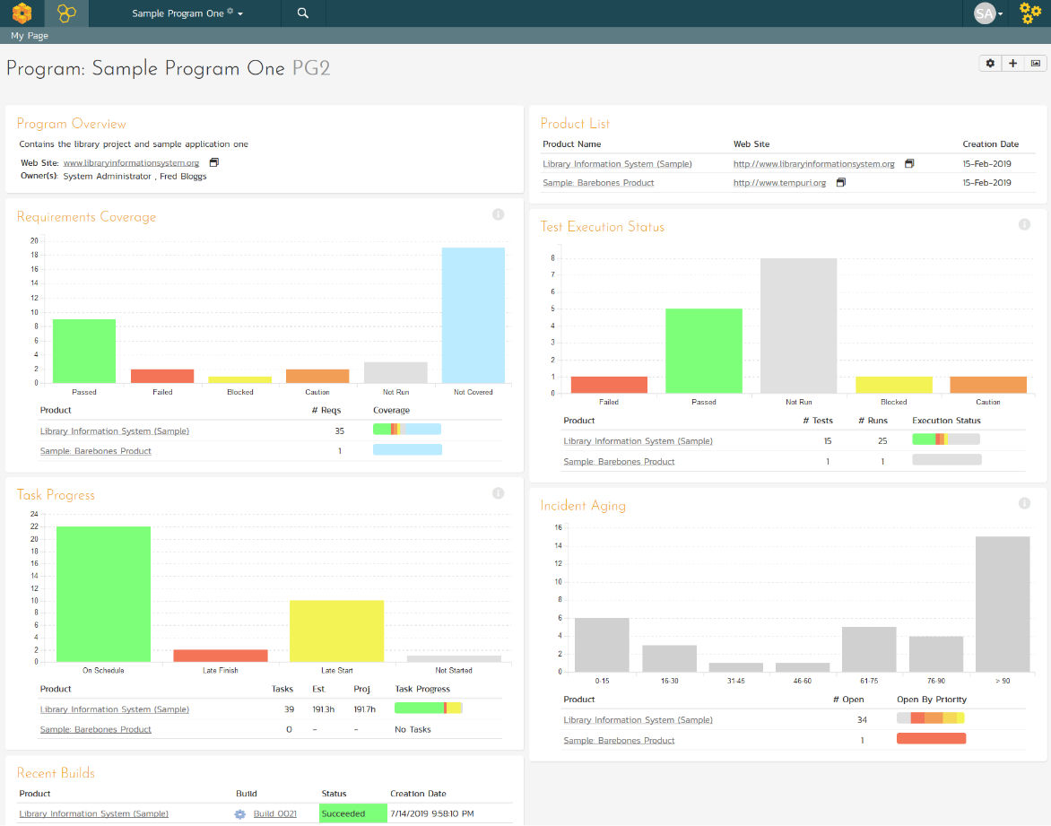
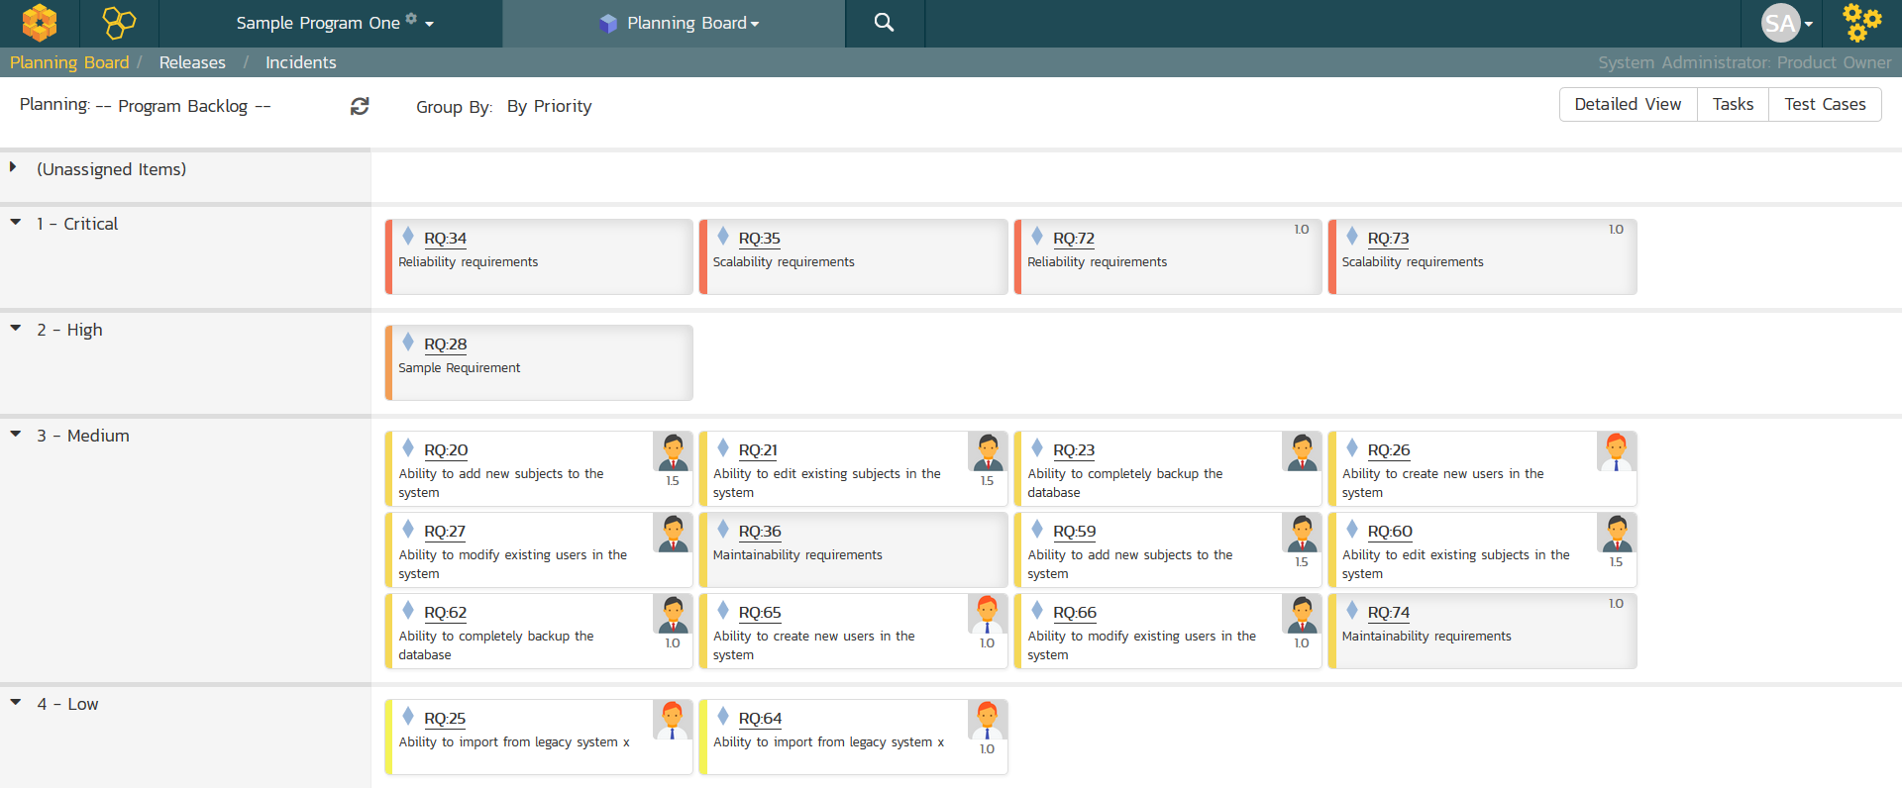
SpiraPlan® - Program & Portfolio Mgt
Extends SpiraTeam with program & portfolio management
Integrated enterprise risk management & tracking

Slide 25
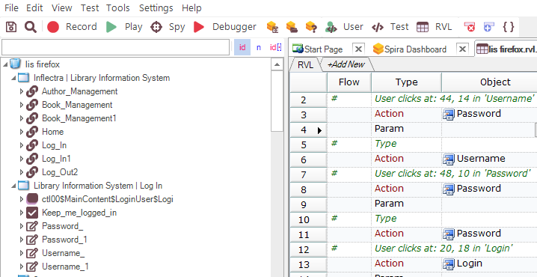
Rapise® - Intelligent Test Automation
Codeless test automation and RPA platform using AI insights
Handles web, mobile, desktop, and APIs in one system

Slide 26
RemoteLaunch® - Automation Integration
Host #1
Windows 2008
IE 8.0
Manual
Tester #1
RemoteLaunch®
Host #2
Windows Vista
Mozilla Firefox
SpiraTeam®
Repository
Manual
Tester #2
RemoteLaunch®
Host #3
Ubuntu Linux
Google Chrome
Manual
Tester #3
RemoteLaunchX®
Integrate automated testing tools with Spira

Slide 27
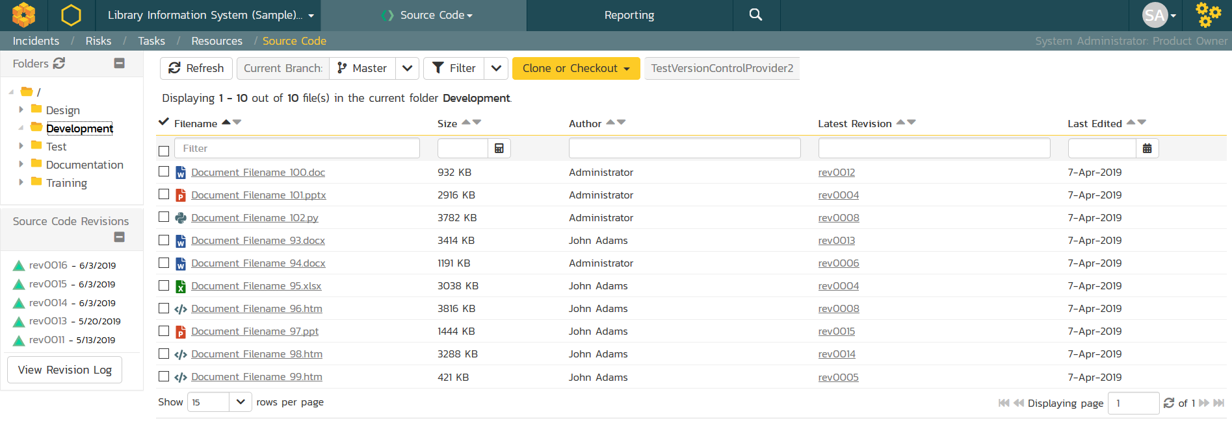
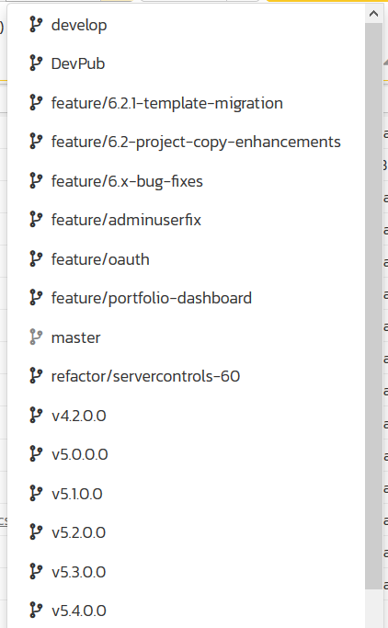
TaraVault® - Source Code Management
Cloud-hosted code repositories using Git & Subversion
&

Slide 28
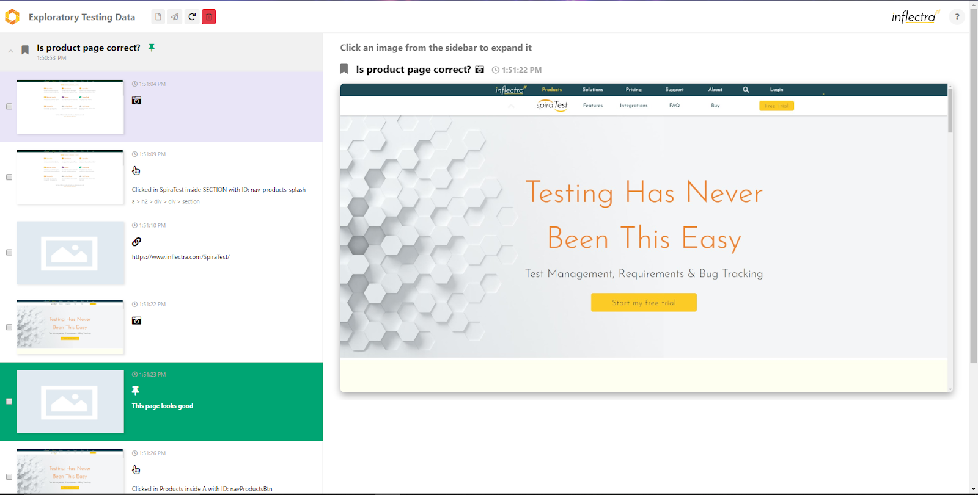
SpiraCapture™ - Exploratory Testing
Chrome extension that captures activity & screenshots
Records and organizes your testing sessions

Slide 29
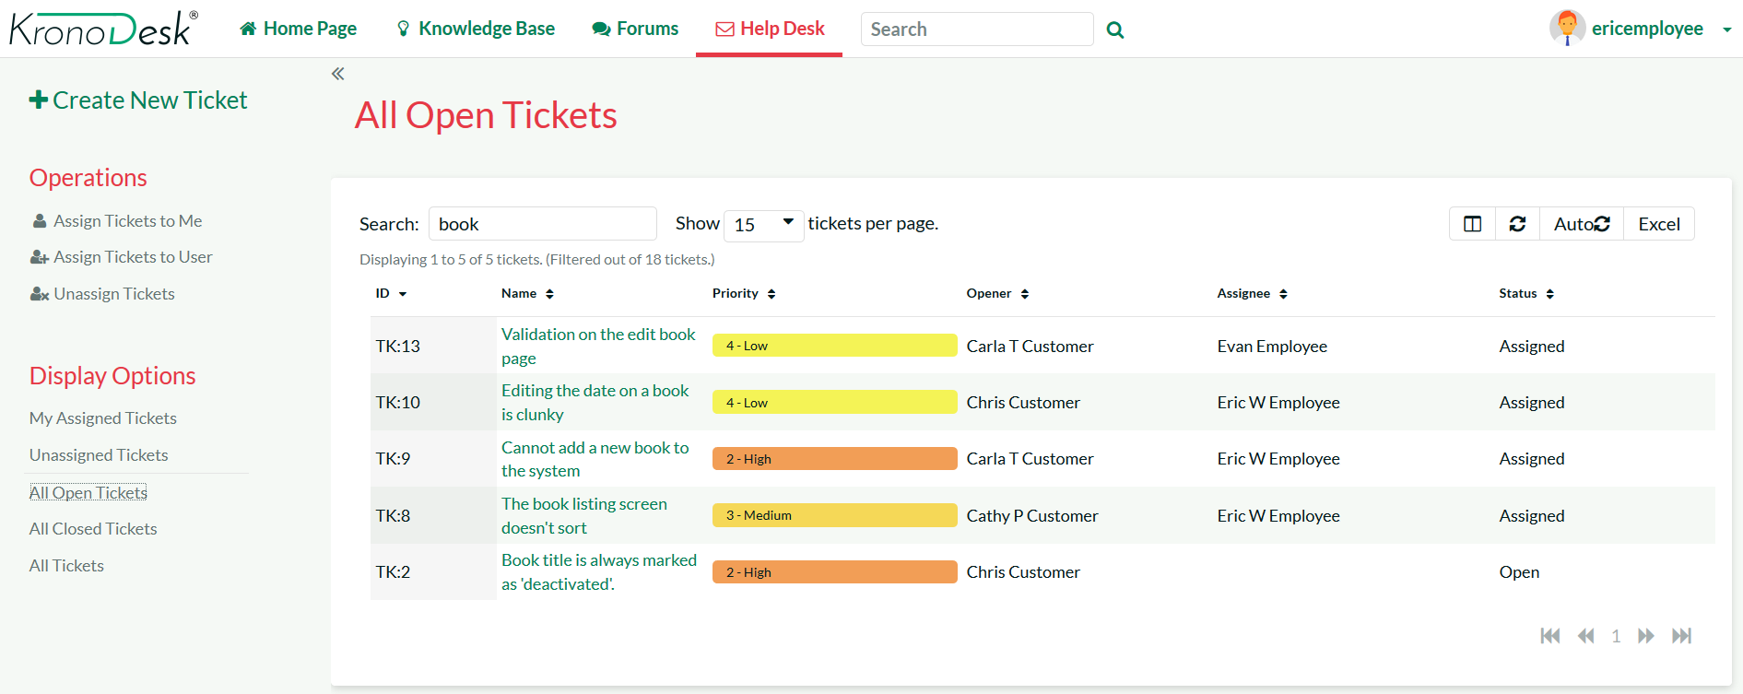
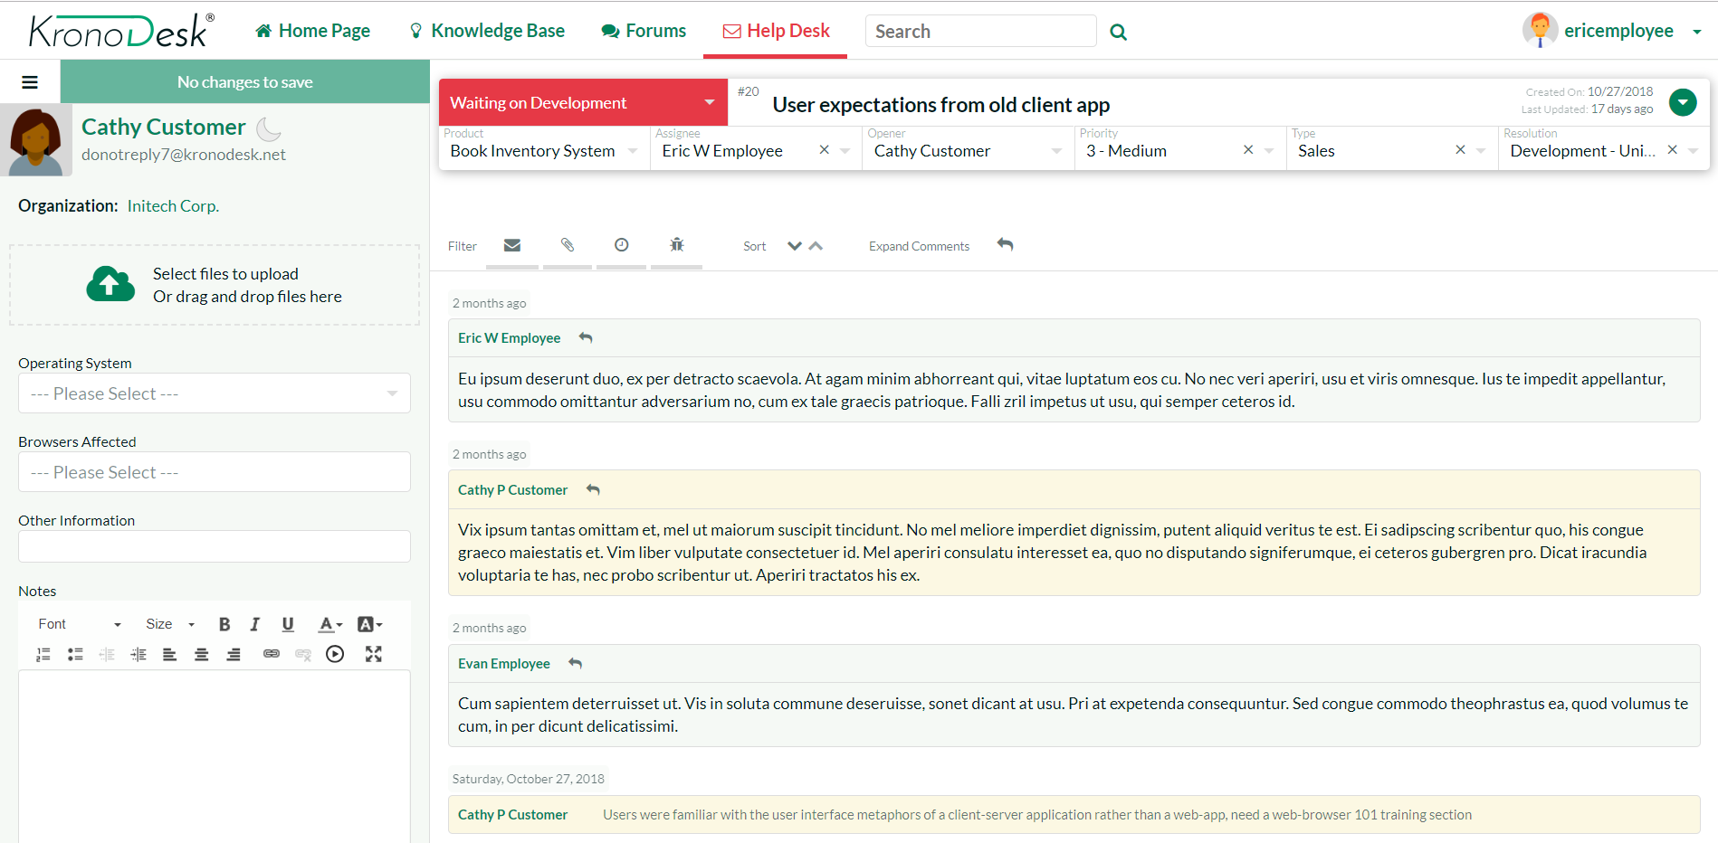
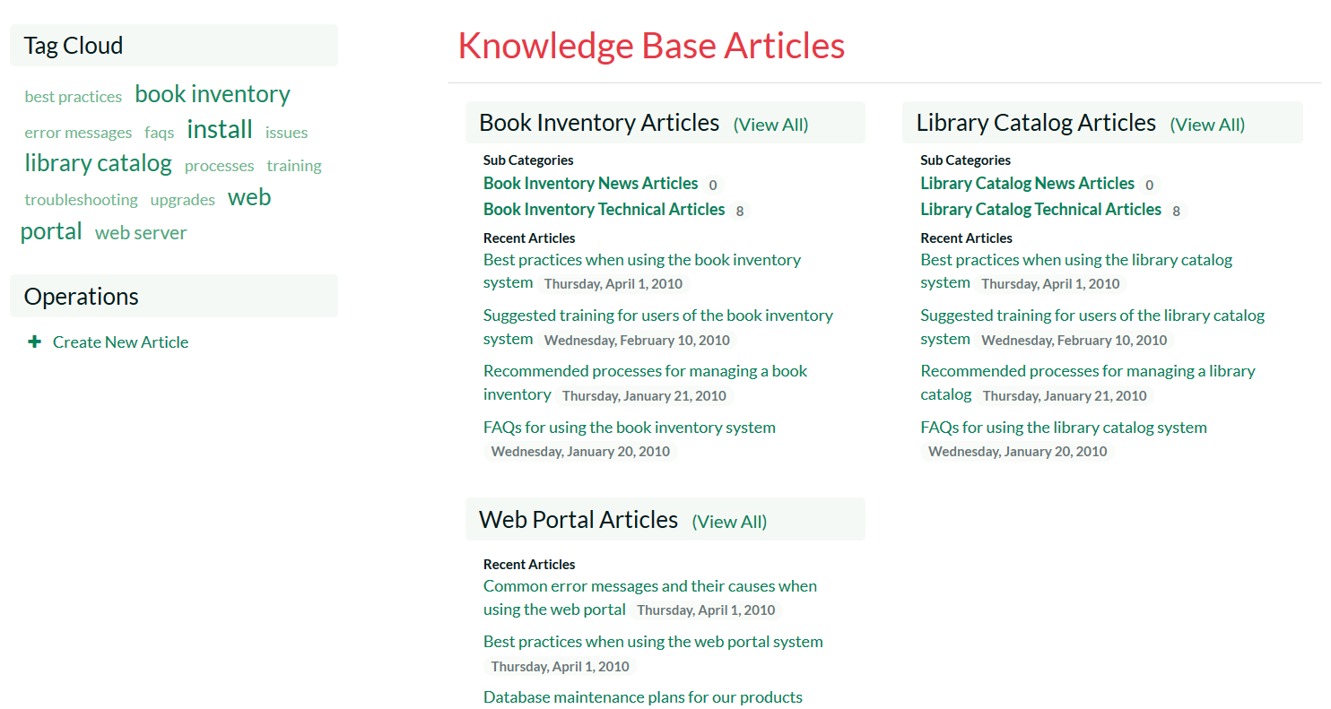
KronoDesk® - Support & Help Desk

Slide 30
Questions?

